Slide 1
Designing and Integrating Benefits Coordination into a Kinship Navigator Program
April 2023

Slide 2
Presenters
Amber Robinson
Benefits Coordinator OhioKAN at Kinnect
We want to know more about you!
Introduce yourself:
Name
Organization
What do you hope to learn in this session?
Samantha Steinmetz
Policy Analyst
Chapin Hall
Notes:
5-6 min
(each into ourselves in this order, )
Ask people to introduce themselves in the chat
Name, Organization, What do you hope to learn in this session? (answered in the chat)
Amber

Slide 3
What we’ll cover:
Brief overview of OhioKAN Kinship & Adoption Navigator Program
The data behind benefits coordination
How Benefits Coordination was built and integrated into an existing kinship navigator program
What Benefit Coordination within OhioKAN looks like today
Gap and Barrier tracking
The future of Benefits Coordination
Notes:
1-2 min
These tools and programming might be helpful in many types of programs, beyond navigation
Amber

Slide 4
Ohio Navigator History
Adoptive families voiced a need
Evidence of effectiveness
County differences
Over 20 years
Notes:
3-4 min
Ohio has a long history of supporting kinship caregivers. So let’s start off with a quick overview
OhioKAN has been lucky to leverage a diverse set of expertise in serving kinship families. Back in the 90s the state of Ohio allocated money to county child welfare agencies to serve kinship caregivers. Counties used this money in innovative ways and some developed kinship programs that still serve families today. Ohio also did a title IV-E waiver demonstration project on Kinship navigation called “Protect Ohio”. OhioKAN was able to build on the learnings of these programs and engage practice experts from across the state.
OhioKAN is also working hard to build evidence of effectiveness. A few years ago, the family first prevention services act, created the opportunity for states to receive federal reimbursement for providing services that prevent children from entering the child welfare system. In order to be eligible, programs must be rated by the title IV-E prevention services clearinghouse. To date, there are no kinship navigator programs have met the clearinghouse’s rigors requirments, and OhioKAN is building evidence in the hopes of becoming the first.
OhioKAN was designed with divers local contexts in mind. Ohio’s child welfare system is county administered and there’s a wide range of local differences the navigators must become experts in so that they can support families in getting what they need.
And final Ohio’s program is unique among kinship navigation programs because of its inclusion of all post adoptive families. This is due to the advocacy efforts of adoption professional like Wendy so I’ll ask her to tell you a bit more about that.
Thanks Wendy, I’m so glad Ohio has prioritized the ongoing needs of adoptive families. lets talk a bit more about who is served by OhioKAN
Amber

Slide 5
Program Highlights
Both formal and informal kinship families
#1 Who OhioKAN Serves
Any kinship and adoptive family residing in Ohio
Families who have adopted privately, publicly or internationally
Notes:
SP 1 min
OhioKAN serves any kinship or adoptive family ion the state
This includes both kinship families who have some type of formal custody arrangement through the courts as well as informal kinship families who have not gotten custody through the courts including families where the kinship care arrangement is designed to be temporary like while a parent attends substance abuse treatment, is deployed by the military, or serving a sentence.
And finally all post adoptive families in the state are eligible for the program regardless of whether the adoption was private or public, domestic or international
Families can also receive services as many times at they need until the child in their home reaches adulthood
Amber

Slide 6
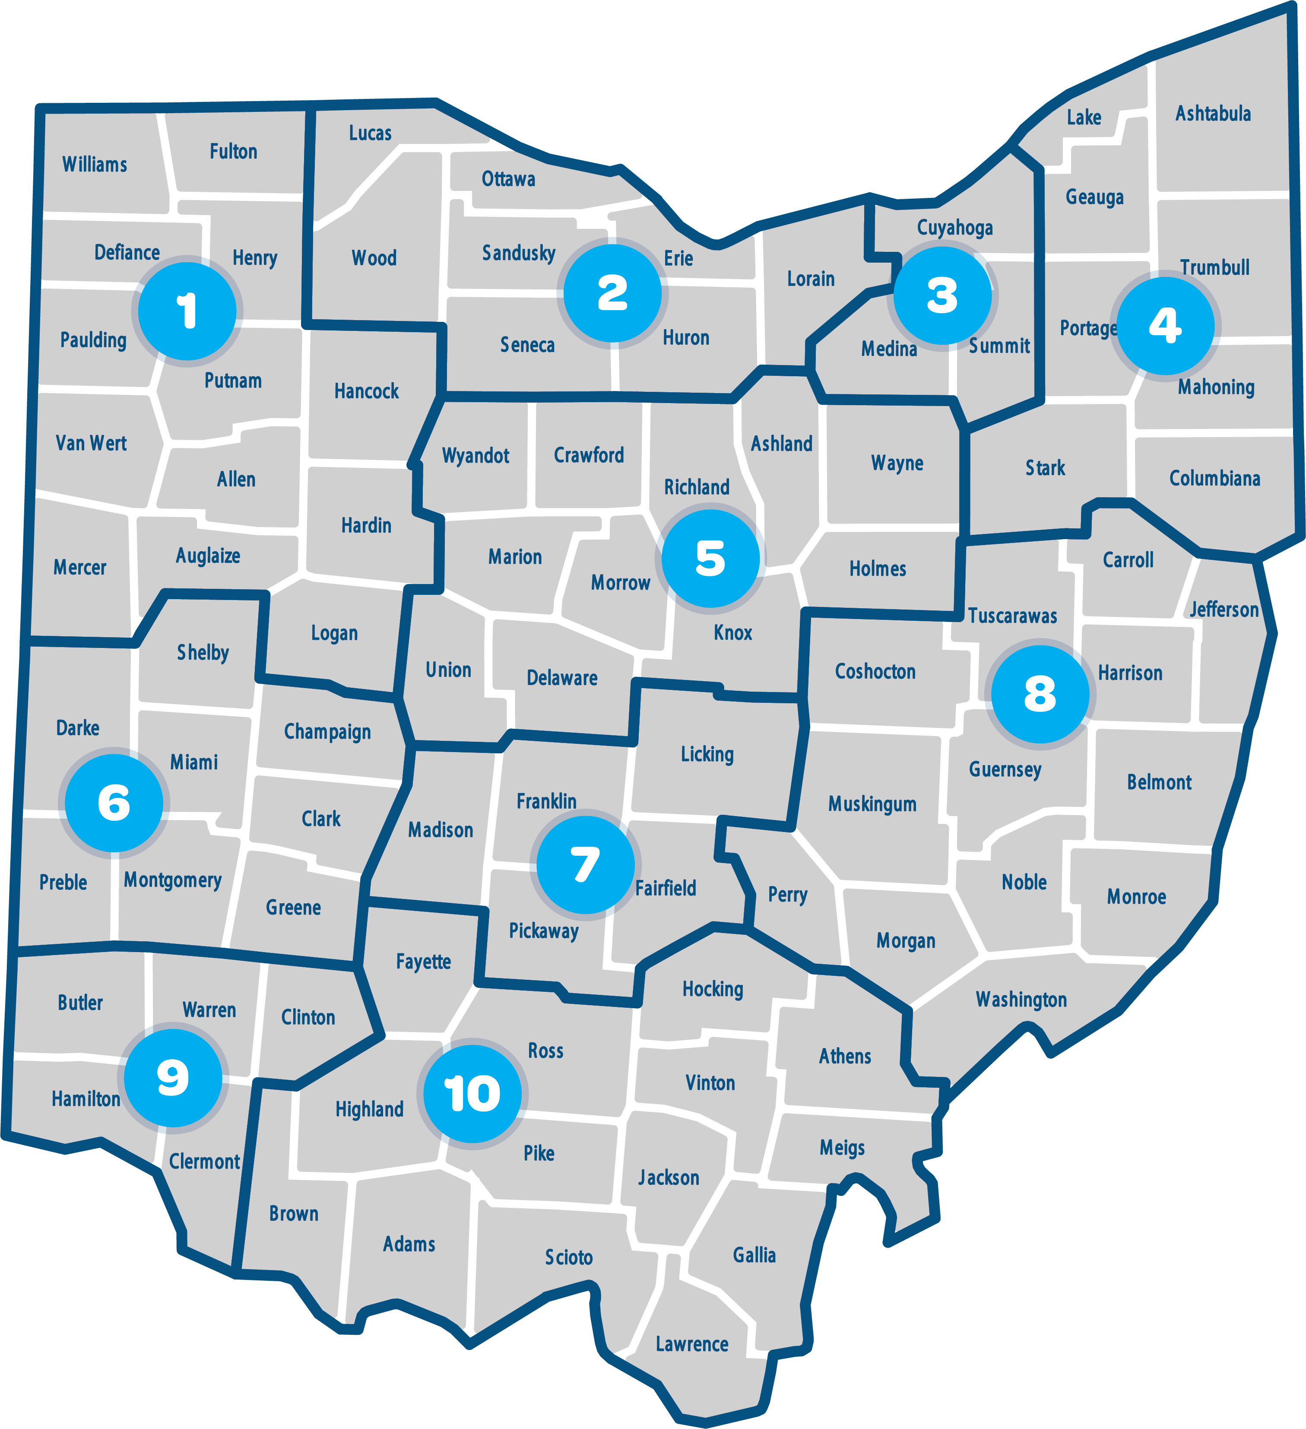
Program Highlights
#2 Statewide Program
Notes:
1 min
The program is delivered statewide and the state has been divided up by population into 10 regions. The staff in each of these regions builds their knowledge of the services available in each county of their region. In addition, each region engages families and subject matter experts on a regional advisory council designed to build community capacity to serve kinship caregivers.
Amber

Slide 7
Program Highlights
#3 Three Levels of Service
INFORM
CONNECT
COLLABORATE
Notes:
2 min
The program has 3 levels of service
Inform is the most general level and includes a publicly available website with resources curated for kinship and adoptive families
Connect involves providing an individualized packet of referrals to local services and supports which families to access on their own, there is a statewide phone number families can call and that will direct them to a navigator near them or they can sign up online to have OhioKAN call them
Collaborate is available to families who need additional support and at this level of services navigator support families by calling referrals with the family, supporting them in the completion of public benefits applications, advocating alongside them by doing things like attending meetings with the child school when needed, and providing finacial support or hard goods in situations where there are distinct finacial needs
Amber

Slide 8
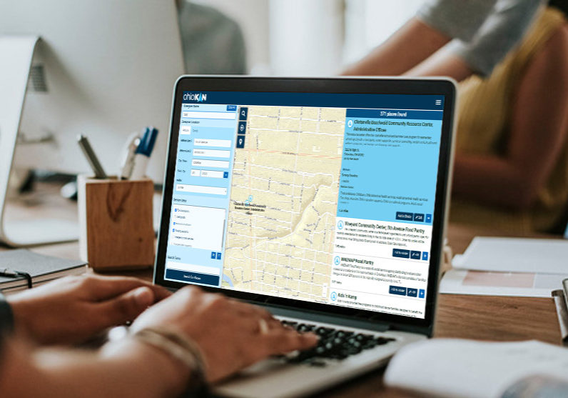
Program Highlights
#4 Community Capacity Building
Notes:
2 min
Not only does OhioKAN directly serve families, the program also builds community capacity. OhioKAN’s has a two pronged theory of change which impacts families through the navigation services I’ve just described and also a community level work focused on systems change. That work involves ensuring local communities and family serving organizations are aware of the unique needs of kinship & adoptive families and best practices for serving them as well as identify service gaps and advocating for ways to address them.
Amber

Slide 9
Designing Benefits Coordination:
The Data
Notes:
Sam

Slide 10
Designing benefits coordination
The Data
National benefits access:
In 2019, 83% of individuals eligible for SNAP accessed the program,(1)
In 2020, only 21% of families experiencing poverty received TANF cash assistance(3)
In 2019, 57% of families eligible for WIC received the benefit (2)

Slide 11
Designing benefits coordination
The Data
Economic & Concrete supports:
Each additional $1,000 that states spend on public benefit programs annually per person living in poverty is associated with a 7.7% reduction in child fatalities due to maltreatment. Public benefits are also positively associated with reductions in foster placements (4)
Mothers who receive TANF and are eligible to receive full child support paid on behalf of their children (without a decrease in benefits) are 10% less likely to have a screened-in maltreatment report than mothers who are eligible to receive only partial child support payments (5)

Slide 12
Designing benefits coordination
The Data
OhioKAN:
Since September 2020, 72% of families, when calling OhioKAN for the first time, have identified basic needs as "somewhat challenging" or "very challenging" for their family.
Basic needs are defined as: housing, utilities, transportation, clothing, food, furniture, etc.
Very challenging means that a family needs support right away.
Somewhat challenging means that additional support could be helpful.

Slide 13
Designing Benefits Coordination:
The Role of a Benefits Coordinator
Notes:
ave little experience with it

Slide 14
Designing benefits coordination
The Role
Train Navigator Staff
Solve difficult problems
Integrate Benefits Coordination
Train all staff to listen benefits needs and solutions
Coordinating programs
Sharing knowledge
Connections to state and county benefit staff
Answer initial questions
Send applications
Initial problem-solving
Work with Families

Slide 15
Designing benefits coordination
Phase 1: Onboarding & Education
1. Benefits education
Federal, state, local benefits research spreadsheet
Benefit fact sheets
2. State and county contact meetings
Subject matter expert interviews, county-level benefit leads
Research and ask questions about existence of statewide groupings for benefit coordinator contacts
Federal Poverty Guideline cheat sheet

Slide 16
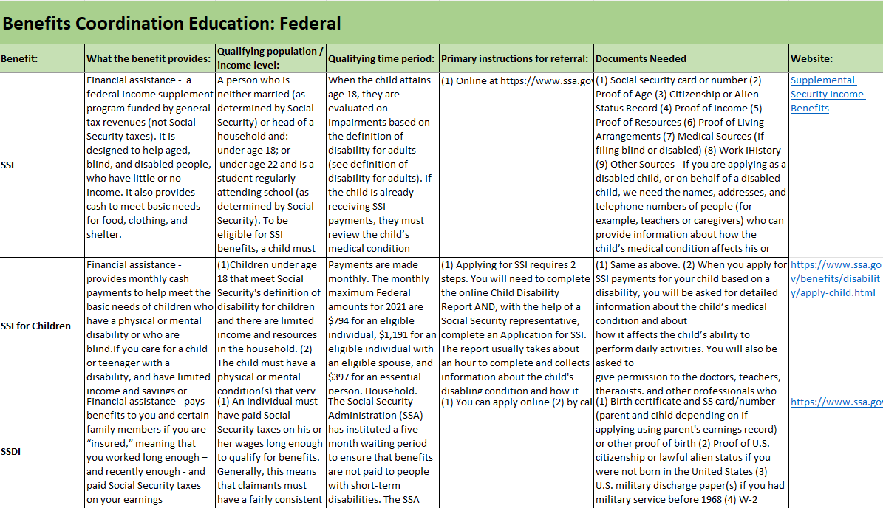
Learning Spreadsheet
Notes:
Send slides 14-18 for handouts

Slide 17
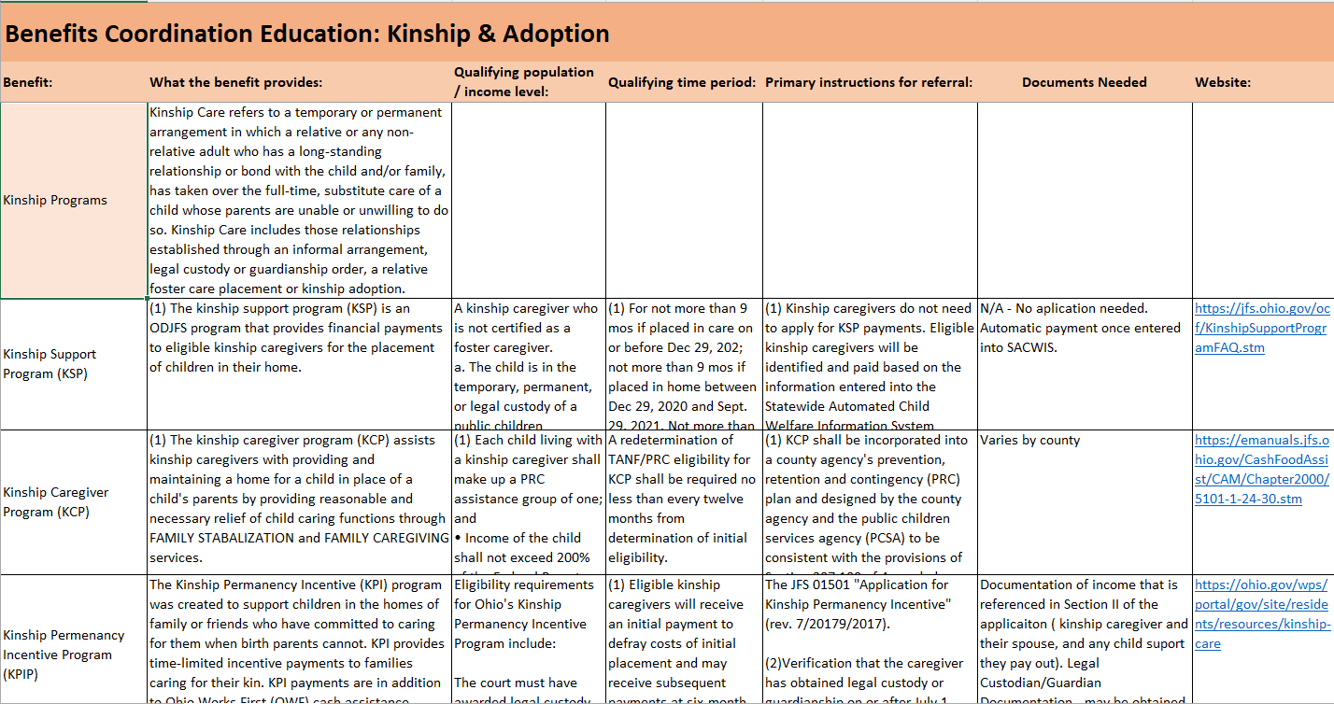
Learning Spreadsheet

Slide 18
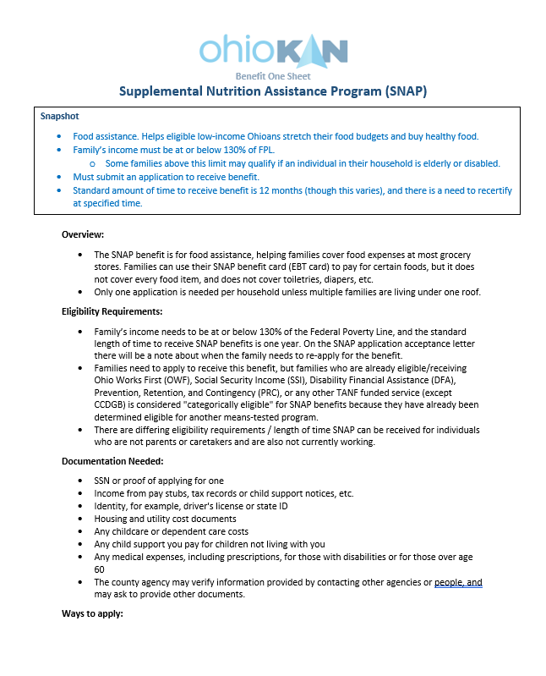
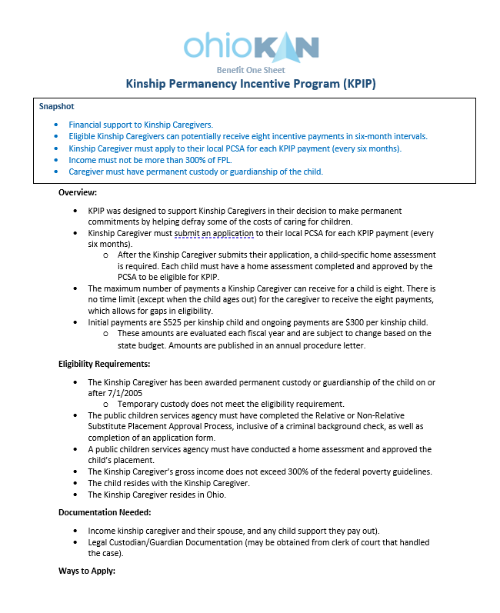
Navigator One Sheets
Notes:
Might be helpful for other community agencies – all these tools, for resource and referral programs

Slide 19
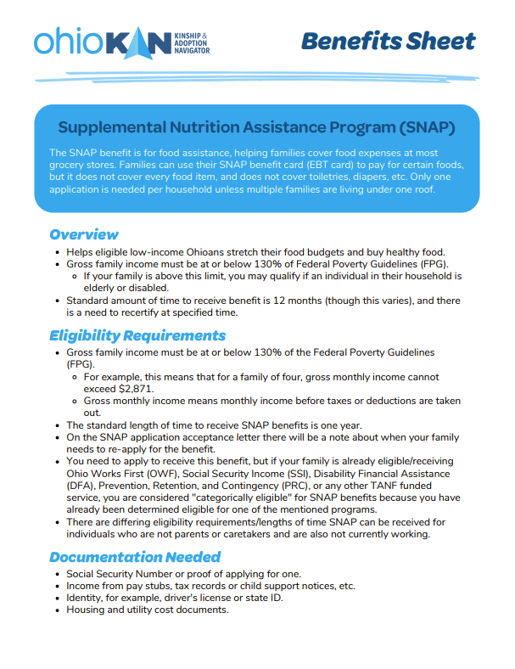
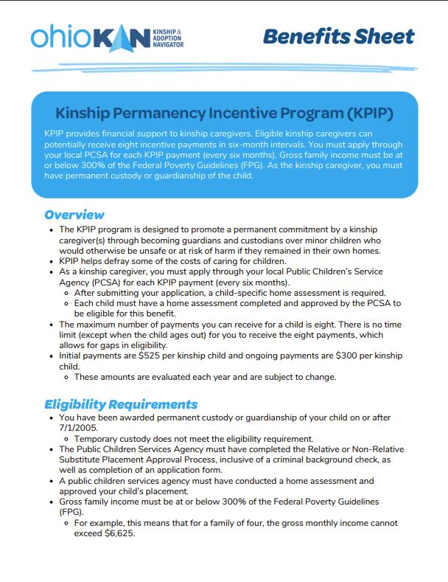
Family One Sheets

Slide 20
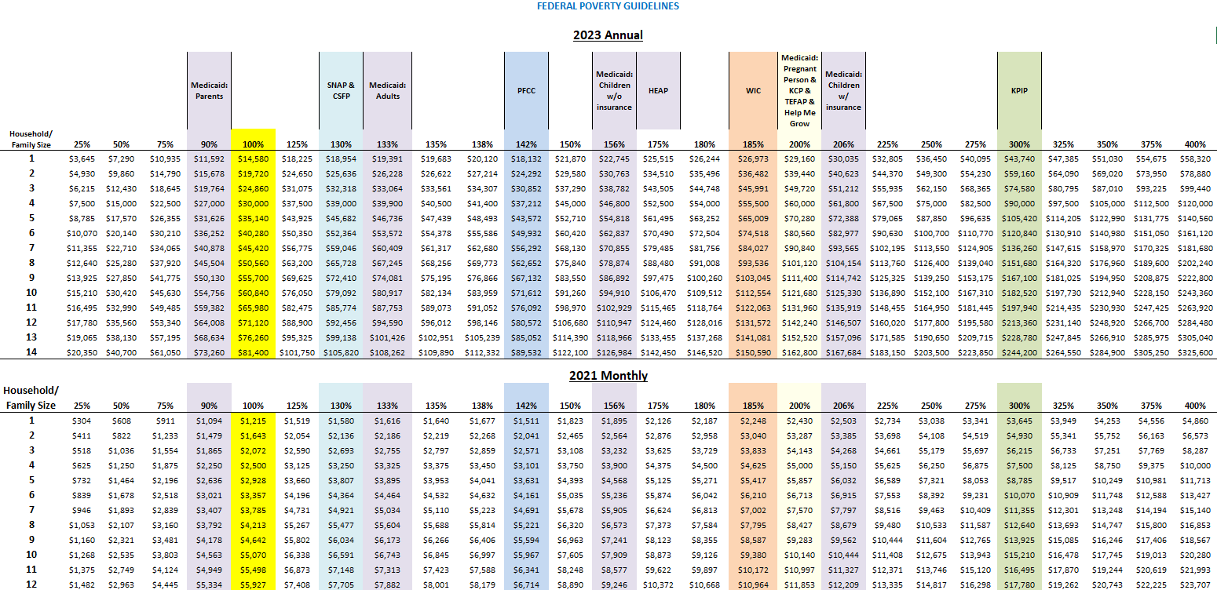
Federal Poverty Guideline & Benefits Cheat Sheet

Slide 21
Designing benefits coordination
Phase 2: Developing Trainings
1. Schedule state and federal benefits trainings available for all staff
Invite representatives from state and federal offices to give trainings to all staff for baseline knowledge on programs
3. Develop benefits trainings
Practice teaching about benefits and the nuances of each program
Develop training on the state’s benefit website where families may go to submit benefits applications and appeals
2. Survey staff on comfort level discussing and connecting families to benefits programs
Comfort level discussing and connecting families to benefits programs
Which benefits most families have questions about

Slide 22
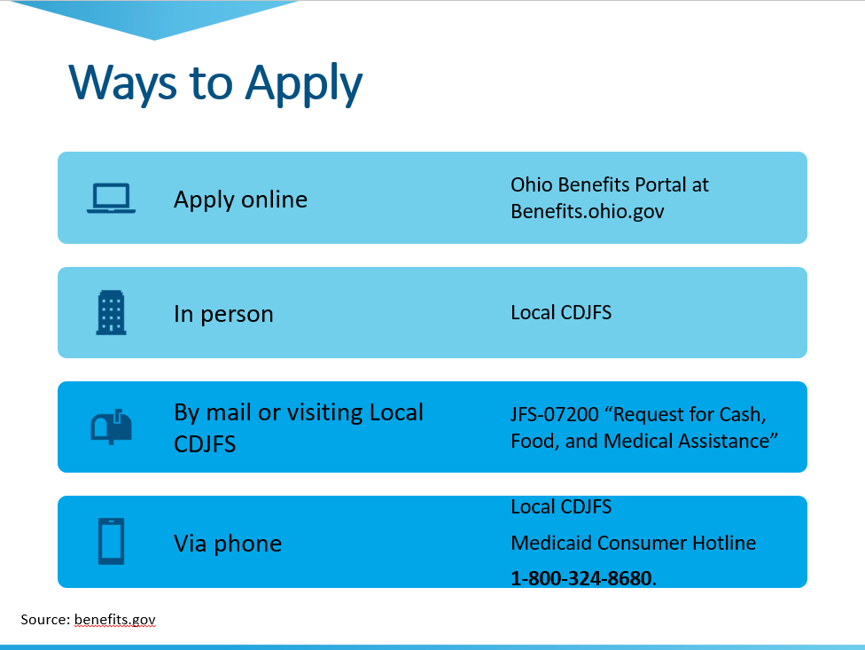
Benefits Trainings
Notes:
A. Developing benefit trainings for caregivers and internal OhioKAN staff and Navigators
1. Let’s Talk About Benefits for caregivers
2. Benefits Onboarding for New Navigators

Slide 23
Benefits Trainings
Notes:
1. Coordinating other federal + state trainings by collaborating with partners (JFS, SSI, ODE, OhioWIC, Medicaid, etc)
1. LMS – enhancing trainings for the virtual/on-demand space with families and staff in mind

Slide 24
Designing benefits coordination
Phase 3: Integrating Processes
1. Put direct questions about benefits in initial assessment for all families
Which federal, state, local benefits do you access now?
List all applicable benefits in initial assessment and ask follow up questions:
Are you interested in learning about potential eligibility for any of the benefits listed? Which ones specifically?
Because you are kinship family, you might be eligible for some of these benefits, would you like to discuss this further?
We have a benefits coordinator on staff to assist with benefits needs. Would you like me to schedule a meeting with them?

Slide 25
Designing benefits coordination
Phase 3: Integrating Processes
2. Develop process for Navigator to communicate with Benefits Coordinator
Build form, communicate email preference and calendar sharing process for Navigator to schedule time with Benefits Coordinator to work directly with a family
Build Business Process Map to visualize process of elevating family’s benefits needs
3. Schedule recurring office hours for staff to ask questions to Benefits Coordinator
Check-ins about a benefits issue with a family
Mini trainings on benefit programs

Slide 26
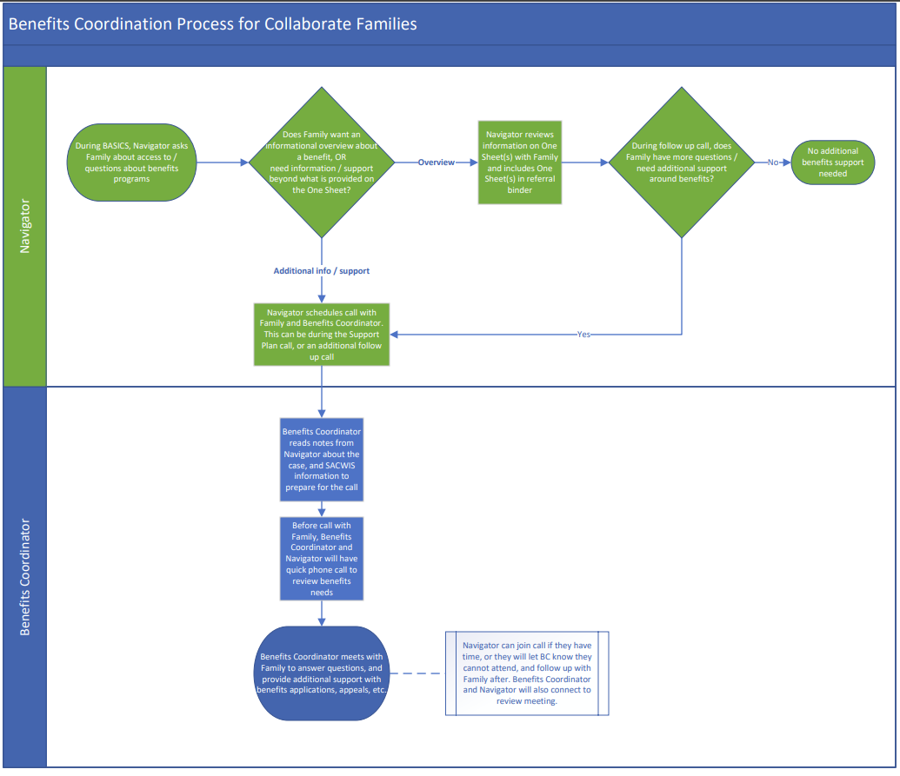

Slide 27
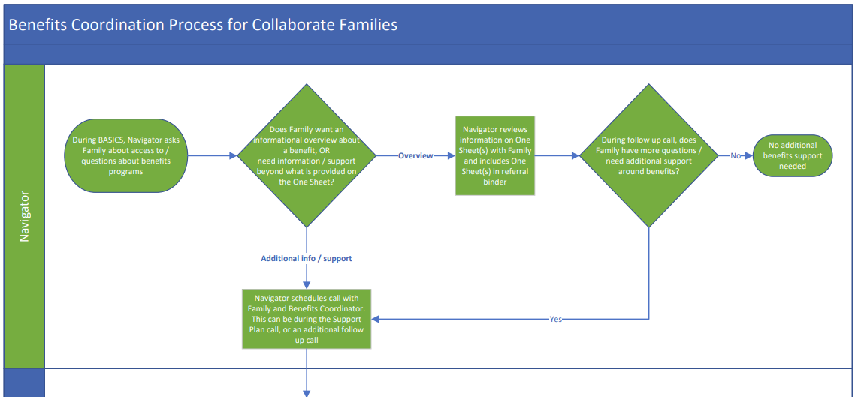
Designing benefits coordination
Phase 5: Full Workflow
Notes:
Print out as handout

Slide 28
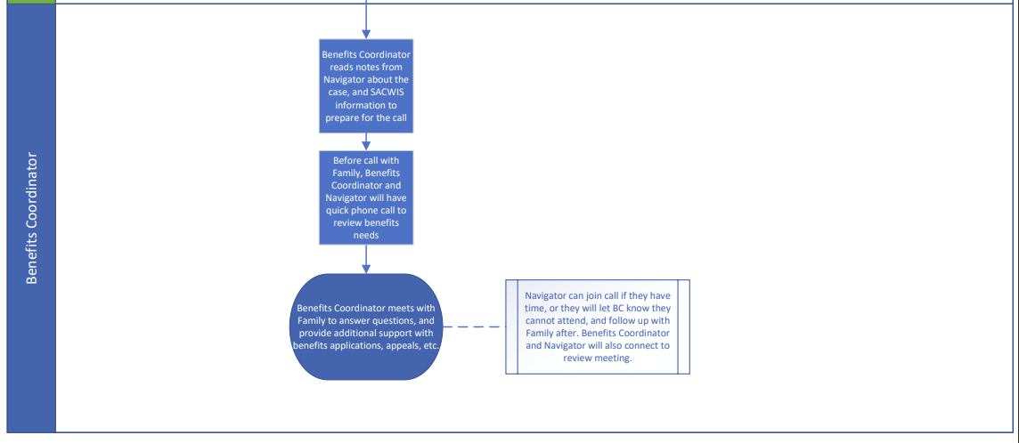
Designing benefits coordination
Phase 5: Full Workflow

Slide 29
Designing benefits coordination
Phase 4: Begin Practice with Families!
1. Start being patched in on calls with families to listen and learn, interject knowledge on benefits as questions arise
2. Develop and practice tracking process for all calls with families
Question / problem with benefit/s
Barriers and gaps in services
Solutions
County of caller
Intake and assessment calls
Support Plan calls
Test developed processes

Slide 30
Designing benefits coordination
Phase 5: Full Workflow
2. Navigators regularly schedule calls with the Benefits Coordinator to address any questions or information that is beyond the initial information on the One Sheets
Calls are scheduled with Benefits Coordinator to help solve problems and investigate additional benefits the family may be able to access
1. Navigators consistently communicating about benefits to families and have practice assisting with application process
Navigators consistently ask about benefits in the assessment
Address initial questions with information that can be found in the One Sheets

Slide 31
Designing benefits coordination
Phase 5: Full Workflow
3. Meets with Navigators on regular basis to check in about gaps and barriers, questions
4. Benefits Coordinator tracks gaps and barriers on state-wide level, escalate to RACs and SAC
5. Trains new hires, provide refresher trainings
6. Advocates on issues of gaps and barriers to benefits for kinship families with leadership and outside organizations
7. Hosts family information training sessions

Slide 32
Implementing Benefits Coordination:
The Work Today
Notes:
ave little experience with it
Amber

Slide 33
Daily Responsibilities
Benefits trainings and onboarding trainings for staff
1:1 with Navigators
Benefits Open Office Hours
Regional Coordinator Gaps/Barrier meetings
Benefits presentations upon request: RAC's SAC, regional teams, external partners
Coordination with other agencies to assist with remedying barriers to access
Data Tracking & CQI
Planning meetings with Benefits Coordination Team
Staying up-to-date on benefit program changes and sharing information with the team
Benefits phone calls with families
Notes:
When not working with families, discuss community track focuses. Discuss fluctuating time spent on family vs. Community track.

Slide 34
Integrating Benefits Coordination:
Tracking Gaps and Barriers
Notes:
ave little experience with it

Slide 35
Tracking Gaps and Barriers
Tracking family calls
Tracking benefit gaps and barriers during monthly RC meetings
Using data to inform CQI discussions, iterate BPM, and present to SAC, RAC’s, etc.
Notes:
Who we talk to re: data. How elevate info so it doesn't stay w/n OhioKAN. SAC, RAC's, etc. Slide re: looking towards future and integrating BC more into community track pathway.
Discussion re: tracking barriers, differences, what the purpose of tracking barriers are for. Discussion across OhioKAN re: the importance of identifying and documenting barriers/gaps.

Slide 36
Gaps and Barriers Tracking
Notes:
The remainder of this presentation, we will look more closely at some of the quantitative and qualitative (or narrative examples) related to some key benefit programs. To begin, I wanted to direct your attention to the counties in which families are utilizing benefits coordination the most:
51% Franklin County – makes sense because heavily populated major city on Ohio
9% Montgomery County
60% of benefit coordination request are coming from these counties.

Slide 37
Gaps and Barriers Tracking
Notes:
Here, we have tracked data as it relates to the actual federal or state benefit programs that families have identified as having difficulty accessing for various reasons.
21% of families that have utilized benefits coordination have identified some sort of gap/barrier as it relates to the Kinship Caregiver Program
16% of families that have utilized benefits coordination have identified some sort of gap/barrier as it relates to the Kinship Permanency Incentive Program
15% of families that have utilized benefits coordination have identified some sort of gap/barrier as it relates to the Ohio Works First Child-Only Program
12% of families that have utilized benefits coordination have identified some sort of gap/barrier as it relates to the Prevention, Retention, and Contingency Program
10% of families that have utilized benefits coordination have identified some sort of gap/barrier as it relates to the Supplemental Nutrition Assistance Program
6% of families that have utilized benefits coordination have identified some sort of gap/barrier as it relates to the Publicly Funded Child Care Program
Just looking at the top 6 benefit programs, what we noticed here is that all of these programs should be able to meet the basic needs that our families identify, whether that’s needing more financial assistance since taking in their grandchildren, needing more food in the household since caring for a growing teenager, seeking support purchasing child furniture, paying rent/utilities…child care.
So again, the top 6 programs that 80% of benefits coordination families have identified as being a challenge to access, are also those programs that should be able to meet these families’ needs.

Slide 38
Gaps and Barriers Tracking

Slide 39
Top 3 Benefit Gaps/Barriers: KCP
Caregiver has been getting the runaround from both Columbiana and Mahoning counties regarding accessing KCP. She was told by various representatives from both counties that they couldn't assist, didn't know about the program, or that the other county should be helping.
Notes:
So as we break down those top 6 programs, I wanted to first begin with KCP
As I mentioned, 21% of families that have utilized benefits coordination have identified some sort of gap/barrier as it relates to the Kinship Caregiver Program (brief review of that program).
This chart represents the reason why families have identified this program as a challenge to access. We’ve broken it down by the following categories:
Benefit overview – not knowing the program existed and needing the basic level information about the benefit
Complex question – specific questions about the program as it pertains to their specific family situation
Application assistance – including where to locate the application
Appeals/denials
Other – see narrative example (read)
Other Examples
Nav txt on 3/17/23: - Nav needed assistance with help re: Montgomery Co. KCP. They reported that after reaching out to both JFS and PCSA, they were told by both agencies that "they have no idea what is it.... the supervisor at JFS said PRC doesn't cover kinship child care even though their PRC application appears that they do." This county admitted that they didn’t know what to do with the application or what the program was.
Other noted issues we are seeing involves problems locating the applications for this program, applications being available on county websites or PRC plans, but out of date,
Also issues where families are told they didn't qualify for KCP since children were not initially involved with CPS in that county.
Have to have an open/active case
Have to have legal custody whereas some don’t require it
Issues with income eligibility for the child care pat of this program – many caregivers are just over the limit for this and have to pay out of pocket or work less hours just to qualify.
Questions?

Slide 40
Top 3 Benefit Gaps/Barriers: KPIP
A caregiver who had a service episode with us in June called twice regarding KPIP. The caregiver wanted to know the timeline as it had been around 8 weeks since the application was submitted. When the family talked to Highland County PCSA, they stated that they could not find the caregiver's application and referred the caregiver back OhioKAN.
Notes:
Next, we have KPIP where 16% of families that have utilized benefits coordination have identified some sort of gap/barrier as it relates to this program (brief review of that program).
This chart represents the reason why families have identified this program as a challenge to access. We’ve broken it down by the following categories:
Benefit overview – not knowing the program existed and needing the basic level information about the benefit
Complex question – specific questions about the program as it pertains to their specific family situation
Application assistance – including where to locate the application
Appeals/denials
Other – see narrative example (read)
Other Examples
Another example involves a family who had been experiencing a lot of inconsistencies with the ways in which their local PCSA handled their KPIP application. The caregiver was explained that she was told by her PCSA to reach out to other personnel for fingerprints, site visits, etc. even after she had already completed those tasks. It took a total of 6 months for her to receive payment because the assigned worker was on maternity leave.
We’ve also recently had families who could really use the extra financial support, get denied KPIP because of previous involvement with a PCSA (more than 40 years ago), but they are now caring for their grandchildren. This grandparent is behind on rent, her car is in jeopardy of being repossessed, she is disabled and is still grieving the loss of her other grandchild. She had either explored and or exhausted other sources of support as it related to state/federal benefit programs.
Questions?

Slide 41
Top 3 Benefit Gaps/Barriers: OWF
A caregiver in Ross County called ODJFS to apply for OWF Child-Only. The caregiver reported that the representative stated that she did not know what she was talking about and hung up on her. She was frustrated when she called us again seeking further advice on this benefit.
Notes:
As for OWF/Child-Only, 15% of families that have utilized benefits coordination have identified some sort of gap/barrier as it relates to this program (brief review of that program).
This chart represents the reason why families have identified this program as a challenge to access. We’ve broken it down by the following categories:
Benefit overview – not knowing the program existed and needing the basic level information about the benefit
Complex question – specific questions about the program as it pertains to their specific family situation
Application assistance – issues with how to apply when wanting to apply for child only, issues with the self-service portal
Appeals/denials – incorrect decision because some workers are taking into account household income
Other – see narrative example (read)
Other Examples
We've also heard from Navigators that there seems to be a trend that some caregivers who are referred to their county JFS are calling us back saying that JFS referred them back to us. There’s some concern that somewhere there’s a lack of understanding of these programs as JFS and sometimes CPS workers are referring families back to OhioKAN to assist directly with providing the funds for the programs that THEY administer.
Questions?

Slide 42
Benefits Coordination:
A Look Toward The Future
Notes:
ave little experience with it

Slide 43
Future of Benefit Coordination
Continuing to integrate benefit coordination into all levels of OhioKAN
Supporting more kinship and adoption families across the state
Hired a second Benefits Coordinator
Presenting benefit gaps/barriers to Statewide and Regional Advisory Councils
Building more collaborative partnerships
Presenting OhioKAN's Benefit Coordination model to other human service systems
Notes:
Purpose of suggesting hiring 2nd
Process of hiring
Developing training and onboarding schedule
Continued support to assist with getting comfortable with role
Collaborative Relationship Building to enhance Benefits Coordination Program
Informational interviews with SME’s
Building relationships with partners
Attending RAC meetings with regional teams
Getting to know internal staff & Navigators
Advocating for better access to federal and state benefit programs?
Removing the barriers and filling the gaps

Slide 44
OhioKAN Theory Of Change
Notes:
Removing the barriers and filling the gaps

Slide 45
Questions & Reflections
Notes:
10 min
If it is hard to engage people: what is one piece of advice you would give to someone who is planning to engage stakeholders in a new or existing program

Slide 46
Citations
(1) Foster, T. B., Knop, B., & Bhaskar, R. (2021, February 2). Access and Eligibility for Supplemental Nutrition Assistance Program Varies County by County. Demographic SNAPshot: Not Everyone Eligible for Food Assistance Program Receives Benefits. Retrieved from https://www.census.gov/library/stories/2021/02/demographic-snapshot-not-everyone-eligible-for-food-assistance-program-receives-benefits.html
(2) Gray K., Balch-Crystal E., Giannarelli, L., and Johnson, P. (2022). National- and State-Level Estimates of the Special Supplemental Nutrition Program for Women, Infants, and Children (WIC) Eligibility and WIC Program Reach in 2019. Prepared by Insight Policy Research, Contract No AG-3198-D-16-0095. Alexandria, VA: U.S. Department of Agriculture, Food and Nutrition Service, Office of Policy Support, Project Officer: COR Grant Lovellette. Available online at: www.fns.usda.gov/research-analysis.
(3) Shrivastava, A., & Thompson, G. A. (2022, February 18). National and State Level Estimates of WIC Eligibility and Program Reach in 2019. TANF Cash Assistance Should Reach Millions More Families to Lessen Hardship. Retrieved from https://www.cbpp.org/research/income-security/tanf-cash-assistance-should-reach-millions-more-families-to-lessen
(4) Puls, H. T., Hall, M., Anderst, J. D., Gurley, T., Perrin, J., & Chung, P. J. (2021). State spending on public benefit programs and child maltreatment. Pediatrics, 148(5), e2021050685.
(5) Cancian, M., Yang, M. Y., & Slack, K. S. (2013). The effect of additional child support income on the risk of child maltreatment. Social Science Review, 87(3), 417-438.

