Slide 1
Building and Implementing a
Family First CQI Framework:
Accomplishments and Lessons Learned
CWLA National Conference
April 26, 2023
Notes:
Jenny

Slide 2
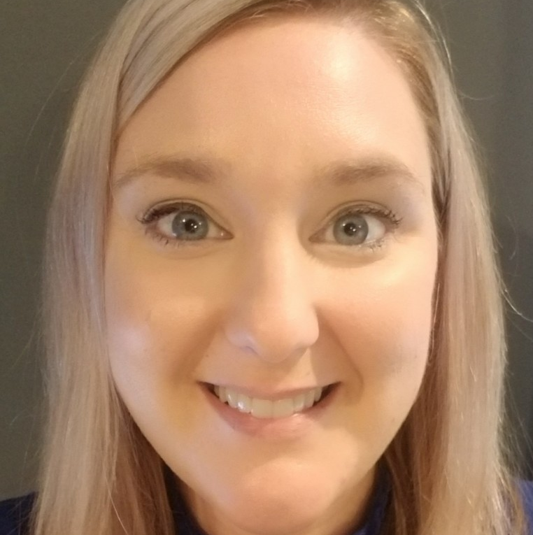
Presenters
Jennifer Thornhill, MSSW, CSW
Prevention Branch Manager
Division of Protection and Permanency
Department for Community Based Services
Jennifer.Thornhill@ky.gov
502-564-7635
Yolanda Green-Rogers, MSW
Senior Policy Analyst
Chapin Hall at the University of Chicago
yrogers@chapinhall.org
Tiffany Mullis, MSSW, MPA
Assistant Director
Division of Service Regions
Department for Community Based Services
Northern Kentucky University, Adjunct Professor
Public Child Welfare Certification Program; Social Work Department
Tiffany.Mullis@ky.gov
859-307-2811
Notes:
All introduce ourselves

Slide 3
Objectives
Learn about a measurement framework designed to collect data on four key elements of Family First implementation: agency capacity, reach, fidelity to EBPs and outcomes.
Learn how the data and evidence gleaned from the measurement framework can be used to identify root causes of needed improvements and inform the development of potential solutions.
Hear how evidence from Family First CQI processes are being integrated into Kentucky DCBS’ broader CQI system.
Notes:
Jenny
This session will highlight the Kentucky Department of Community Based Services’ (DCBS) experience measuring and monitoring the initial and ongoing implementation of its Family First Prevention Services plan. Participants will learn about DCBS’ accomplishments and lessons learned building an infrastructure to collect the evidence needed to fuel a continuous quality improvement (CQI) process that engages a broad array of stakeholders in solution-finding. Participants will also hear how data and evidence from the Family First CQI process is being integrated into the agency’s broader CQI system to inform Child and Family Services Review preparations. Key components of Chapin Hall’s prevention services measurement framework will be shared, and participants will have an opportunity to explore where they are on their own prevention services CQI journey.

Slide 4
What is the status of your Title IV-E Prevention Program
Five-Year Plan?
Notes:
Jenny-Menti (prompts are not submitted, submitted, approved, approved and pursuing amendments

Slide 5
Historical Context and Preparing for Family First
Notes:
Jenny

Slide 6
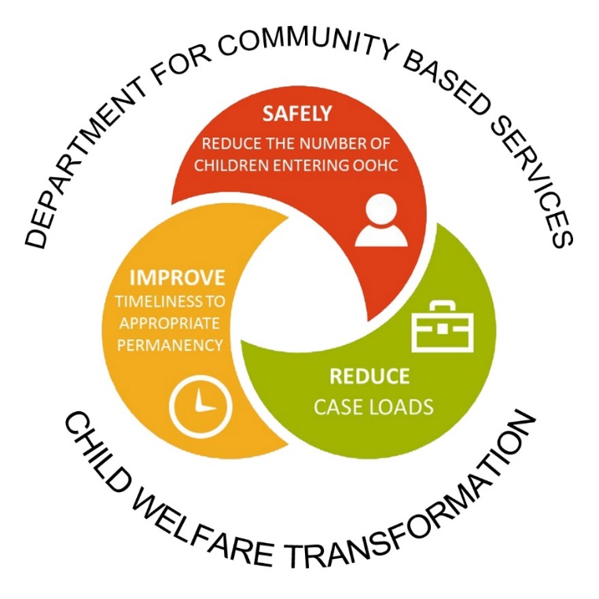
Practice Transformation in Kentucky
Child Welfare Transformation launched in Kentucky in April 2018
Phase one began in May 2019
Reform goals:
Reduce case loads
Improve timeliness to permanency
Safely reduce the number of children
entering into OOHC
Notes:
Jenny-The current approach to child welfare was no longer sustainable and the system was overwhelmed.
Record # of kids in OOHC –With an out of home care (OOHC) population of almost 10,000 children and a lack of adequate foster home capacity to match the growing need.
Children lingering without timely permanency.
Record # of cases contributing to a destabilized work force experiencing burnout/secondary trauma and where workers were set up for failure.
It wasn’t fair to staff and it wasn’t fair to families and children who had a new case worker every 6 months
The consequences were a less experienced workforce challenged to adequately engage families, and effectively deliver services.
The impact on the workforce was further evidenced by the poor outcomes ratings received during the 2016 Child and Family Services Review (CFSR).
Structure and a consistent method was needed to formulate strategies.
Commitment from sister agencies was necessary toward a shared vision.
It’s time for transformation and a call to action….

Slide 7
Project Management
Structure
Process
Outcomes
9 Workgroups
Workforce
Permanency
Prevention
Fiscal Mod.
Trans. Aged Youth
Foster Parent
Relative Pl.
Service Regions
IT
Requirements
Scope of Work
Key Themes
Risk Assessment
Communications
Project Monitoring
Stakeholder Engagement
Strategy implementation
Deliverables
Early evaluation
Course correction as needed
Embed into ongoing practice
Notes:
Jennifer
The project management framework provided a systematic approach for continuous improvement and established a formal methodology for strategic planning.
Fostered an environment for consistent evaluation and decision making;
Structure:
Nine workgroups composed of subject matter experts, and each had a defined purpose statement.
Collective charge was to formulate strategies to create a child welfare system in which families and children are the primary focus.
Process:
Requirements gathering: to define the problem
Scope development to set priorities and identify key focus areas for each group.
Key Themes were identified, strategies developed, tasks assigned, and tracked until deliverables were completed.
Ongoing risk assessment and review to ensure the focus remained on the identified strategies.
Communications plan both external and internal
Project performance monitoring through ongoing review of data and the early identification of trends which have allowed the system to become more proactive in addressing challenges, rather than the more typical reactionary position. Created a process for new action items or workgroup strategies to be added when necessary to accommodate the ongoing and changing needs of the agency.
Continuous stakeholder engagement to ensure we were accountable and addressing needs that impacted the entire system.
Outcomes:
Strategy implementation-52 transformational strategies
Deliverables were met; you can see our annual report.
Early Evaluation allowed us to continually reprioritize as we progressed.
Course Correction when needed, there were 2 separate occasions where we merged work to prevent duplication.
Embed the process into everyday practice, moving into a redesign of our current CQI system now.
Outcomes embedded in everyday practice; leading into Phase Two of Child Welfare Transformations in redesigning our CQI system

Slide 8
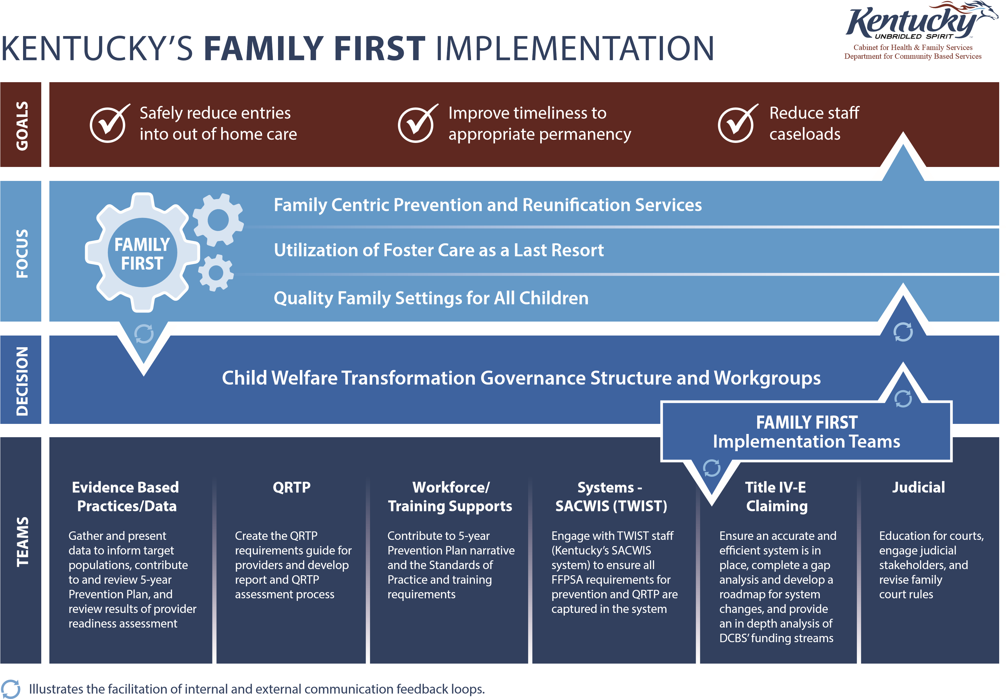
Notes:
Jenny
This slide is a visual of how DCBS approached the implementation of Family First
3 Priority Goals of the Department and the child welfare transformation
The agency embarked on a Child Welfare Transformation in April of 2018. When news of the passing of Family First was reviewed, it was seen as a lever to help achieve the goals of CWT, not merely a compliance obligation.
Family First is a huge piece of legislation. Many workgroups and teams were developed to prepare for implementation as referenced in the bottom part of this visual.
The gears represent that all of these areas play into each other and work in collaboration.

Slide 9
Kentucky – Family First Theory of Change
Inputs
Outputs
Impact
TWIST enhancements
Title IV-E funding
CQI/Evaluation team
Evaluation plan
CQI plan
Provider agency and child welfare and workforce
Provider Readiness findings
Intentional services
Monitoring for effectiveness and appropriateness
Access to accurate and comprehensive data
RESOURCES
Parent Capabilities Built
Improved problem-solving skills
Improved family relationships
Changes are maintained
An empowered ability to access resources
An ability to independently address issues as they arise
The confidence to parent and manage behaviors
Child and Family Outcomes
Entries into Out of Home care
Re-entries
Maltreatment
Repeat maltreatment
Caseloads
Child and family well-being
Child and Adolescent Needs and Strengths
Structured Decision-Making
Training and Coaching
Family First Prevention Services Act liaisons
Prevention Plan
Quality assessments of risk, safety, and protective factors
Quality strengths and needs assessments
Appropriate evidence-based practice identification
Greater evidence-based practice linkage and family participation in service
PRACTICE INVESTMENTS
Culture of Safety
Public/private partnerships
Legislative commitment
Stakeholder engagement
A workforce that feels safe and supported with the right tools
Greater workforce retention
CULTURE CHANGE
Expanded business model
Well-supported evidence-based practices
Functional Family Therapy
Homebuilders
Motivational Interviewing
Multisystemic Therapy
Parent-Child Interaction Therapy
Promising evidence-based practices
High-Fidelity Wraparound
Sobriety Treatment and Recovery Teams
Trauma Focused-Cognitive Behavioral Therapy
Greater service capacity
Aligned service array
Fidelity monitoring
Child Welfare Agency Outcomes
Increased investments in preventative services
Decreased foster care expenditures
Decreased child welfare caseloads
SERVICES
Notes:
Jenny

Slide 10
Phase One Highlights: Prevention
2019 Provider Readiness Assessment
Assess service provision needs
Identify evidence-based practices
Regional forums
Draft/submit 5-year FFPSA State Plan
Expand in-home services
and invest in prevention
Notes:
Aligned with CFSP goals

Slide 11
Implemented Family First Prevention in October 2019
> State plan approval April 2020
> State plan amendment December 2021
> State plan amendment September 2022
> Partnered with Chapin Hall to implement a Family First CQI Measurement Framework
> Integrated Family First CQI into broader agency CQI
> Expanded prevention services
> Expanded evidence-based practices
> Expanded capacity through agency commitment and organizational change
> Increased funding for prevention services
> Legislative appropriations for prevention
> Decreased Foster care expenditures
Notes:
Jenny

Slide 12
Division of Prevention and Community Well-Being Primary Prevention
Family & Youth Driven
Community Collaboration
Connecting Families to Support
Leverage & Communicate Data
Policy & System Changes
Addressing equity & inclusion
Prevent Child Abuse Kentucky
Changing paradigm for how families are served
Honoring family voice and choice
Community Partnerships-social determinants of health
Statewide Prevention Collaborative
Parent Engagement Meetings
Parent Advisory Council
Lean on Me Initiative
Building Community Well-Being Among Families Grant
Fatherhood Engagement
Community Collaboration for Children
Ensuring families have access to information and support necessary for family well-being.
Equity
Inclusion
Notes:
Jenny
The scope of work and responsibilities for this branch would include all programs funded by the Community Based Child Abuse Prevention (CBCAP) grant statewide. This includes all Community Collaborations for Children contracts statewide, parent engagement meetings, and all contracted activities with Prevent Child Abuse Kentucky. Activities included in these contracts and programs include parent education, parent support groups, child abuse prevention awareness activities, prevention hotline, and supports for navigating community resources. At the national level, there is significant advocacy and support for additional CBCAP funding to states to expand primary prevention efforts. Additionally, DCBS is actively seeking other grant opportunities to support primary prevention efforts. Additional staff support would be needed to administer this funding and programming.

Slide 13
Division of Prevention and Community Well-Being Community Response and Well-Being
Family & Youth Driven
Community Collaboration
Connecting Families to Support
Leverage & Communicate Data
Policy & System Changes
Addressing equity & inclusion
Changing paradigm for how families are served
Honoring family voice and choice
Community Pathways
Statewide Prevention Collaborative
Parent Advisory Council
Safety net & economic supports
Community Response pilots
Thriving Families, Safer Children Initiative
Formal collaborations with other family serving agencies
Collaborating and enhancing community-based partnerships to support families who may have risk factors for child maltreatment
Equity
Inclusion
Notes:
Jenny
The scope of work and responsibilities for this branch would include administering the collaboration of community response programs statewide. A formalized structure for administration of services to families of children at risk of maltreatment is necessary to curtail rates of abuse and neglect in the state. Under our current system, concerns called in to the child welfare hotline that do not meet criteria for investigation typically are not referred for any type of services. Often challenges may continue to escalate until an incident of alleged maltreatment occurs that may meet criteria for child welfare agency involvement. Many states have moved to a model of community response, which allows these families to be referred to services by community partners which then prevents future maltreatment. This is an ideal model for secondary prevention which not only prevents trauma to children and families, but also reduces the unmanageable caseloads for child welfare staff. While the staff on this branch would not provide any direct services, staffing would be necessary to develop and administer the formalized structures for communication and agreements for collaborative services at the regional level across the state. In addition to administering a formalized plan for secondary prevention, numerous memoranda of understanding would be necessary with community partners across the state including HANDS, Family Resource Youth Services Centers, and other prevention providers. Finally, existing programs under the current Prevention Branch would be included as they relate to community wellbeing. These include Citizens Review Panels and Social Services Block Grant administration.

Slide 14
Division of Prevention and Community Well-Being Prevention Evidence Based Practices
Family & Youth Driven
Community Collaboration
Connecting Families to Support
Leverage & Communicate Data
Policy & System Changes
Addressing equity & inclusion
Changing paradigm for how families are served
Honoring family voice and choice
Sobriety Treatment and Recovery Teams (START)
Community Pathways
Statewide Prevention Collaborative
Family Preservation and Reunification Services
Parent Advisory Council
Kentucky Strengthening Ties and Empowering Parents (KSTEP)
Family First Prevention Pilots
Providing a robust prevention service array to prevent future maltreatment and entry into care
Equity
Inclusion
Notes:
Jenny
The scope of work and responsibilities for this branch would include the administration of all Family Preservation and Family Reunification programming. These programs are aligned with and supported by the Family First Prevention Services Act of 2018. Services to families under these programs are administered by contracted prevention providers which are required to utilize evidence based practices (EBPs) approved by the federal Prevention Services Clearinghouse. These services are provided to families with children who have been identified by the child welfare agency as “candidates for foster care”. In addition to the prevention EBPs provided by the contracted Family Preservation and Family Reunification providers, this branch would be responsible for oversight of the Kentucky Strengthening Ties and Empowering Parents (KSTEP) and the Sobriety Treatment and Recovery Teams (START) programs. These programs also provide services to the families of children who are “candidates for foster care”. Federal requirements for administration of these programs require fidelity monitoring of each of the evidence based practices, as well as intensive continuous quality improvement procedures which include case reviews of a sampling of prevention cases. These federally required activities require adequate staffing to properly administer. This branch would also be responsible for the state’s federally required Five Year Prevention Plan. Finally, there are several existing pilots for child welfare involved families focused on prevention of entry into care. This branch would also provide oversight for those pilots.

Slide 15
Prevention Plan Implementation and CQI
Notes:
Yolanda

Slide 16
Measuring Performance
Measure and monitor initial and ongoing implementation of the Prevention Plan
Use a measurement framework to produce the information needed to fuel improvement efforts
Establish routine forums with a diverse array of partners to engage in improvement planning
Ensure race equity is centered and constituent engagement is intentional
Notes:
Yolanda-Building the infrastructure to measure and monitor and adjust initial and ongoing performance

Slide 17
Has your state started to build infrastructure for Family First CQI?
Notes:
Yolanda-Menti

Slide 18
CAPACITY
REACH
FIDELITY
OUTCOMES
https://www.chapinhall.org/wp-content/uploads/Template-Measurement-Framework-for-Implementing-and-Evaluating-Preventive-Services.pdf
Notes:
Yolanda
These are the links to the tools in Chapin Halls Family First Toolkit on improving quality:
MEASUREMENT FRAMEWORK: https://www.chapinhall.org/wp-content/uploads/Template-Measurement-Framework-for-Implementing-and-Evaluating-Preventive-Services.pdf
The measurement framework is NOT CQI – it provides the infrastructure needed to produce the data and evidence that will fuel continuous quality improvement efforts
DATA MEASUREMENT COMMON TERMS: https://www.chapinhall.org/wp-content/uploads/Data-Measurement-Common-Terms.pdf
SAMPLE SIZE CALCULATOR: https://www.chapinhall.org/wp-content/uploads/Sample-size-calculator-20220617.xlsm
FAMILY FIRST REPORTING REQUIREMENTS, CODEBOOK and CROSSWALK: https://www.chapinhall.org/wp-content/uploads/Toolkit-3_Tool_2-Family-First-Reporting-requirements-codebook-and-Crosswalk.pdf

Slide 19
Agency Capacity Measures*
Assess the degree to which the agency devoted the necessary resources to support its implementation of prevention services
Reflect key implementation drivers
Staffing^
Training
Coaching
Technology supports & infrastructure
Facilitative administration
Systems interventions
*This framework groups capacity measures into six domains that correspond closely to seven “implementation drivers” identified by the National Implementation Research Network (NIRN). (NIRN’s seventh implementation driver – Fidelity – is captured later in its own section.) For more information on NIRN and these implementation drivers, see https://nirn.fpg.unc.edu/module-1/implementation-drivers.
^NIRN calls this driver “Selection”
^^NIRN calls this driver “Decision Support Data System”
Notes:
Yolanda
Staffing: development of statewide and/or local Family First implementation teams; recruiting, interviewing, and hiring if new staff or clinicians are needed
Training & Coaching/workforce preparation: training on new practices and processes under Family First that are not related to a specific EBP; training on the use of new IT systems or features related to prevention initiatives, such as interfaces used to document candidates, develop case or prevention plans, process referrals, etc.)
Tech supports & infrastructure: such as:
- an IT system(s) that supports identification of candidates, service matching, tracking referrals and service uptake, invoicing, and exchange of case information with providers;
- linkages between the CCWIS and external IT systems as needed to facilitate data exchange for children and families receiving preventive services;
- tools to facilitate data collection, reporting, and analysis for metrics of interest, such as those related to reach, service uptake and outcomes, and data that must be reported to the Children’s Bureau
Facilitative administration: resources and efforts to support staff and remove barriers, existence and usefulness of policies and procedures that support the program, effective communication from supervisors and leadership, leadership strategies to problem solve and make changes and improvements as needed)
Systems interventions: strategies to work with external systems and stakeholders not under the agency’s direct control)

Slide 20
Agency Capacity
Surveys delivered to DCBS staff in October 2021
Focus groups to assess capacity measures were delivered to service providers in January 2022
Responses analyzed through Quality Insurance and Chapin Hall
Findings presented to Family First CQI Stakeholders Group
Ex. Turnover/retention challenges for providers and DCBS
Ex. Need for EBP training sustainability/training of trainers
Notes:
Yolanda

Slide 21
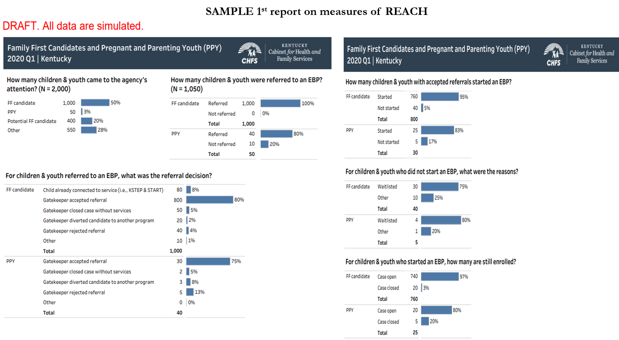
Reach Measures
Measures related to children and families referred to services, outcomes of those referrals, and service uptake and completion
Notes:
Yolanda

Slide 22
Fidelity Measures
The extent to which the service is carried out with adherence to the intended approach and can be assessed by measuring the degree to which capacity, process, and quality requirements are met.
Notes:
Yolanda
Fidelity is the extent to which the service is carried out with adherence to the intended approach and can be assessed by measuring the degree to which capacity, process, and quality requirements are met.
Process - How services are delivered and what is done (e.g., type, frequency, intensity, duration, timeliness)
Quality - How well services are delivered. Quality can be measured with observations, interviews, focus groups, and surveys.
Capacity - The resources the agency devotes to the work to implement the EBP with fidelity to implementation guidelines and process and quality standard
The Family First Prevention Services Act requires states to:
Clearly outline how EBPs will be continuously monitored to ensure fidelity to the program model and to determine outcomes achieved, as well as how information learned from monitoring will be used to refine and improve practices – the CQI approach
Selecting the right fidelity monitoring approach will depend on the EBP and available resources

Slide 23
Motivational Interviewing - SOURCE: Miller and Rollnick (2012) Motivational Interviewing 3rd Edition
Staffing and Training: licensure, certification, qualifications, training; supervisor/staff ratio, staff/client ratio; coaching and supervision
Fidelity Question | Explanation/Guidance | Case Review Key Findings:
a. Does the provider have the appropriate education? | High school diploma or GED
b. Does the provider have appropriate training? | 1) Basic Skills Training for "on the ground" workers
c. Is there appropriate supervision and movement toward proficiency in MI skills? | 1) Advanced Training is required for supervisors (reviewer should look for evidence of Advanced Training)
 | 2) There is use of fidelity measures and coaching to work toward proficiency through observation, note review, or role playing. The reviewer should look for the MITI, MISC or MIA-STEP (clinician assessments)
 | 3) Coaching and supervision are specific and detailed (i.e. "you said xxxxx", that can be considered judgmental. How can we say that in the MI spirit?")
 | 4) Session notes indicate the supervisor is supporting the provider in adhering to the model
Fidelity Question | Explanation/Guidance
a. Is the client appropriate for IV-E? | 1) Current SUD diagnosis (active or in remission), 2) Relapse Prevention, OR 3) deficit in daily living resulting from SUD
Notes:
Yolanda-Example of EBP fidelity monitoring case review tool

Slide 24
Motivational Interviewing - SOURCE: Miller and Rollnick (2012) Motivational Interviewing 3rd Edition
3. Activities of the service: type, content. Dosage (e.g., frequency, intensity, duration), timeliness of assessments and services
Fidelity Question | Explanation/Guidance | Case Review Key Findings
a. Are appropriate assessments used to determine base score and to show progress? | Use of ASAM Dimension 4 "Readiness for Change" or URICA to assess base score/stage of change and progress during treatment.
b. Competent use of skills | 1) OARS Skills (open ended questions, affirmations, reflections, summaries),
 | 2) Consistency with MI Spirit (MI is based on partnerships, acceptance, empathy, autonomy, affirmation, compassion and evocation NOT confrontation, judgement, imposition, authority, criticism, indifference, or education),
 | 3) Change Talk is Used (goal setting, pros and cons lists, values, scaling)
Case Review Strengths:
Case Review Enhancement Opportunities:
Notes:
Yolanda

Slide 25
Outcomes
The extent to which the services are achieving the desired results for children and families, outcomes may be:
Prescribed by the EBP
Agency specific, for example:
CPS report while still receiving the EBP
CPS report within 12 mos. of competing an EBP
Entered foster care while receiving the EBP
Entered foster care after EBP closure by timing
Federally required outcomes for Family First candidates (long term outcomes related to foster care entry)
Notes:
Yolanda

Slide 26
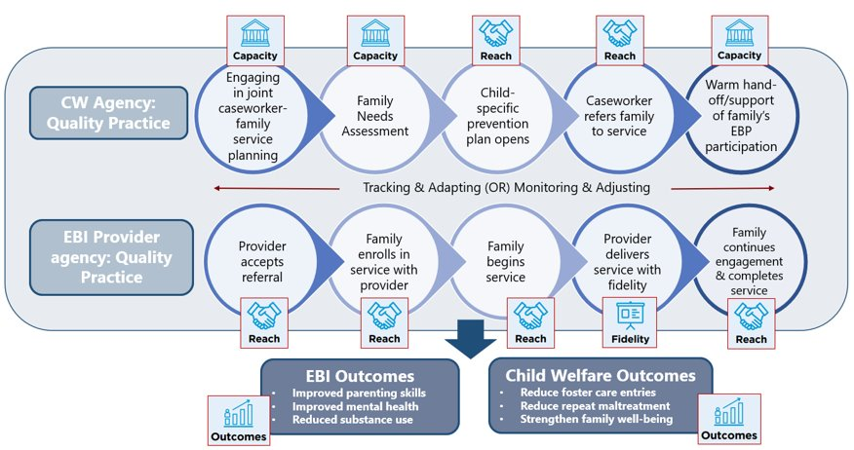
Quality Practice Leads to EBP Participation and Outcomes Pathway: The Whole Picture
Heaton, L., Creavey, K., Green-Rogers, Y., Reardanz, J., Obrien, J., Small, L., Harison, A., & Thomas, K., (in preparation). Family First CQI Implementation Framework to Support Practice, Service Delivery, and Improve Outcomes.
Notes:
Yolanda

Slide 27
Proposed CQI framework
State Level
Three integrated components
Regional Level
1. Overall Statewide CQI
Local Level
Provider level
2. Family First CQI
Fidelity Monitoring & CQI for Well-Supported EBPs
Overall Family First Evaluation
3. Family First Evaluation
Evaluation of Supported & Promising EBPs
START/KSTEP Evaluation
Notes:
Yolanda Inter-related activities that feed up into the overall Statewide CQI process

Slide 28
Discussion Questions
If you have started to build infrastructure or have implemented Family First CQI processes, what successes have you experienced?
If you have not started or are in the planning process now, what challenges do you anticipate?
Notes:
Yolanda-share menti results, then prompt group to partner up and discuss the questions, then popcorn report out.

Slide 29
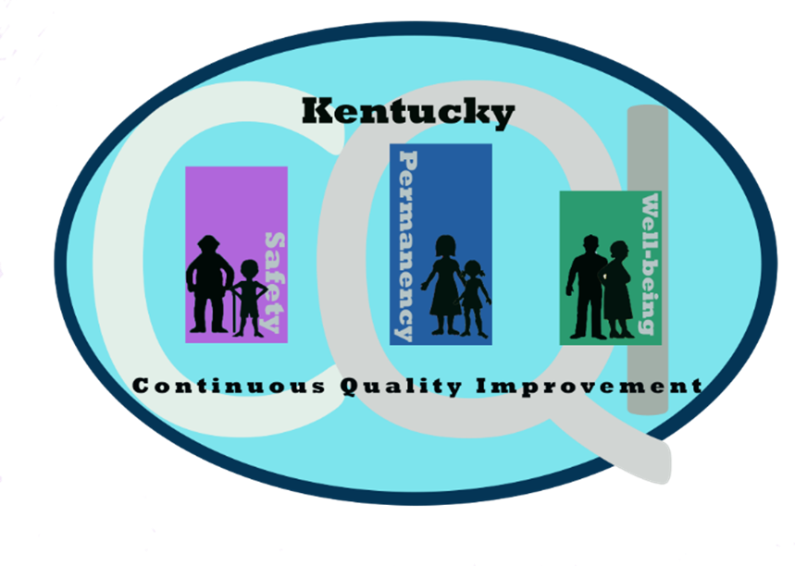
Child Welfare Transformation Phase Two: CQI Re-design
Notes:
Tiffany

Slide 30
TIMELINE
June 2019 –Dec. 2019
Staff engagement
CWT Phase II
QA groups
April 2018
Child Welfare Transformation Launch
Feb. 2020-Sept. 2020
CQI Self-Assessment
CQI Training Academy
Jan. 2021-June 2021
of rollout, CQI Forums Launch
Oct. 2020-Dec. 2020
CQI Redesign Project
Modifications to the CQI
State plan informed by
Self-assessment
Recommendations & staff feedback
May 2019
CWT Transition
Begins
July 2021 to present: Implementation, Monitoring, Evaluation
Jan. 2020
CQI Redesign Project
Center for States Collaboration
Notes:
Tiffany
Self-Assessment
Embed CWT into everyday operations;
A systematic structure for responding to agency’s changing needs;
Foster a culture of learning;
Consistent stakeholder engagement at all levels of the agency;
Application of data to inform new strategies; and
Structured communication.

Slide 31
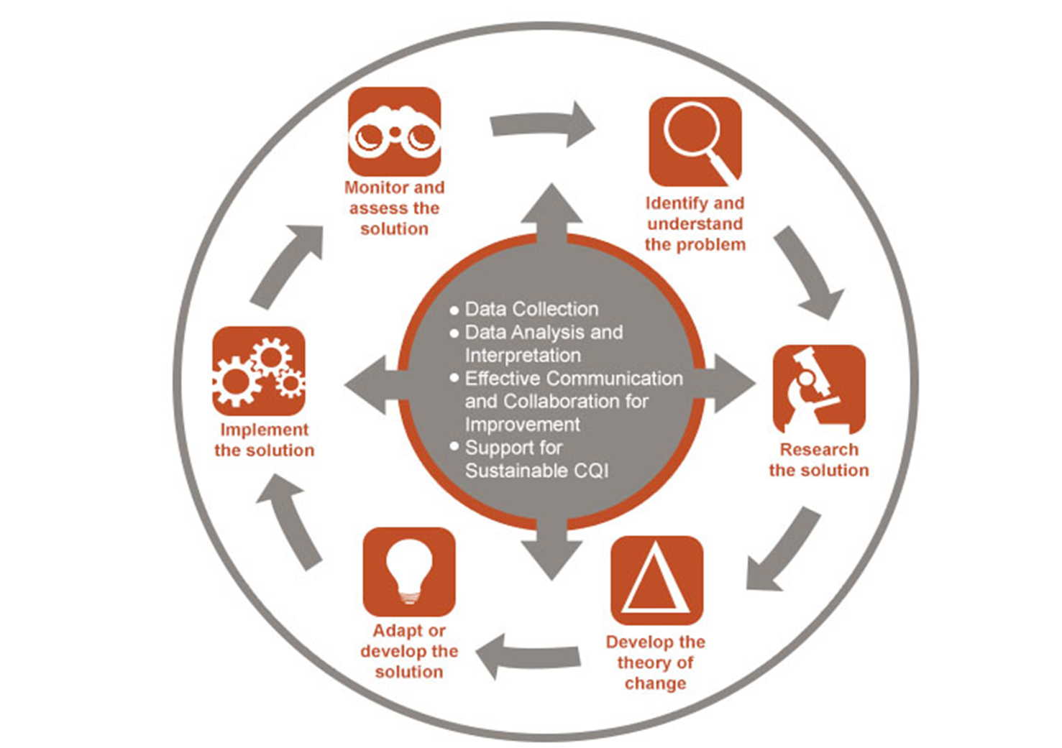
Cycle of Learning utilized for CQI
CQI issues are defined as affecting/impacting the same 3 topical outcome focused areas as the CFSP:
Safety
Permanency
Well-being
Notes:
Tiffany

Slide 32
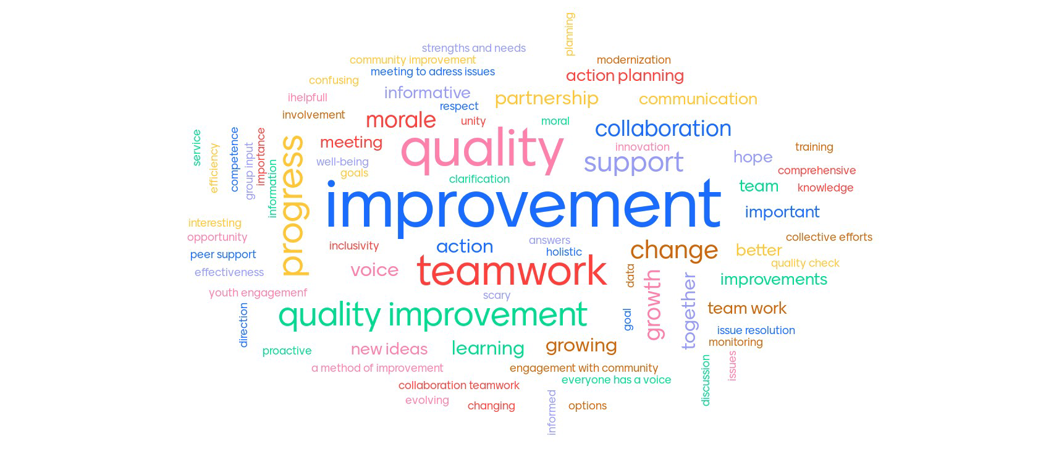
Finding Common Ground: “What is CQI”?
Notes:
Tiffany

Slide 33
Definition of CQI:
It is a philosophy – it places a high value on improvement. (CFSP)
It is a system – a coherent set of components that supports the continuous improvement process. (KPIs)
It is a cyclical process – it seeks to identify, describe, and analyze strengths and problems and then test, implement, learn from, and revise solutions. (APSR/CFSR)
Key Features of a CQI System:
It is data-informed, systematic, and proactive.
It is inclusive, involving stakeholders and staff at all levels.
It is holistic, incorporating information about multiple aspects of the system and establishing linkages
Embed CWT into
everyday operations; changing the
CULTURE of CQI
Data: Key Performance Measures (or KPI’s)
Aligned with Safety, Permanency, and Well-Being
Will be re-evaluated and changed as necessary.
Regions will be able to include other performance measures specific to their needs.
Inclusion of racial equity and disparity outcomes.
Notes:
Tiffany

Slide 34
Foster a Culture of Learning
Ongoing training for CQI Specialists
Center for States CQI Training Academy and coaching sessions
My Purpose online trainings
Subject matter experts informing the work
Ongoing forums and department wide CQI orientation training
CQI Specialists facilitating and coaching local teams
Notes:
Tiffany

Slide 35
CQI can be seen as a trifecta for addressing concerns, supported by data and informed by practice review
Tiered teaming system: Local, Regional and State CQI teams identify and solve barriers to service delivery and outcome achievement.
Management Reports and data: Connect data with outcomes and benchmarks by highlighting and monitoring trends.
Reviews of case work quality: Multi-level case reviews and feedback at each level to promote high quality case work and best practices.
Notes:
Tiffany
Tiered teaming system: Local, Regional and State level CQI teams. These Identify and solve barriers to service delivery and achievement of outcomes.
Management Reports and Data: Monitor and allow for trending of the results. Connecting data with outcomes. Are intended outcomes and goals actually occurring?
Reviews of case work quality: Promote high quality case work and best practices. This includes multi-level case reviews and feedback at each level. Case reviews also help address our Performance Improvement Plan and speak to Kentucky’s benchmarks to meet goals and intended outcomes.

Slide 36
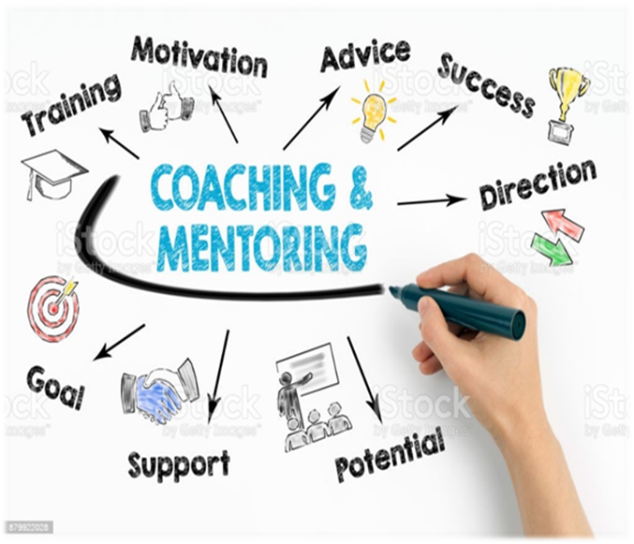
SOP 30.6 CQI and the Case Review Process
CQI Case Review process
Debriefing
Regional Action Planning
CQI State Plan and Procedures Manual
Available in SOP for access
Conducting annual review and eval of State Plan
(CQI-ing our own CQI plan)
Notes:
Tiffany

Slide 37
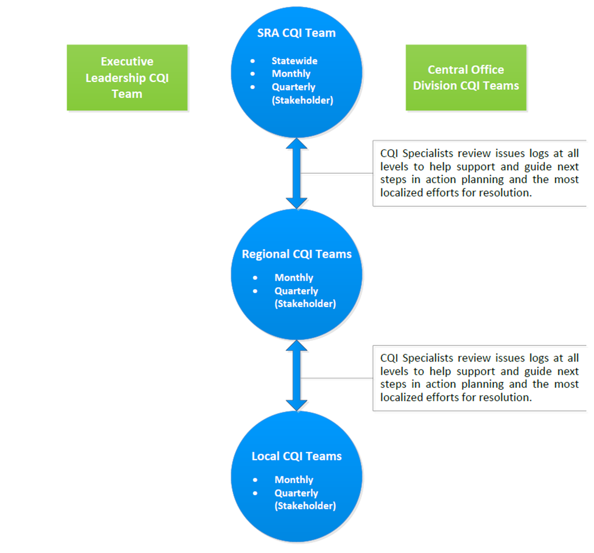
A systematic structure for
responding to agency’s
changing needs.
Teaming Structure
Notes:
Tiffany

Slide 38
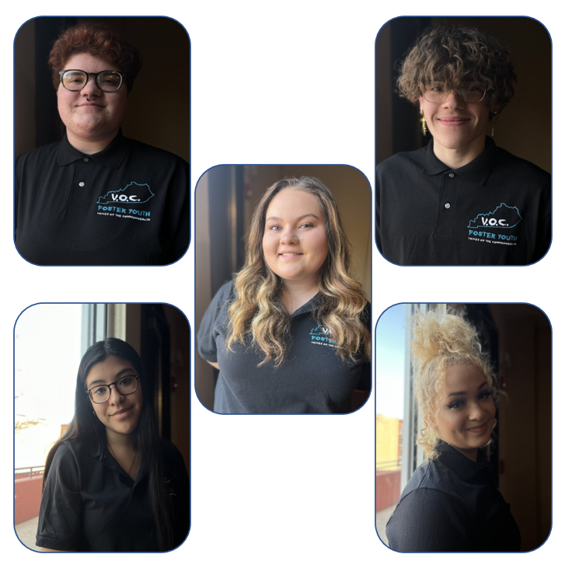
CQI Youth Engagement
Strengths:
Collaboration with Voices of the Commonwealth, Murray State and SKY
Virtual platforms allowed more participation statewide
Feedback loop (TEAMS channel for feedback from agency, follow-up with VOC/youth)
CQI Youth FAQ brochure
Surveys-ongoing
Barriers:
Lack of participation/engagement (virtual fatigue)
Feedback doesn’t always reach same youth
Current Youth serving as Voices of the Commonwealth
Youth Feedback example: Goal 3: Increase the timeliness to appropriate permanency for all children in OOHC
feedback: ensure youth are engaged in decision making around permanency
obtain ongoing surveys from youth to inform practice
joint training/team building between foster youth/foster parents
Notes:
Tiffany

Slide 39
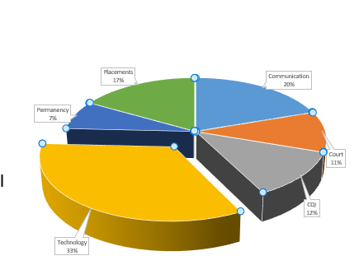
Foster/Adoptive Parent Stakeholder Engagement
CQI training-partnership with stakeholders bi-annually
Foster/Adoptive Parent survey
Polls during CQI overview
Identified training needs/barriers
Regional Foster/Adoptive Parent CQI teams
“In one word, identify a strength in fostering children”
Barriers in Achieving Permanency for Children
from resource family POV
Notes:
Tiffany

Slide 40
Consistent stakeholder engagement at all levels of the agency
Decision point to collect focused community partner meeting minutes from our identified community partner gaps from the PIP
Youth: Meet with Voices of Commonwealth quarterly, residential meetings at facilities with youth rep
Foster/Adoptive Families: Support networks monthly meetings
PCC/PCP regional quarterly meetings
CCC: monthly
Court/Judges: Reviewing permanency data, way for courts to vet CQI
RIAC---Monthly meetings—regional level
KY began with a hand count and collecting localized community partner meeting notes, barrier is workload and human resource burden, despite multiple connections occurring.
Notes:
Tiffany

Slide 41
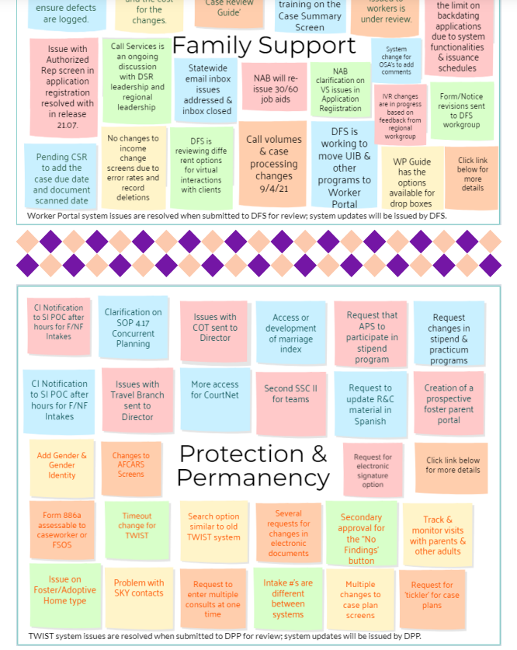
Agency
feedback loop:
making the conversation tangible
Notes:
Tiffany

Slide 42
Use of Surveys and Polling
Notes:
Tiffany

Slide 43
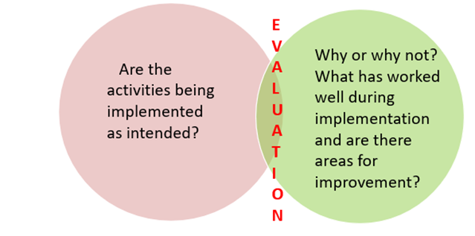
Evaluation & Monitoring Phase
CQI Plan Component
CQI Vision
Teaming Structure
Agency Feedback Loop
Infrastructure Supports
Core Data Set
Case Record Review Process
Training Requirements
Communication Plan
Notes:
Tiffany

Slide 44
Has your state begun Family First CQI integration into broader agency CQI?
Notes:
Jenny-menti poll instructions

Slide 45
Family First CQI
Broader Agency CQI
Collaboration
Stakeholder Involvement
Integration
Notes:
Jenny and/or Tiffany

Slide 46
Integration: Collaboration and Stakeholder Involvement
Agency CQI monthly collaborative
Feedback loop for Family First
Data sharing, issue identification agency wide, integration of CFSR/PIP
Quarterly Family First CQI meetings
Robust stakeholder participation
Feedback loop for outcomes
Aligned with measurement framework
Notes:
Jenny and Tiffany
Attendance-purveyors, regional leadership, family first liaisons, regional gatekeepers, regional CQI specialists, CQI agency leadership, provider agencies, overall agency leadership
Purpose-provide a feedback loop for outcomes, progress, assessing and responding to needs, deliver training, engage stakeholders through focus groups or group work-addition of lived experts
Case review outcomes/action steps-purveyor engagement and attendance at agency debriefings, development of tools, and at CQI meetings
Capacity-deliver of DCBS staff survey and provider focus groups to assess capacity in implementing family first. Delivery of results, brainstorming solutions, priority matrix, and feedback on actions taken.
Reach report/dashboard-assessing the reach and trends for FF services in KY.

Slide 47
Integration: Reach of Services
Notes:
Tiffany and Jenny
Role of CQI Specialist
-Key focus areas (assessment of children eligible and not referred, assessment of differences in referrals/outcomes by race and ethnicity, and rejection rates at gatekeeper and provider levels)
-Presentation at Collaborative meetings and Stakeholder meetings

Slide 48
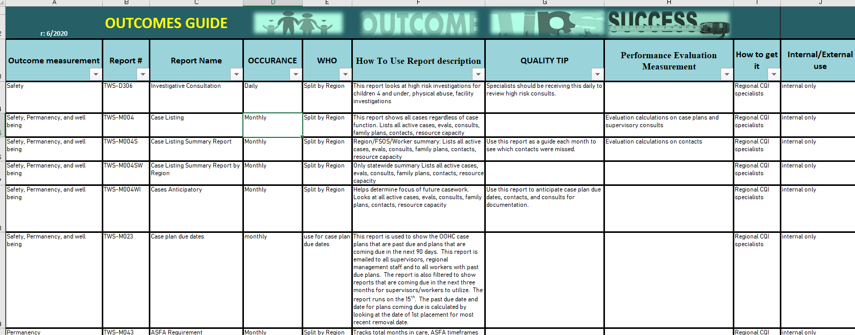
Reports Directory:
Access and User Friendly to connect data and reports to the work
Notes:
Tiffany and Jenny
Highlighting the use of management reports to support CQI/QA processes related to Family First, the reach report, 377A, 401, 292, safety and risk consults.

Slide 49
Integration: Race Equity
Implementation of a race equity assessment
Assess design and implementation of Family First
Ensure cultural responsiveness
Avoid disproportionality/disparity in services
Current scope of work to integrate findings in Family First and broader agency CQI
Notes:
Jenny and/or Tiffany
SFY 22 KY partnered with a sister agency, DBHIDD and recipient of an SOC grant, in implementing a REIA, including delivery of training, stakeholder engagement and interviews (FF CQI group), document review, root cause analysis, and data analysis. Data shared included youth entering OOHC by region, youth permanency goals, age at entry, youth sibling groups, proximity of placement, placement stability, length of stay, type of maltreatment, type of placement, referral finds by race, ethnicity, and sex. Data analysis occurring to inform audit findings report.
FFY 23 Consultation and strategies for integrating audit findings into Family First CQI processes under DPCW, and integration with broader DCBS CQI
Developing more comprehensive data infrastructure DPCW and DPP survey occurring currently to assess training needs regarding staff use of data audit and assessment results in everyday work
Pillars, including social and economic equity, guiding agency strategic planning
Integration in DCBS race equity action planning (goals and objectives), structure of leadership (RECT agency wide with representation from each division, division RETs with division goals/objectives.

Slide 50
Notes:
Jenny and/or Tiffany
The Cabinet for Health and Family Services has a racial equity vision and goals, and each Cabinet department and its respective divisions and regions have supporting racial equity teams, goals, and objectives. Each department is supported in the Cabinet-wide Community of Practice. In DCBS, those teams include the Division of Service Regions, 9 service regions, the Division of Protection and Permanency, the Division of Administration and Financial Management, the Division of Family Support, the Division of Child Care, and now the Division of Prevention and Child Well-Being. Commissioner’s Office staff participate as well. There are also workgroups that focus on staffing and poverty.
The overall goals for the DCBS-wide racial equity action plan are listed on the right. In addition to Cabinet-wide goals, DCBS also had a health equity audit, whose findings and recommendations also shaped the Department-wide plan.

Slide 51
Discussion
If you are currently building or have already integrated Family First CQI into broader agency CQI, what successes have you experienced?
If you have not started or are in the planning process now, what challenges do you anticipate?
Notes:
Tiffany-share menti results, prompt group/partner discussion of questions, report out.

Slide 52
Additional Questions and Discussion
Notes:
Jenny

