Slide 1


Creating Systems that Empower Women and Families
Kathleen Savino, Psy.D (she/her) & Alison Friar, LMFT (she/her) The Connection Inc., Middletown, CT
Rebecca Petersen, LCSW (she/her) CT Department of Mental Health and Addiction Services, Middletown, CT

Slide 2
agenda
INTRODUCTION
WHY?
WHAT?
HOW?
WHERE DO WE GO FROM HERE?

Slide 3

introduction
This presentation will detail the effective collaboration between Connecticut’s Department of Mental Health and Addiction Services, the Department of Children and Families, and private non-profits in creating a continuum of care to support women/birthing persons who are pregnant or parenting and struggling with substance use disorders. Movements through the continuum include residential substance abuse treatment (with children residing at program), step down residential programs, and community-based scatter-sited housing services. This presentation will focus on how these collaborative services can reduce child removal and increase parent/child bonding, all while mothers/birthing persons receive the treatment they need to parent safely.

Slide 4
Why?
Notes:
Rebecca - WHY (Rebecca); unique needs of women (10-15 mins)
Specific and unique needs of women

Slide 5

DMHAS
The Connecticut Department of Mental Health and Addiction Services (DMHAS) is a health care agency whose mission is to promote the overall health and wellness of persons with behavioral health needs through an integrated network of holistic, comprehensive, effective, and efficient services and supports that foster dignity, respect, and self-sufficiency in those we serve.
DMHAS promotes and administers comprehensive, recovery-oriented services in the areas of mental health treatment and substance abuse prevention and treatment throughout Connecticut.
Notes:
DMHAS Mission and Vision
Targeted population: Adults (over 18 years of age) with psychiatric or substance use disorders, or both, who lack the financial means to obtain such services on their own
Women’s Service Division (highlight as a specific population served)

Slide 6

What we know
The opioid epidemic is impacting all 50 states.
Substance use disorders impact all races, ages, genders, and economic classes.
The problem is getting bigger and as a result more lives have been lost.
Addiction is a disease like any other medical condition, but it is often viewed very differently …
Substance use disorders impact all races, ages, genders, and economic classes.
The problem is getting bigger and as a result more lives have been lost.
Addiction is a disease like any other medical condition, but it is often viewed very differently …
Notes:
To help frame today’s discussion, I want to spend a minute talking about the Opioid epidemic. We know that the Opioid Issue is a National Epidemic AND that there are also more commonly used substances (like alcohol and marijuana) that also negative impact people’s lives.
The Opioid Epidemic, though, because of the lethality of the substance has been driving an increase in the deaths associated with substance use disorders, and has truly become a public health crisis.
We also know that Substance Use Disorders are a medical condition that do not discriminate and are an issue in ALL communities. Yet there continues to be a lot of stigma surrounding substance use disorders that we don’t see with other medical conditions, such as cancer or diabetes.

Slide 7
1524
Notes:
One thousand, five hundred and twenty-four. This is the number of People Who Died from an Opioid Overdose in CT in 2021 and current data for 2022 shows that it trended in the same direction.
When looking at this number of individuals that have died from this disease in Connecticut alone, it is a startling reminder of the devastating impact of this epidemic.

Slide 8
Understanding Stigma
Defined by Cambridge Dictionary as: a strong lack of respect for a person or group of persons or a bad opinion of them because they have done something society does not approve of
Clouds our lens of seeing a person clearly as a multifaceted individual and often putting them into a box of only a single characteristic
Notes:
As I mentioned earlier, stigma has significant consequences for those impacted by substance use disorders. I’m going to just provide a brief overview to help plant the seed. Stigma is defined as….

Slide 9
Consequences of Stigma:
*Source: American Addiction Centers
Mental Health/Trauma – chronic exposure to prejudice, avoidance, rejection, judgement, and discrimination
  Low self-esteem, feelings of hopelessness, fear, depression, anxiety, increased substance use
Internalizing stigma -- Feelings of shame and guilt which decrease the likelihood of seeking treatment or having access to harm reduction strategies and resources
Decreases chance of seeking treatment which leads to increased economic, social, and medical costs
Distrust of community/medical/police/criminal justice providers
Health disparities
Legal and/or Child protective involvement
Notes:
Co-occurring issues --
Health disparities – BIPOC, LGBTQ+, low socioeconomic status, etc.
Stigma as it relates to women, birthing persons; those utilizing substances while pregnant

Slide 10

Language Matters
Language is powerful. Positive language increases access to recovery. Recovery friendly language focuses on the person, not the disease.
When discussing substance use disorders, consider these shifts in language and perspective:
  Substance use disorders are a treatable health condition and recovery is possible vs. Addiction is a failure of morals or will power
  Substance use disorder, person with addiction, person living with addiction or substance use disorder, person in recovery vs. Substance abuse, addict, junkie, substance abuser, recovering addict
  Recovery is not linear vs. Relapse is to be expected
  Harm reduction is a recovery pathway vs. Recovery = abstinence
  There are multipole pathways to recovery, there is always hope vs. Person is hopeless, has not hit rock bottom, has burned all bridges
  Medication is one of multiple pathways to recovery vs. Medication is a crutch, a person on medication is not sober/clean
  Recovery community vs. Self-help

Slide 11

Considerations for the LGBTQIA+ Community
Biological or assigned sex does not always tell the complete story
  assigned female at birth -- trans male, non-binary, intersex
Trauma when accessing medical care
Avoiding assumptions about gender and family structure
Inclusive Language, Pronouns
Hospital documentation and resources may be more directed towards women; important to think about how your policies and practices can be as inclusive as possible
DMHAS is committed towards ongoing training to support the LGBTQIA+ community
Notes:
We know that families are unique and assumptions about someone’s gender, sexual orientation, or family structure should be avoided and systems and services should be inclusive and affirming to all.
Using inclusive language and correct pronouns, and updating documentation to be inclusive of all individuals and families is important. Many folks in the LGBTQIA + community have experienced trauma when trying to access medical care, and as a result, often feel particularly vulnerable when trying to access services or seek treatment for a substance use issue.
DMHAS committed to training, etc.

Slide 12
Maternal Health: National Impact
United States continues to see the loss of approximately 700 birthing persons during pregnancy and in the post partum period
Considerable racial disparities exist: American Indian, Alaska Native, and Black women are 2-3x more likely to die of pregnancy-related causes than White women
Two out of three deaths are identified as preventable- understanding risks, access to early diagnosis, and treatment are essential
Mental health & substance use disorders can play a role in this
CDC Campaign: HEAR HER Campaign | CDC
The maternal mortality rate has increased nearly 89% since 2018

Slide 13
The Disconnect
CT has a robust treatment continuum to provide birthing individuals, and those in the post partum period, with access to comprehensive behavioral healthcare
Ensuring that resources are available & accessible in real-time and known across the state
Multi-departmental meetings & collaborative aimed at sharing knowledge
Trainings
Social Media & Technology resources/ enhancements
Notes:
We all have our own lens and areas of expertise. In CT, we are very fortunate to have a robust continuum of care, but we often here feedback from providers in the community that we do not have enough services, while this is just not the case. We continue to strategize towards ways to help providers increase their knowledge surrounding our robust service continuum and available resources. We have done this by engaging in ongoing collaborations with partner state agencies and community providers, including participation in collaborative workgroups, providing extensive training and technical assistance, and awareness and marketing strategies (social media, etc.) aimed at ensuring resources are available and accessible in real-time.

Slide 14
Resources Available to Support Treatment and Recovery

Slide 15
DMHAS Funded LOCs
Medically Managed Intensive Inpatient Services, Withdrawal Management (4.0)
Medically Monitored High-Intensity Inpatient Services, Withdrawal Management (3.7 D)
Medically Monitored Intensive Inpatient Services(3.7)
Medically Monitored Intensive Inpatient Services, Co-occurring Enhanced (3.7RE)
Clinically Managed High-Intensity Residential Services (3.5)
Clinically Managed High-Intensity Residential Services (3.5) (Pregnant and Parenting)
Clinically Managed Population-Specific High-Intensity Residential (3.3) Services
Clinically Managed Low-Intensity Residential Services (3.1)
Recovery Houses
Women’s Recovery Support Programs (Pregnant and Parenting)
Outpatient (PHP, IOP, Outpatient, Methadone Maintenance)
Notes:
People can access these LOC’s at different points of time. Individualized – i.e. Shelly only needs 3.5 and Rebecca needs, etc.
Folks can move throughout this continuum based on their individual needs. Not a linear process.

Slide 16
Parents Recovering from Opioid Use Disorder (PROUD)
SAMHSA funded community-based, family-centric SUD program for pregnant and parenting individuals.
Multidisciplinary teams of clinical, case management, and peer recovery staff.
Family needs assessment conducted with eligible birthing individuals and their family members. Creation of individualized recovery plans to address substance use and mental health treatment, connections to medical providers (including prenatal care), basic needs, employment, housing and recovery support.
In-home, telehealth, and in-person services provided to reduce barriers
https://portal.ct.gov/PROUD

Slide 17
Guiding principles
Offering choice in a variety of community based (voluntary) services focused on delivering gender responsive and trauma informed care
Integration of those with lived experience
Establishing and integrating evidence-based curriculum & practices
In depth training opportunities
Focus on personal strengths
Inclusive practices
Reducing stigma & shame while empowering individuals and rebuilding hope
Harm & Risk Reduction- Education on Disease model
Impact of ASAM Waiver- Individualized LOS and treatment course
Interagency collaboration

Slide 18
Medication for Opioid Use Disorder/Medication Assisted Treatment
Opioid Addiction
Buprenorphine
(Suboxone)
Naltrexone
(Vivitrol)
Methadone
Notes:
Different substances can be used to support individuals with OUD.
A key component to combating the opioid epidemic

Slide 19
MOUD/MAT
MOUD/MAT can be a crucial tool for individuals with an Opioid Use Disorder, and it can also be beneficial for individuals with an Alcohol Use Disorder.
Opioid Use Disorder is a chronic brain disease impacting how the brain is wired, which directly impacts how people think and live.
MOUD/MAT assists in normalizing brain chemistry, blocking the euphoric effects of opioids and/or alcohol, relieving physiological cravings, and normalizing body functions, without the negative and euphoric effects of the substance used.
Dose will likely need to be adjusted during pregnancy (increased) and postpartum (decreased) as MOUD/MAT may be metabolized different during that time.
Research shows that the mortality rate of untreated individuals using heroin is 15 times higher compared to individuals receiving methadone maintenance treatment (who have a similar mortality rate to the general public)
DMHAS acts as the State Opiate Treatment Authority (SOTA) and works in collaboration with the methadone provider network
41 OTPs including DOC programs
Notes:
** Women’s specific dosing, MAT, best practices, opioid withdrawal in pregnancy can have serious consequences (i.e. preterm labor, fetal distress, or miscarriage)
SOTA enforces the federal standards
OTP = Opioid Treatment Programs
ACOG = American College of Obstetricians and Gynecologists
*SAMHSA
*Source: Beacon Health Options White Paper on Opioid Crisis

Slide 20
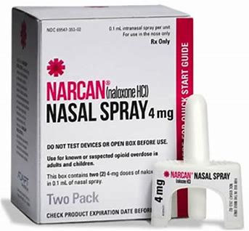
Naloxone (Narcan)
Following an opioid detox or a period of abstinence, a client is at higher risk for overdose as their tolerance has decreased:
Prescription medication that reverses an opioid overdose.
Can be obtained at pharmacies throughout CT without a doctor’s prescription and is covered by many insurance plans.
Should be on hand where individuals with an opioid use disorder may be.
Connections to ensure clients leave services with a kit in hand.
Notes:
Overdose prevention education and access to Naloxone is a key component to treating individuals with SUD, including pregnant individuals
Educate family members and natural supports as well
Giving someone a Narcan kit is only part of a conversation. Really need to use safe use strategy and a safe use strategies. It can feel uncomfortable for some to have these conversations, as it can feel like we are encouraging people to use, but utilizing harm reduction strategies can be lifesaving.
NARCAN is safe for pregnant women

Slide 21

DMHAS Women’s Services Program Oversight
Annual on-site reviews which includes:
  Trauma & Gender Fidelity Review
  Clinical Chart Review
  Client Focus Group
  Leadership Interview
  Physical environment evaluation
  Policy Review
Ongoing on-site technical assistance on new initiatives and best practices
Regular learning collaborative meetings
Critical Incident Monitoring and Support
Notes:
Our charge is working in collaboration with these providers. There is a lot of technical assistance and training provided to ensure programs are getting the best services possible. An essential part of monitoring process is soliciting feedback from women and birthing persons receiving the services.

Slide 22
One Key Question
DMHAS Women’s Services has an ongoing commitment to providing comprehensive and inclusive reproductive health education
Collaboration with Power to Decide, March of Dimes, Planned Parenthood, Every Woman CT and the CT Women’s Consortium to develop an interdisciplinary team to support ongoing integration and sustainability of comprehensive, empowering reproductive health care throughout the system of care
Team comprised of state partners to provide ongoing reproductive health training and technical assistance

Slide 23
CAPTA and Family Care Plan 101
CAPTA: Child Abuse Prevention and Treatment Act​
Federal legislation addressing child abuse neglect across the United States​
FCP: Family Care Plan (formally Plan of Safe Care)
Addresses the health and treatment needs of the mother/birthing person, infant and significant others
Originally enacted in 1974, reauthorized in 2010, amended in 2016 by Comprehensive Addiction Recovery Act (CARA)
Requires hospitals to report data on infants born prenatally exposed to substances and for FCP implementation
March 15, 2019: CT legislation goes into effect - birthing hospitals submit a notification to the CAPTA Portal
Substance exposure alone is NOT grounds for 136
Ideally developed early in pregnancy, but may be developed at the hospital after birth
FCP are a key component of the notification process
If a FCP cannot be verified or created, the portal will direct the reporter to a (potentially avoidable) 136 track

Slide 24











PARTNERSHIP
Notes:
Between:​
Persons with lived experience,​
Moms,​
Partners/Families, ​
Health care providers,​
Social Workers, ​
& Key Providers: ​

Slide 25

CT Definition of Infant Born Substance Exposed for Notification Purposes
1. Newborn exposed in utero to:
Methadone
Buprenorphine
Prescription Opioids
Marijuana
Cocaine
PCP
Prescription Benzodiazepines
Other illegal/non-prescribed medication, and/or the misuse of prescription/over the counter medication
2. Newborn with withdrawal symptoms
3. Diagnosed with Fetal Alcohol Syndrome
Notes:
Connecticut defined infants born substance exposed to include three sets of conditions.
1) exposure during pregnancy to any of these substances or conditions: methadone, buprenorphine, prescription opioids, marijuana, cocaine, PCP, prescription benzodiazepines, alcohol, other illegal/non-prescribed medication, and/or the misuse of prescription/over the counter medication.
2) This includes infant born substance exposed includes a newborn with withdrawal symptoms.
3) diagnosed with Fetal Alcohol Syndrome. (recognizing this would be rare, but it is in the federal legislation.

Slide 26

The difference between a report and notification?
  A DCF report or referral, sometimes called a 136, occurs when anyone has concerns about the safety of a child. They report their concerns to the DCF Careline. DCF will then make a decision if the referral meets criteria for acceptance.
  A CAPTA notification to DCF occurs when a newborn baby has been born after being exposed to certain substances (because the mom/birthing person used substances during pregnancy) but there are no other concerns about safety & Family Care Plan has been developed. A notification does not contain any identifying information about the birthing person or their baby.
Notes:
Important slide:
A report and notification are different.
The “136” or contact to the Careline is the same: when there are concerns of abuse or neglect.
A CAPTA notification is De-IDENTIFIED data (no names, etc). It is data collection to help us to build a system that meets the needs of infants and families in CT.
Just because a person is using substances does not mean that they are not able to safely parent their child. As we discussed earlier about stigma, a lot of times we make assumptions about people’s ability to safely parent. We have resources in place to support people where they are at in the recovery journey.

Slide 27
Educating & Empowering Women/Birthing Persons
It is important that all pregnant women/birthing persons are educated on the CAPTA legislation early in their pregnancy and talk through how it might impact their delivery
  This provides an opportunity for providers to give correct information;
  To dispel myths and talk through fears;
  To allow for behavioral change around use;
  To help explore their support system and begin to think about what mom/birthing person will need to be successful
  Begin to develop the Family Care Plan

Slide 28

Best case scenario
Woman/Birthing Person learns of their pregnancy
  Connects with community provider
    Explores their intention around the pregnancy
    Receives education around CAPTA & Family Care Plan
    Explores intention around their use
      Develop plan to support, refer for MOUD/MAT & other services
    Identifies team who will support their FCP’s
    Signs ROIs to support communication
  Develops Family Care Plan (FCP)
    Modifies plan over time as situation or recovery needs may change or evolve
    Don’t assume another provider has taken the lead
  Shares FCP
    With partner, family members, providers, support network, etc.
    Ensures medical team is aware/ NAS consult
    Copy of plan is included in record and available to hospital in advance

Slide 29

DMHAS – Women’s Services
To learn more about DMHAS programs and services visit our website:
Women's and Children's Services (ct.gov)

Slide 30
What?
Notes:
Alison – what? Continuum of care, intersectionality between nonprofits and state agencies, relationships and partnerships in community (hospital) ; brief program descriptions

Slide 31
Brief History of Women and Substance Use
Traditional substance use treatment programs were made based on research about addiction and men.
Did not take into consideration the gender difference of women
Focus was on substance itself and finding recovery for it
Did NOT treat factors like trauma, abuse and violence
Women have often experienced greater levels of stigmatization around substance use as a results of their traditional societal roles as mothers, caregivers and often the central organizing factor in their family units
Notes:
Focused solely on substance use and “stopping” that behavior; didn’t take a hard look at the multi-layered factors – trauma, abuse, violence, family of origin, childhood experiences etc.

Slide 32
Barriers to Treatment
Inadequate/nonexistent rural public transportation systems exacerbate the issue of insufficient treatment facilities by making it difficult for residents to reach them.
Women often have lack of access to childcare services, discouraging attendance or even preventing treatment entry
70% of women entering addiction treatment have children. Women entering treatment are more likely to have primary responsibility for their children
Women cite being responsible for the childcare as one of the biggest barriers to entering treatment
Women with children may also be hesitant to seek treatment for fear of legal action and social service involvement.
Notes:
https://www.recoveryanswers.org/resource/women-in-recovery/

Slide 33

Tonier Cane
Notes:
Tonier Cane – 1:17 – 5:27

Slide 34
Engagement
Engagement, what happens at the start of any relationship – therapeutic or otherwise – sets the stage for the work to come.
Can this person trust you?
Do they feel heard?
Do they believe you have their best interest at heart?
While this might seem basic, the lack of solid relationship and mutually agreed-upon goals can lead to ineffective and failed treatments
Notes:
Can’t gloss over engagement
When pressed for time, and there are many pressures from various agencies, we may want to get to a solution quickly…but most important is trust
We know that persons with SUD and Co-Occurring d/o’s have been highly stigmatized and in many cases have experienced trauma as a result of the judgmental attitudes and beliefs they have encountered when trying to seek help. So the way we engage in these conversations is so important. If we use an empathetic lens we are able to connect more effectively and increase the likelihood that someone will feel safe to accept help or seek help again in the future.

Slide 35
Connecticut Continuum of Care
Notes:
Focus on Connection Specific programs
The Connection LOC; our role in the continuum

Slide 36
Pregnant and Parenting: Residential
3.5 PPW:
24/7 staff support, 20 hours of in-house clinical services; psychoeducation, peer services, psychiatric services, integration of substance use and prenatal services; linkages to programs for infants and children with prenatal exposure to drugs and alcohol; Pregnant and parenting women must be granted priority access within 48 hours of their request for treatment
3.3 WRSP:
24/7 staff support, step-down program where pregnant/parenting persons are required to participate in community treatment while living in a safe and structured environment; onsite weekly case management and daily Psychoeducational groups. Prior to transitioning into a WRSP, a discharge meeting will be held with the referring provider, client, relevant community providers, and the WRSP team
Notes:
LOS individualized to each person in treatment and progress towards treatment plan goals and objectives
All female staff
MAT – take home bottles; MOU ROOTS
PROUD Services and collaboration

Slide 37

Women’s Specific Programs
One Key Question
Family Care Plan
Onsite groups
Case Management
Referrals to treatment and community providers
Speakers & Collaborations
Notes:
OKQ – Health History Questionnaire; asking at admission and throughout the course of program
Reproductive Healthcare groups and individual work
Feedback we’ve received on reproductive psychoeducation and how that’s impacted them
Women’s feedback on receiving education; not historically questions/information they've been asked/provided
Building trust and engagement/rapport in order to have these types of discussions – all female staff
Housing needs and linkages ASAP; advocacy

Slide 38

Family Care Plan
Family Care Plan 2022
Notes:
Link to family care plan

Slide 39
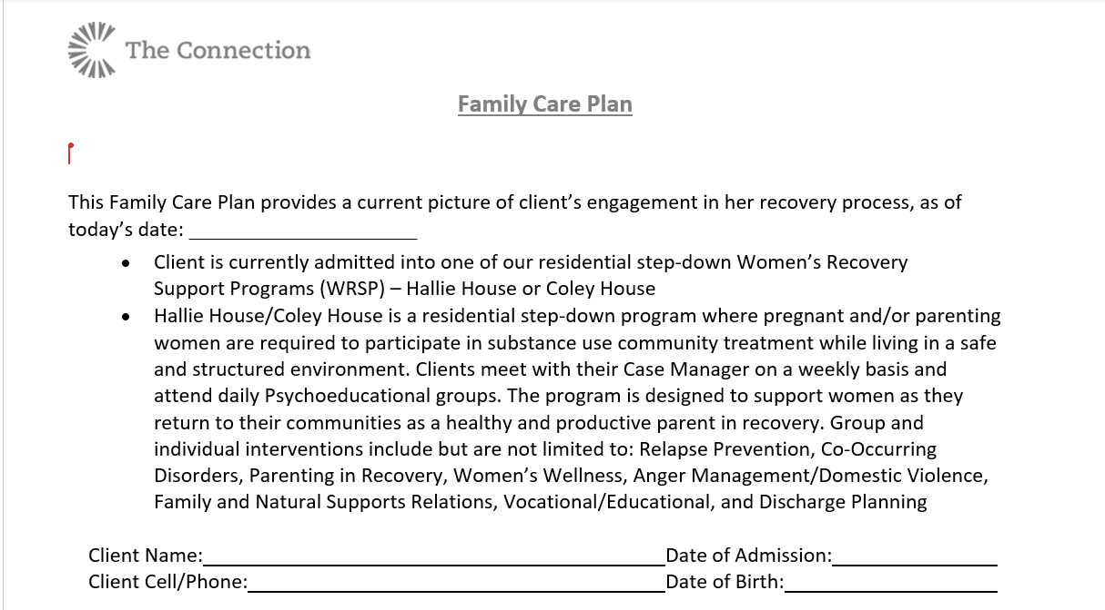

Slide 40
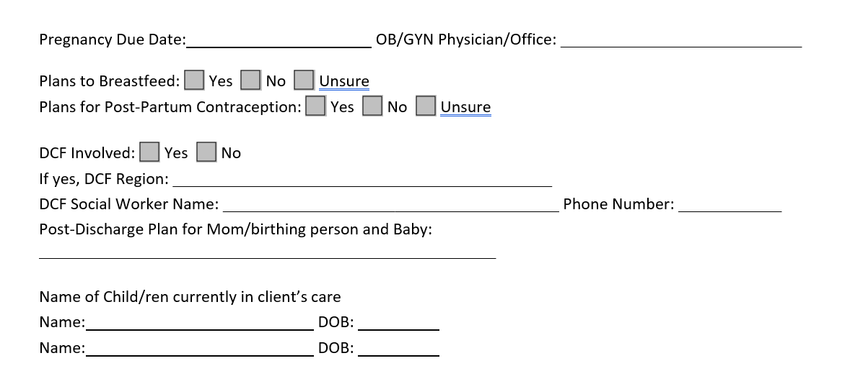

Slide 41
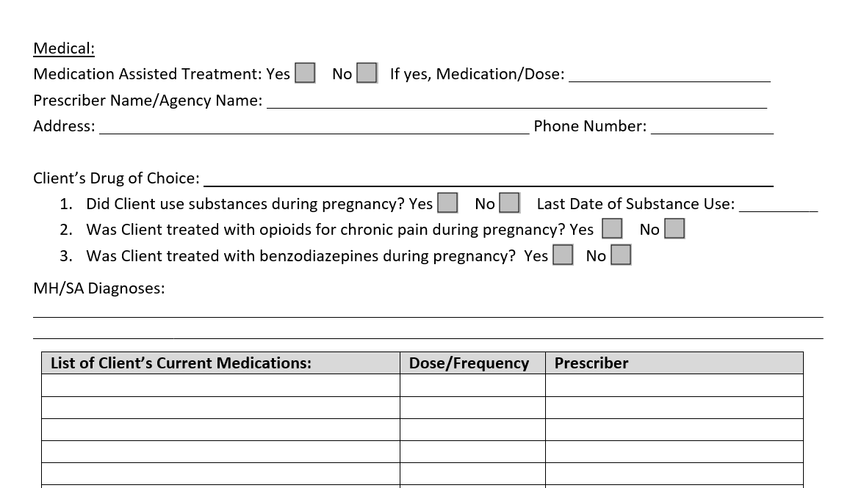

Slide 42
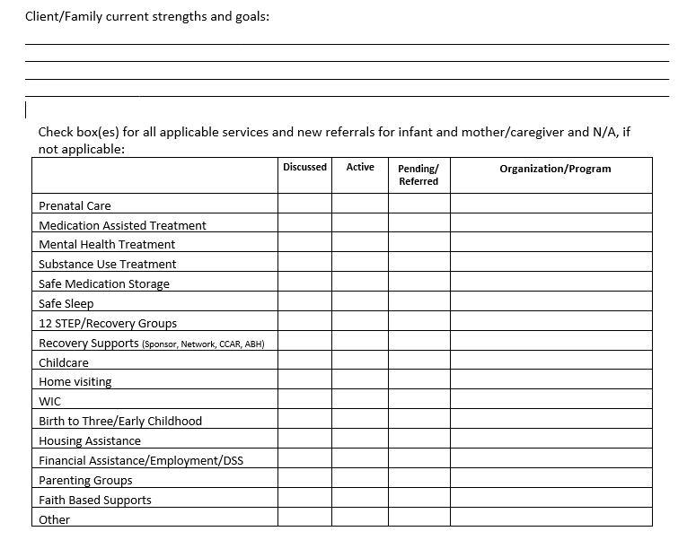

Slide 43
Intensive Outpatient (IOP) & Outpatient
Intensive outpatient programs (IOPs) are treatment programs used to address addictions, depression, eating disorders, or other dependencies that do not require detoxification or round-the-clock supervision.
Outpatient care can involve one or more mental health/substance use services that don't require a prolonged stay in a facility. Treatment provided in Outpatient care helps patients learn to cope with stressors and manage their MH/SA. These services can include counseling, group therapy, medical consultations, and psychiatry
Notes:
Women’s only IOP at CBH
OP women’s groups –Substance Abuse Intervention Group, DBT Group, Trauma Recovery and Empowerment Group
Can attend any services virtually as needed
MAT provider onsite;

Slide 44
Women’s REACH
Women's REACH (Recovery, Engagement, Access, Coaching & Healing) program provides statewide integration of 15 Recovery Navigators
The Recovery Navigators are women who can use their own personal recovery journey to help others. These women use recovery coaching techniques and case management services to support women in their community.
Services are prioritized for pregnant or parenting women with substance use or co-occurring disorders. Based on an outreach and engagement model, female recovery navigator develop collaborative relationships with local community-based programs and providers within the medical and behavioral health community
The recovery navigators work within their respective communities to engage women needing access to care to increase real time engagement with treatment and support the development of an individualized recovery support network.
These navigators have a key role in the development and support of individualized plans of safe care, in line with state and federal CAPTA legislation.

Slide 45

SHF Program
A child welfare program providing intensive case management, vocational supports, and temporary housing subsidies to families that are homeless or at risk of homelessness in order to support the achievement of family reunification and/or prevent the removal of children from their families.

Slide 46

Women’s Community Transition Support Program
This service provides community-based case management services to women exiting the women and children’s substance abuse treatment continuum of case. Case management services to center around independent living, linkages to treatment, vocational assistance, budgeting and tenancy skills, and securing stable housing.
Notes:
Provider experience; Women’s Community Transition Support Program; SHF

Slide 47
Intersectionality
Collaborative reoccurring meetings between residential programs and Department of Children and Families
Weekly meetings between WRSP and Department of Mental Health and Addiction Services
Intersectionality between DMHAS, DPH and residential providers
Perinatal Health Committee; providers in collaboration with local hospital
Women’s Services Practice Improvement Collaborative (WSPIC)
Trauma and Gender Initiative (TAG)

Slide 48
Community Partners
PHC
OBGYN
PCP
Dental
Behavioral Health
MAT
Peer Services

Slide 49
How?
Notes:
Kathy; takeaways from a nonprofit perspective as to how we can work together with state agencies and create opp for growth; overall system growth
TCI partnered with various state entities to create programs over time

Slide 50

How do we create opportunity and system growth as a non-profit?
Knowledge
Courage
Creativity
Relationships

Slide 51
Knowledge
Know
Know your organizational strengths and areas of expertise
Study
Study the broader system in which the program or your organization falls
Understand
Understand the strengths and gaps of the system and conceptualize how your expertise can provide solutions

Slide 52
Relationships
Develop relationships and trust
Invite law makers, funders to visit and see what you do
Understand perspectives and role
Request or schedule meetings with key people so relationships are maintained
Target your proposal to help solve a funder problem
Solve the system gaps or weaknesses

Slide 53

Creativity
We need to create collaborative systems which encourage creative thinking
  How do you identify the right people and create a safe space for the right people to be wildly creative and hash things out?
  Reinforce and reward creativity in your organization
Notes:
Internal; creating the space for open dialogue
Seat at the table; internal → external
Constraints of both systems
Creativity and flexibility
Ability to produce and think in the moment (provide info as needed)

Slide 54

Courageousness
  Embody and encourage the “we can do” attitude in your organization
  Take risks
    Use pilot programs to your advantage
  Value courage
Notes:
Part of our mission/vision
Courage of clients, ourselves
Value courage in our org and taking risks
Pilot programs, unfunded, ran for a year and then became funded following data support; demonstration
How to embody “we can do” from an org perspective; staff feel empowered and encouraged to do

Slide 55
WHERE DO WE GO FROM HERE?
Notes:
Relationships are core; how to engage nonprofits partners/funders etc.
Needs assessment, strengths as org, system gaps,
Platform for this

Slide 56
Next Steps:
Perform assessment of your organization and the unique skills and strengths that you have
Identify the key people in your system who you want to have at the table as creative partners
Pinpoint system gaps and strengths for target service area
Cultivate and reinforce relationships with key stakeholders and funders

Slide 57
The Connection Inc.
Kathy Savino (she/her), Psy.D, Chief Operating Officer, ksavino@theconnectioninc.org
Alison Friar (she/her), LMFT, Vice President of Family Support Services, aefriar@theconnectioninc.org
Department of Mental Health and Addiction Services
Shelly Nolan (she/her), MS, LPC, Director of Women’s Services, Shelly.Nolan@ct.gov
Rebecca Petersen (she/her), LCSW, Behavioral Health Program Manager, Rebecca.Petersen@ct.gov

Slide 58
thank you!

