Slide 1
Authentic Child and Youth Engagement in Program Planning and Implementation: How to Practice What We Preach

Slide 2
Quality Improvement Center Engaging Youth
Is charged with advancing child welfare programs and practice to ensure that children and youth are authentically engaged and empowered, especially in relation to permanency decisions.
Focuses efforts on legal, cultural and relational permanency.
Will support intentional policy, practice and culture shifts in 6-8 pilot sites, including two tribal nations.
Is committed to engaging youth voice in all aspects of the work.

Slide 3
QIC-EY Partners
Collaborative five-year grant funded by the Children’s Bureau that started October 2021:
Spaulding for Children
University of Washington
University of Nebraska at Lincoln
NACAC
New England Association of Child Welfare Commissioners and Directors

Slide 4
Addressing the Problem
Despite the express desire of children and youth and their right to have a say in decision that impact them, child welfare has neither historically nor currently centered on youth voice or engagement.
Studies show that, children and youth in foster care felt that they had have, “limited opportunities to be involved in important decisions about their lives, such where they live and when and how often they see their parents.”
When given opportunities, youth reported that they felt unprepared, confused, voiceless, and lacking an influence on decisions being made.
Imbalance of power where professionals have most and decide “what is best”, and children have little power and no opportunity to collaborate to determine what will help them thrive.

Slide 5
National Youth Engagement Advisory Council
Convenes to ensure that youth voice is amplified in the activities of the QIC-EY.
Comprised of 10 youth serving agencies from across the country.
Members provide both personal and professional expertise to the QIC-EY to promote systemic change ensuring children and youth are recognized as competent, knowledgeable parties who deserve to have input and decision-making power about their lives.
Florida Youth Shine | Three Precious Miracles
Foster Care Alumni Association | Yakama Nation
National Foster Youth Institute | You Gotta Believe
New England Youth Coalition | Youth Villages
Think of Us | FosterClub

Slide 6
Work of the National Youth Engagement Advisory Council
Actively participated in an environmental scan to identify promising child and youth engagement practices and programs
Identified barriers to authentic engagement of children and youth and generate strategies to increase engagement
“Massive turn over in child welfare makes it hard for workers to really have engagement with youth. They often switch plans and start from scratch every time a new worker starts a case. Worker turnover is a huge barrier. This impacts trust and causes many things to start again from the beginning. Hard to engage well with youth when you don’t have a stable work force.” Council Member

Slide 7
Work of the National Youth Engagement Advisory Council
Participate in Delphi Review to identify content for workforce training and coaching modules
Co-develop content and participated in videos that are a part of the training for child welfare workforce
Co-develop Child and Youth Engagement Orientation Packet and Process

Slide 8
What is Authentic Child and Youth Engagement?
Authentic engagement means actively and intentionally partnering with children and youth about their lives, on their terms, in ways that make sense to them. To authentically engage children and youth, child welfare professionals must:
be committed, flexible, self-aware, and open to shared decision-making;
use strong communication skills to build trusting relationships with children and youth;
be guided by knowledge of child and adolescent development and trauma-informed care;
use a strength-based approach;
have a vivid self-awareness of potential power dynamics;
have cultural humility; and
partner with, prepare, inform, and advocate for children and youth.

Slide 9
Common Themes Elevated by National Youth Engagement Advisory Council
Child Welfare Workforce and Court Personnel can engage youth authentically by:
Enhancing communication and listening skills
Preparing children and youth for permanency as early as possible
Utilizing Family Finding
Maintaining community connections
Supporting culture and identity
Redefining kinship to include family friends and other supportive adults
Expanding and enforcing visitation policies
Acknowledging power dynamics

Slide 10
Workforce Literature Review
Goal: To identify the essential characteristics and competencies of youth engagement workers
“Being a person in academia, it’s intertwined. I saw my voice mixed with the literature.” Council Member

Slide 11
Literature ReviewArticle Inclusion Process
1104 articles identified through database searching
15 articles identified through other sources
Inclusion criteria:
Published after 1980
English
Full text available online
Discussed how staff promote youth engagement in planning efforts or activities
1119 total articles identified
981 articles excluded (752 during title review, 229 after full article review)
138 articles coded for analysis (81 experimental, 57 gray literature)

Slide 12
Final Themes
Competencies | Characteristics | Court
Partnering with youth | Committed | Preparing youth for court
Communication and listening | Flexible | Open communication
Building trusting relationships | Self-aware | Active listening
Strength-based approach | Authentic* | Providing extra time
Preparing and informing youth | Empathetic* | Encouraging youth participation
Advocating for youth Cultural humility Trauma informed care |  | Accommodate youth attendance at court
Knowledge of adolescent development
 | *identified by Workforce Council

Slide 13
Delphi Review
The child welfare Delphi review was conducted with 11 caseworkers, 20 child welfare supervisors and administrators, 13 trainers, and 29 people with lived expertise all who left the child welfare system in various ways (reunification, guardianship, adoption, aged out), ages 18-30, from 17 states ranked each of the themes to determine the most important training themes to be prioritized and included in the development of a 12 hour, modular-based curricula designed to increase knowledge and attitudes related to child and youth engagement for child welfare staff. The child welfare Delphi was conducted using an online survey.
A live Delphi review was also completed with 27 people with lived expertise in the child welfare system, representing 18 states, to rank the most important themes for a court training for legal professionals. The court Delphi review was conducted virtually through a zoom platform and offered an innovative and interactive approach to curriculum development that centered the voices of lived experts in program planning efforts.

Slide 14
Child Welfare Training Modules
Art of Engaging Children and Youth (Foundational)
Benefits of Child and Youth Engagement (Foundational)
Characteristics and Competencies that are Important to Authentically Engage with Children and Youth (Foundational)
Respecting, Responding and Maintaining Connections and Cultural Strengths
Permanency Planning and Engagement
Inform and Prepare Children and Youth Transitions
Trauma’s Impact on Children and Youth Engagement
Child and Youth-Adult Partnership and Shared Decision Making
Sexual Orientation, Gender Identity and Affirming Engagement
Having Difficult and Sensitive Conversations
Interpersonal Communication Skills
Supporting Child and Youth Voice

Slide 15
Court Training Modules
Module 1: Child and Youth Engagement for Legal Professionals focuses on research findings and national best practices. It invites learners to reflect on their own beliefs and professional roles in this work.
Module 2: Trauma, Grief and Loss is dedicated to building empathy in the learner by increasing understanding of the impact of trauma, grief and loss on children and youth. It includes lessons about trauma-informed practices that can help to promote engagement.
Module 3: Adolescent Brain Development and Effective Interpersonal Communication elevates the learner’s knowledge of child development and adolescent brain science. It explains techniques to improve communication styles based on developmental stages and the use of age-appropriate language in legal settings.
Module 4: Maximizing Child and Youth Participation in Court provides concrete tips to improve child and youth engagement before, during and after court hearings.
Module 5: Walk the Walk-Engaging Children and Youth in Court to Improve Outcomes and Experiences summarizes and synthesizes the key learning objectives of the training and guides the learner in applying these skills to a hypothetical case scenario.

Slide 16
“
When you're alone, or you feel like you're alone, it's all the difference in the world to have somebody be there with you and hear you.
“

Slide 17
Voices of Lived Expertise

Slide 18
WORK WITH PILOT SITES
Hawaii
Michigan
Montana
Yakama Nation
Rhode Island
Oklahoma Southern Plains Consortium
Nebraska
A child welfare training and coaching model
An authentic youth engagement model
Systemic changes
A court training

Slide 19
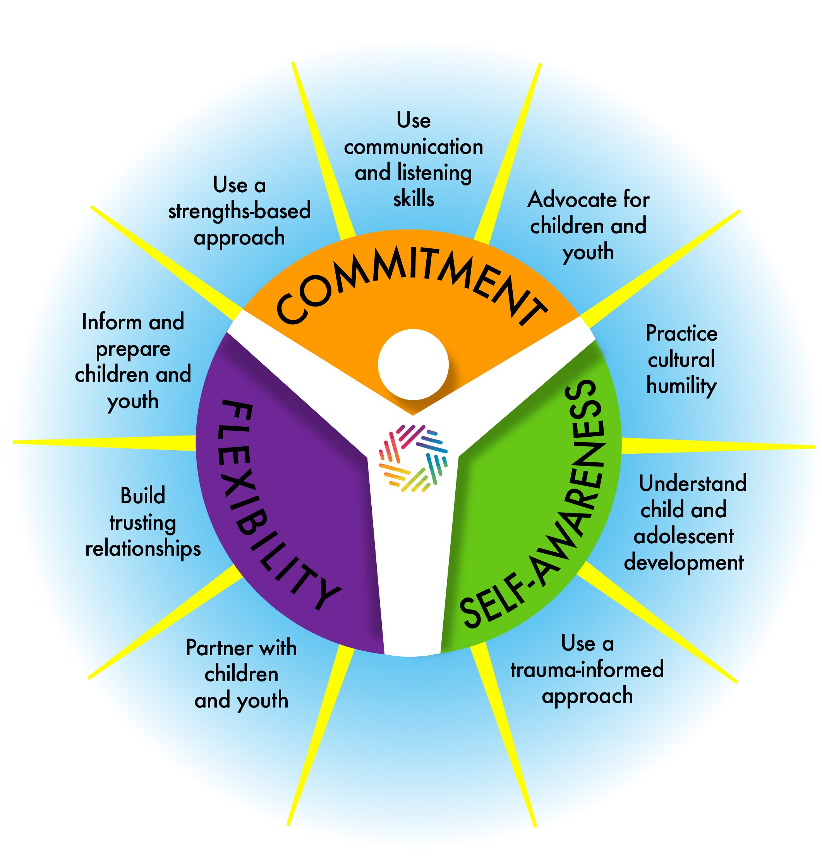
What is Available Now
Literature Review
Barriers to Authentic Youth Engagement in Permanency Planning
State Survey
Expert Interviews
Catalog of a curated list of programs, frameworks, and training curriculum that support the promotion of youth-adult partnerships in child welfare systems
https://qic-ey.org

Slide 20
What We Learned from Council Members
“Balance of young and older lived experience voices and looking at things together.”
“Shared goals for bringing group together.”
“This is the biggest thing I’ve ever been a part of.” Council Member
“Stuff I learned form the council I use with other people in my work.” Council Member
Love being part of group with people from other states, “got to hear how other states are doing things, other than the state that I’m from.” Council Member
“I feel heard in this journey. I have space to say what I actually want to say. We have power and leverage here.” Council Member
“I love emails about the products, I love the updates.” Council Member
“everyone is really engaged in the process. We get to see that what we are doing is making a difference.” Council Member

Slide 21
Child and Youth Engagement Coordinator Orientation Packet
Council Letter to CYEC
Considerations for Creating a Team of Lived Expertise
Orientation and TA Guide
Pilot Site Assessment of Youth Engagement
Team Charter Template
Compensation Guidelines

Slide 22
Questions for Us?
Dr. Angelique Day dayangel@uw.edu
Tawanna Brown tawannabrown.impact@gmail.com
Phoenix Santiago psantiago@bakercenter.org

