Slide 1
School-Based Mental Health: The Why, The How, & The Best Practices
Brittney Walters, LCSW
CHRIS 180
Atlanta, Georgia
2023 CWLA Conference

Slide 2
Introduction
Brittney joined CHRIS 180 in 2017 and brings a diversified background of mental health experience to our leadership team. She is a Licensed Clinical Social Worker and earned both her Bachelor of Science in Child and Family Development and her Master of Social Work degrees at the University of Georgia (UGA). It was at UGA where she also obtained a graduate certificate in Marriage and Family Therapy. Brittney has extensive experience working with Community Service Boards across the state, as well as the Psychiatric Residential Treatment Facility (PRTF) level of care. Brittney’s areas of expertise include acute and chronic psychiatric disorders, complex trauma backgrounds, co-occurring developmental disabilities, crisis intervention, and Autism Spectrum Disorder.
From 2017-2020, Brittney served as our Clinical Director of our Atlanta CHRIS Counseling Center in addition to supervising our Drop-In Center for young adults at risk of or experiencing homelessness, our Permanent Supportive Housing Program (TransitionZ), and our Integrated Health Clinic. It was this vigorous growth and experience as a CHRIS 180 leader that positioned Brittney well to shift to supervising our school-based division in the summer of 2020. Brittney operates as CHRIS 180’s representative for the Georgia Alliance of Therapeutic Services (GATS), currently serving in the nominated role of Vice Chair for a second term. She is frequently called upon to speak on panels with reputable organizations, a few of whom include The Atlanta Women’s Foundation, Georgia Pacific, and The Fulton-Dekalb Hospital Authority. Brittney is honored to work with a robust, dynamic team of clinical professionals as they lead the charge for providing quality trauma-informed services within our school communities. She aims to ensure that barriers are broken down and access to care is increased for all individuals, with the goal of providing the highest quality mental health services and supports possible. With an eye for strategy, a solution-focused approach, and a trauma-informed style of supervision and accountability, Brittney continues to expand our partnerships and relationships within the academic realm of Metro Atlanta.

Slide 3
Training Objectives
Present data surrounding the importance of making school-based mental health services more readily available to academic communities.
Explore how organizations can secure funding from a variety of entities, create a diversified partnership landscape, utilize best practices for service delivery, and implement trauma-informed training into the school-based mental health model.
Seek to gain a deeper understanding of what school-based mental health can and should look like, specifically addressing post-pandemic effects on children.
Learn about best practices around service delivery in non-traditional settings and how implementing training and support opportunities for school staff can help create more trauma-informed, sustainable school environments.

Slide 4
Agenda
Introduction
STATISTICS
HISTORY OF SBMH
Our Model
Diversified Funding
Summary

Slide 5
Statistics
ADHD, anxiety problems, behavior problems, and depression are the most commonly diagnosed mental disorders in children. Estimates for ever having a diagnosis among children aged 3-17 years, in 2016-19, are given below.
ADHD 9.8% (approximately 6.0 million)
Anxiety 9.4% (approximately 5.8 million)
Behavior problems 8.9% (approximately 5.5 million)
Depression 4.4% (approximately 2.7 million)
For adolescents, depression, substance use and suicide are important concerns. Among adolescents aged 12-17 years in 2018-2019 reporting on the past year:
15.1% had a major depressive episode.
36.7% had persistent feelings of sadness or hopelessness.
4.1% had a substance use disorder.
1.6% had an alcohol use disorder.
3.2% had an illicit drug use disorder.
18.8% seriously considered attempting suicide.
15.7% made a suicide plan.
8.9% attempted suicide.
2.5% made a suicide attempt requiring medical treatment.
CDC.gov

Slide 6
In 2016, 1 in 6 U.S. children aged 2–8 years (17.4%) had a diagnosed mental, behavioral, or developmental disorder. (CDC.gov)
Nationwide, over one-third of school districts use school or district staff to provide mental health services, and over one-fourth used outside agencies to provide mental health services in the schools (youth.gov)
The Center for Mental Health in Schools estimates that between 12 and 22 percent of school-aged children and youth have a diagnosable mental health disorder (youth.gov)

Slide 7
What words come to mind?
Notes:
What words come to mind when you hear school-based mental health?

Slide 8
History of SBMH
1890-1930: Progressive Era
Period local, state, and national reform
Complete shifts in philosophies around education and child-rearing
Enrollment was higher (child labor laws)
“Matters of the home” shifted to school responsibility, too (health, recreation, mental hygiene)
4 basic educational challenges arose
More students attended schools (or were supposed to) and they were not ready to learn
Presence of these students increased discipline challenges
Cultural disconnect between new school philosophy and educators
The failure to educate these students posed a public health and social control problem
Flaherty, L.T., Osher, D. (2003)

Slide 9
Fixing Schools vs. Fixing Students
Two schools of thought
Fixing Schools:
Transform the educational approach and the results will follow
Responsibility to ensure culture supports learning
Creation of classroom settings that promoted mental health
Fixing Students
Identify the students who have challenges and get them help
Treat them outside of school before they return to school
Flaherty, L.T., Osher, D. (2003).

Slide 10
Especially prevalent through changes made to Special Education
“An Experiment in Discipline” in San Francisco → Deportment Class
Special education classrooms designed for those with intellectual disabilities to achieve their highest potential – were now being filled with students that exhibited behavioral issues.
Flaherty, L.T., Osher, D. (2003).
Notes:
Tension continued to rise between the different groups
Deportment class – principal in san Francisco – created for students “of such a type”

Slide 11
Systems of Care
Became a household term in the field during the 1980’s
The idea of implementing plans to address a child’s physical, emotional, social, educational, and family needs
Teams included family advocates and representatives from mental health, health, education, child welfare, juvenile justice, vocational rehab, recreation, substance use, and other disciplines as indicated.

Slide 12
Full-Service Schools
Bring together resources from a variety of disciplines to make an array of services available to students and families
Uses the school as the organizing entity
Goal to create “one stop shop” and replacing fragmented and overlapping systems

Slide 13
First school nurses – New York City around 1905. By 1996 – 40,000 RN’s working in the 82,000 public schools in the U.S.
First school psychologist was statewide for Connecticut – 1915
Guidance Counselors – 1900-1950 – predominantly focused on vocational assessments
School Counselors – in 1950’s guidance counselors shifted their focus from vocational to an approach that “integrated issues of personality and human development”
Social Workers – were called “visiting teachers” prior to 1920. These are the individuals that became School Social Workers between 1920 and 1930.
Special Education Teachers – 1960s – the field of behavior disorders moved away from psychodynamic approaches that focused on internal conflict and moved toward development of psychoeducational and behavior management skills.
Flaherty, L.T., Osher, D. (2003)

Slide 14
School-Based Mental Health Today
Providing traditional forms of treatment in the school setting
Reducing barriers and increases access for students and families
Varies based on a tiered system (I, II, III)
Offers the Clinician the ability to directly observe behaviors in the natural setting they are occurring
Encompasses the client’s support system at school and in other settings
Helps to address the whole child

Slide 15
Develop evidence-based programs to provide positive school climate and promote student skills in dealing with bullying and conflicts, solving problems, developing healthy peer relationships, engaging in activities to prevent suicide and substance use, and so on.
Develop early intervention services for students in need of additional supports such as skill groups to deal with grief, anger, anxiety, sadness, etc.
Develop treatment programs and services that address the various mental health needs of students.
Develop student and family supports and resources.
Develop a school culture in which teachers and other student support staff are trained to recognize the early warning signs of mental health issues with students.
Develop a referral process to ensure that all students have equal access to services and supports.
Youth.gov

Slide 16
Georgia’s Tiered System
Tier I: prevention for all students (example: SEL curriculum)
Tier II: focus on students identified through screening as underperforming or at risk for learning/behavioral challenges . Typically involves some fidelity measuring (example: referral to CHRIS 180, IEP)
Tier III: focus on students who have not responded positively to T1 or T2 interventions. Often involve daily, intensive services
GA Dept of Education, 2019

Slide 17
SBMH at CHRIS 180
First school-based partnership was established in 2013
By 2017, we were partnered with 24 schools
Currently partnered with 76 schools (and counting!)
Schools are within 4 districts in the Metro-Atlanta Area
Diversified funding landscape

Slide 18
A little about us…

Slide 19
Our Model
Sets us apart from other organizations in our area
Fully embedded model
Therapist has an office in the school
Reports to the school daily
Is a part of the school community (pep rallies, back to school nights, school events, parent events, community events/resource tables, etc.)
Predominantly provide Tier 2 services, but also able to provide Tier 1 services and act has a support or referral source for Tier 3 needs (wraparound, IOP, PHP)
Emphasis on Trauma-Informed Training for school personnel
Strategic funding decisions that allow us to serve any student at no cost, regardless of legal or insurance status

Slide 20
Our Model Tier II + Tier III Service Delivery
Individual and Family Therapy
Therapy can take place in office or in another confidential setting (playground, basketball court, library, media center)
COVID telehealth relaxations have resulted in better family therapy outcomes (reduced barriers, reduced no-shows)
Emphasis on training our staff in a variety of modalities and approaches
Play therapy
Art therapy
EMDR
CBT
TFCBT
Internal Family Systems
Behavior Modification
DBT
Tier III intervention – treat student referral with standard assessment, staff case, attempt intervention, determine if higher level of care is warranted.

Slide 21
Our Model Tier I Service Delivery
Psychoeducational or Skill-Building Groups (consent is covered under SEL and school forms)
Student groups
Parent groups
Themed events coordinating with various months (i.e. suicide prevention month, ADHD awareness month, etc.)

Slide 22
Our Model Trauma Informed Training
The school is our client
Goal of maximizing the impact of our staff
Teach the school “to fish”
Classroom observation and consultation
Open office hours for teacher support – case staffing, venting, burnout prevention, stress management
Formal trainings on a variety of topics – library of pre-developed content
Ability to create content based on needs of school
Development of “off the shelf” menu options for schools provided at the beginning and throughout the year

Slide 23
Our Model Trauma Informed Training Offerings

Slide 24
Peace Corners
Don’t be afraid to get creative with grant-writing!
Funders want to support out-of-the-box thinking and new, innovative ideas
Peace Corners offer students the ability to self-regulate and safely take a break from stimulus that has either led to or has a high probability of leading to behavioral disruption in the classroom
Vary based on ages
Typically include sensory soothing activities, a peaceful area for students to de-compress or manage intense emotions before returning to group
Reduces out-of-classroom discipline
Empowers the student
Reduces stress on teachers
Eliminates need for ancillary school staff to be pulled away from responsibilities to monitor students in distress

Slide 25
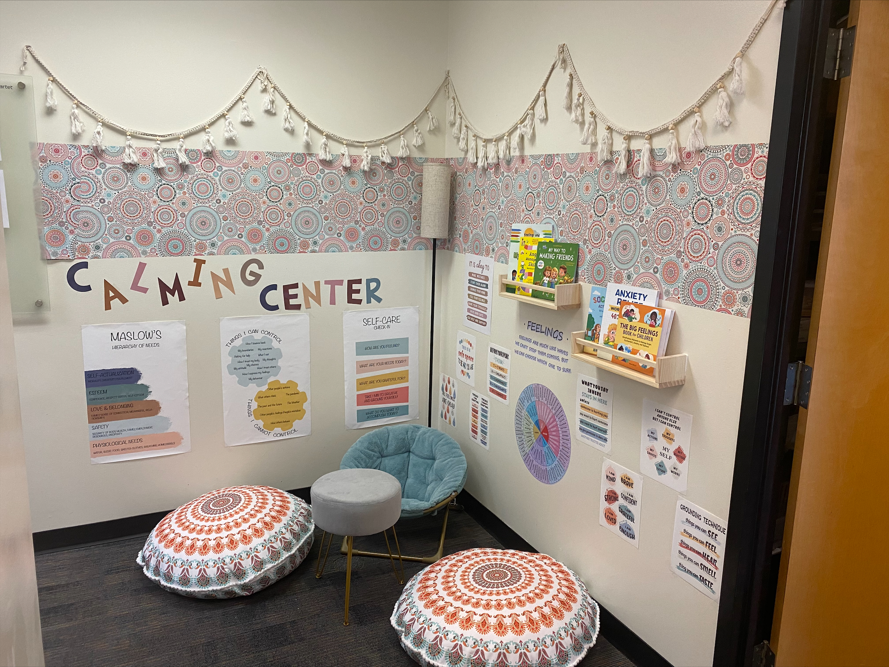
Examples

Slide 26
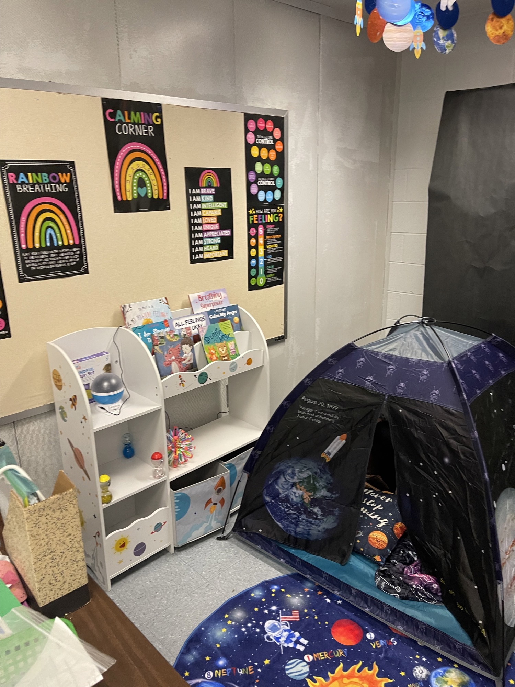
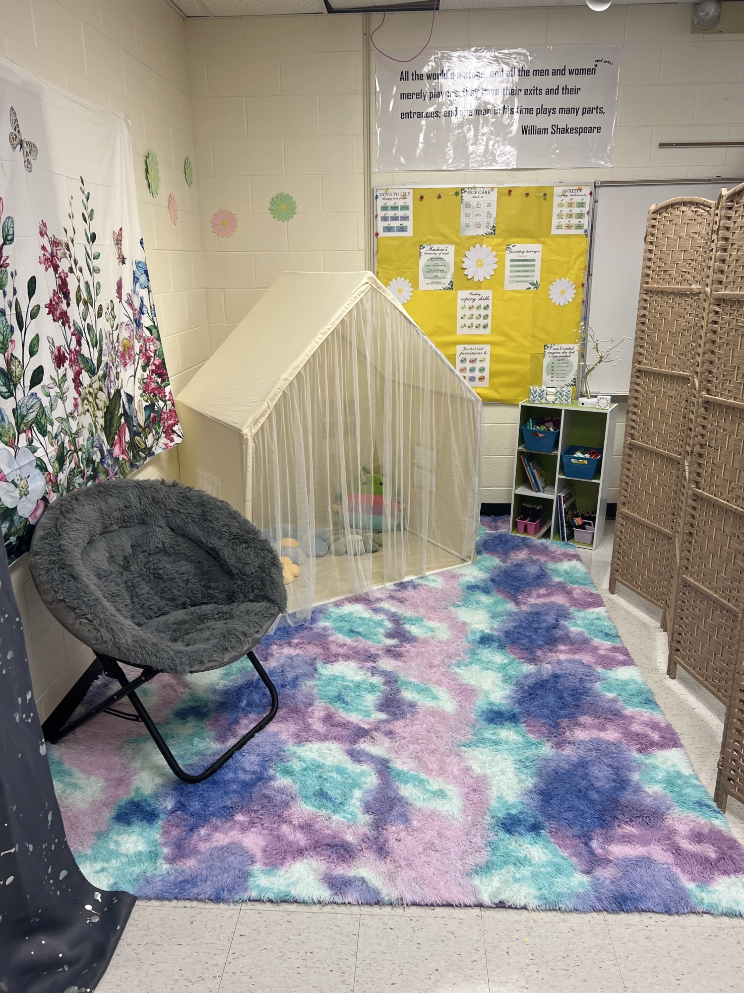
Examples

Slide 27
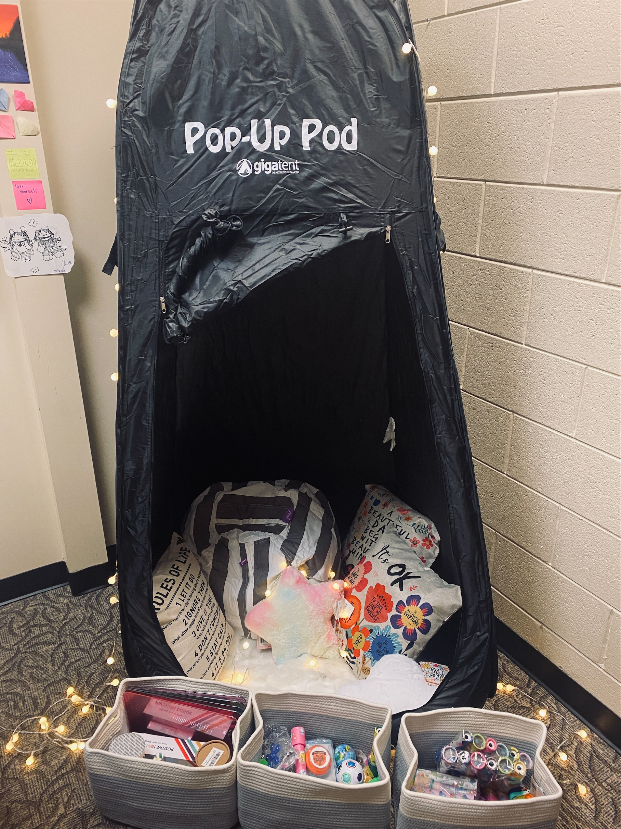
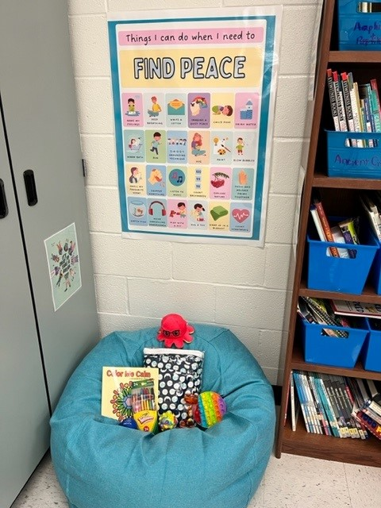
Adaptations

Slide 28
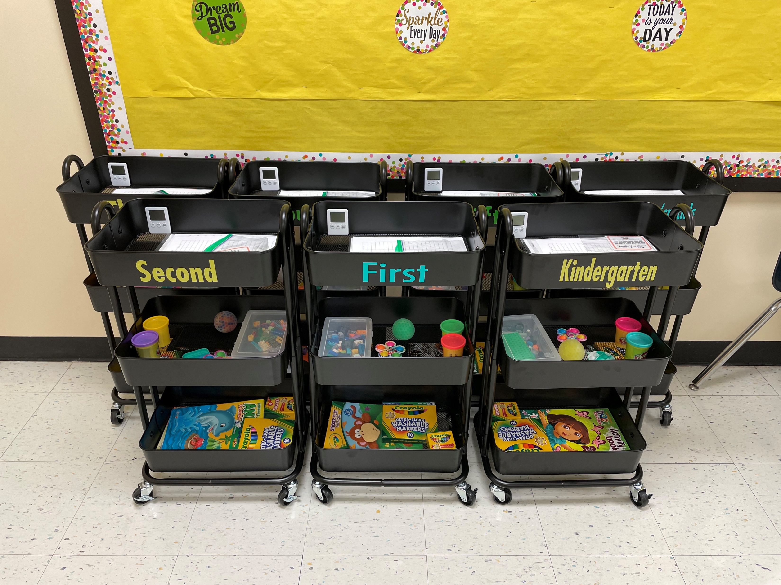
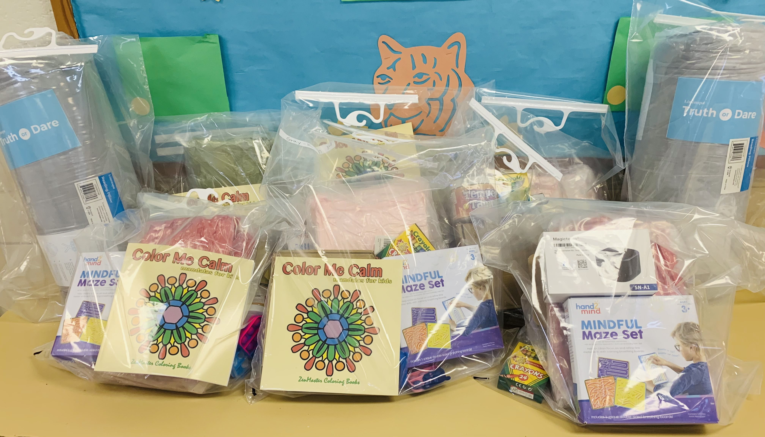
Adaptations

Slide 29
The Importance of Partnerships
Communities in Schools
School Based Health Centers (SBHCs)
Food Pantries
ABA providers
IFI and WRAParound providers
Student Support Office

Slide 30
Funding
Diversity is key!
SBMH Division @ CHRIS 180 currently has 19 different funding streams including state grants, federal grants, district contracts, foundation grants, and private partnerships.
Funding to support serving uninsured, underinsured, or undocumented students is critical and sets us apart from other providers
Linking the above students to Insurance Navigators at time of referral helps work toward sustainability

Slide 31
Summer Opportunities
Our services are provided year-round
Engagement is lower over summer
Supplemental partnerships have helped with financial viability
Summer camp partnerships who pay our billable hourly rate
Offers staff the opportunity to do something different and fun, while also helping our cash flow remain consistent
Creativity keeping our school-based clients engaged over the summer – groups, telehealth appointments, community based appointments
Some schools allow kids to be seen at school over summer
Partnering with summer school staff to coordinate on-site services when kids are already engaged or on-site

Slide 32
Balancing Billables with Deliverables
Be strategic and creative in grant writing
Strategic placement of staff – part time vs. full time schools
Almost always start off at part-time
Grow partnership incrementally as funding allows and as caseload/billable opportunities increase organically
Don’t have Therapists assigned to more than two schools
Be wary of mission-drift even when funding seems lucrative
Ensure leadership infrastructure grows appropriately as school partnerships, grant deliverables, and other responsibilities grow
Provide “billable credit” for grant deliverables and certain non-billable activities (i.e. student group, parent group, back to school nights, teacher trainings and support groups) – this incentivizes people to WANT to do the “extra stuff”

Slide 33
In Summary
Create a model that is client-centered and trauma-informed
Invest in your staff members – without them no product exists!
Don’t be afraid to get creative with grant writing – people love funding things that have never been done before
Diversify your funding streams
Create supplemental programs for summer when engagement is lower
Embed staff into the school community to reduce stigma and increase connection
Ensure infrastructure of leadership grows alongside program growth to ensure adequate supports are in place
Celebrate the wins as a team

Slide 35
Brittney Walters, LCSW CHRIS 180 Brittney.Walters@CHRIS180.org 470-728-1862

Slide 36
References
School Based Mental Health | Youth.gov
Data and Statistics on Children's Mental Health | CDC
Flaherty, L.T., Osher, D. (2003). History of School-Based Mental Health Services in the United States. In: Weist, M.D., Evans, S.W., Lever, N.A. (eds) Handbook of School Mental Health Advancing Practice and Research. Issues in Clinical Child Psychology. Springer, Boston, MA. https://doi.org/10.1007/978-0-387-73313-5_2
Microsoft Word - Document1 (gadoe.org)

