Slide 1
Experts in the Field
How Foster Care Alumni are changing the face of case management
Presented by Jessica Funk & Anthony LaBellarte

Slide 2
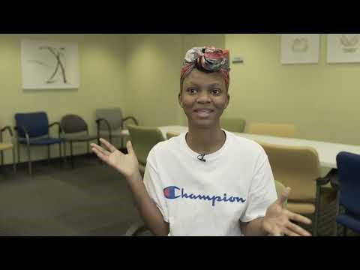
Community Connections Youth Project

Slide 3

What is CCYP?
We are the Community Connections Youth Project (CCYP) at FosterAdopt Connect
We provide aftercare case-management services for current and former foster youth ages 17-26 in the state of Missouri
Notes:
What is CCYP? (Jessica & Anthony)
We are the Community Connections Youth Project (CCYP) at FosterAdopt Connect (Jessica)
We provide aftercare case-management services for current and former foster youth ages 17-26 in the state of Missouri (Anthony)
Our team is comprised of individuals with lived experience (Jessica)
What does that mean?

Slide 4
We are…
Jessica Funk (Independence, Missouri)
  Program Manager
  6 Years
  Bachelor of Arts in Psychology
Anthony LaBellarte (Springfield, Missouri)
  Program Manager
  4 Years
  Bachelor of Arts in Philosophy & Religion
Notes:
Jessica (HQ, Kirksville, & Popular Bluff): 6 Years @ FAC; Started as a Specialist in April (2017) then became PM in March (2018)
Anthony (SWMO): 4 Years @ FAC; Started as Specialist in August (2019) then became PM in August (2020)

Slide 5
Common Definitions & Phrases
Specialist(s)
Domain(s)
Client/Individual
Aged Out
Children’s Division (CD)
Family Support Team Meeting (FST)
Transitional Living Program (TLP)
Lived Experience
Aftercare Case Management
Community Supports/Resources
Notes:
INTERACTIVE PORTION: (#1) Show of Hands Exercise (Anthony)
Who here provides direct services? Who’s at the admin level? Who’s mid-level management?
Definitions & Phrases (Jessica)
Domain
Specialist = Case Manager
Domain =
Client = Individual = Youth | Someone that we are serving or have served aged out left the state foster care system
Aged Out =
TLP: Without obtaining permanency between the ages of 18 and 21 TLP-programs for older youth to prepare them to live independently (it’s the in between – Transitional)
Should be getting life skills during this time CD-Missouri’s child welfare agency FST
When this happens and why?​
Children’s Division =
Family Support Team =
Lived Experience =
Aftercare Case Management =

Slide 6
Key Takeaways
How lived experience plays a vital role in direct services
The importance of trauma-informed approaches when supervising those with lived experience
Identify different tools to provide direct services and supervision
Obtain the knowledge and tools on how to replicate the program through FosterAdopt Connect
Notes:
Anthony Presenting

Slide 7

Where we started…
Founded in 2016 by Nathan Ross
We receive funding through three different streams
  State Funding
  Local Funding
  Fundraising
Notes:
Program History (Jessica)
Founded in 2016 by former foster youth Nathan Ross-program was originally designed to assist aged out foster youth access their Medicaid
We saw gaps where these individuals were not utilizing their primary care physicians or being preventative for their health
We quickly saw that the individuals we were working with were not having their basic needs met
We encountered a lot of homeless youth, unemployed youth, youth that were hungry or in a state of constant crisis
This quickly changed the trajectory of the program and the services we offered
Started out with 2 branches
Funding Information (Anthony)
State Funding: At most FAC locations in Missouri, CCYP operations are largely supported by State funding through our contract with MO Department of Social Services. LINC manages our contract with the Missouri Department of Social Services | They are another non-profit organization that works with state and local government among other businesses within the community – They ensure that we're meeting contract outcomes on behalf of the state
Local Funding: At the Independence facility, we also receive a grant from Jackson County COMBAT (a local anti-drug, anti-violence fund administered by the county – which also funds drug courts and treatment services, but not at FAC)
Fundraising: A small portion of program expenses that can’t be billed to other sources (food, some employee benefits, direct assistance to clients, etc.) will likely be covered with unrestricted funding from various events and campaigns
This tends to be less than 10% of overall program expenses
A note on our contracts:
Both MO DSS and COMBAT are contracts (not grants) and reimburse based on actual costs (not a fee-for-service arrangement like in the BI or clinical programs). In essence: we have to spend the money before we can bill our partners (draw-down revenue)

Slide 8
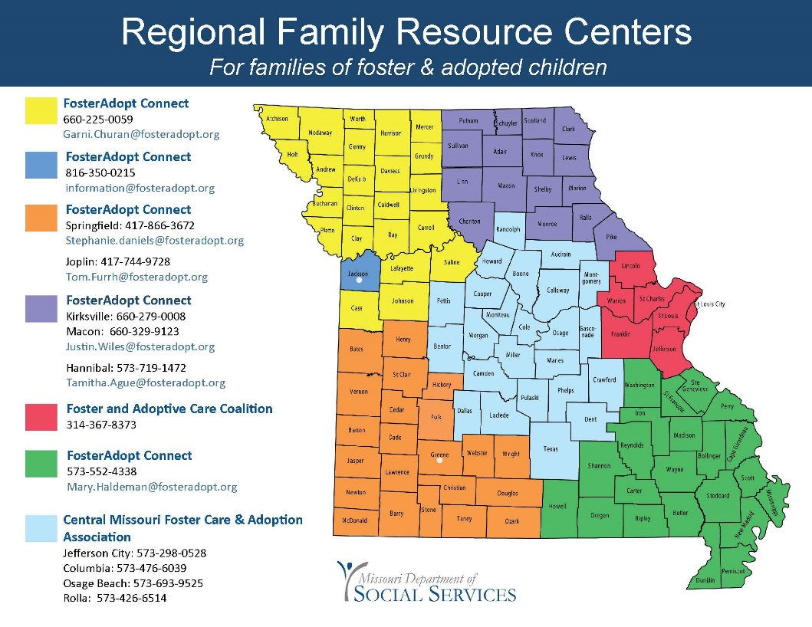
Where we are now…
Managing Sites
Additional Sites
Clients Served
Notes:
Managing Locations​ (Jessica & Anthony)
Independence (HQ)
Manages Kirksville & Poplar Bluff
Kirksville: Provides services to (#) surrounding counties
Poplar Bluff: Provides services to (#) surrounding counties
Jessica helped with the replication sites in Columbia, Rolla, Jefferson City & Ozarks
Springfield (SWMO) | Provides services to the southwestern region of Missouri
Springfield Area | Provides services to 12 surrounding counties
Joplin Area | Provides services to 7 surrounding counties
We try to stay within’ 35 mile rule, but will travel farther to ensure services are provided to outlying cities and counties
Total Clients Served (Jessica) (2017 – Present)
Springfield & Joplin (310)
Independence (487)

Slide 9
Domains Serviced
Housing​
Employment​
Legal​
Education​
Financial
Transportation​
Community Supports​
Social Supports​
Physical Health​
Mental Health​
Notes:
Anthony Presenting

Slide 10

What sets us apart you ask…
Program Policies & Procedures
Length of Service
Client Eligibility & Criteria
Hiring Practices
Self-determination Support Model
Authentic Engagement
Relationship Building
Notes:
Jessica 1st Half
Anthony 2nd Half
Program Development
- The program was created by Foster Care Alumni
Program Policies
Client-Driven & Client Centered Case Management
Client led-we present the domains offered and how we can help within those domains but ultimately let the clients tell us what they would like to work on, we work with them on how to set goals and they tailor their own Action Plans
We offer guidance but at the end of the day we recognize they are young adults and it is their life
“No Eject” Policy
No eject and opt-in/opt-out unless it’s a safety concern we don’t kick anyone out
“Opt-in, Opt-out” Service Policy
If a client moves out of the area, lets us know they no longer want services or they stop engaging in services they are placed inactive but are welcome to come back at any time​
Client Surveys & Compensation
Survey’s are conducted at the 3 month mark and again at annual mark
Client’s are compensated for the information they provide to the program
Advocacy & Community Opportunities
History of CCYP | Passed a bill foster care bill of rights
Participate in youth advisory boards
BIPOC focus groups, LAC Committee, and more​
Client Eligibility, Criteria & Service Length
Voluntary & Client-Driven Services + Domains Served
- The program is client-driven and voluntary which means that clients can choose to “opt-in” and “opt-out” of the program as long as they are between the age range (17 – 26)
Housing; Employment; Legal, Education; Financial; Transportation; Community Supports; Social Supports; Physical Health
Additional Services Provided
Conflict Resolution
Emotional Support
Client Eligibility & Criteria
Aged-Out; Adopted; Reunified; Kindship Placement
As long as they’ve spent time as a child in Missouri’s foster care system we can serve them
Aftercare Case Management
- Being able to build rapport starts at the intake really taking the time to get to know them and acting quickly-treating every meeting like it’s their last-showing up for them increases program participation​
- Accountability Examples | Financial Agreements; Difficult Conversations
- Conflict resolution | Allowing them to feel what they feel-we get yelled at, cussed at etc. Giving them time to cool off but addressing it later, discussing boundaries and how they can handle future problems​
- Meeting clients where they are-understanding that their ideal level of success is different, finding out what that is, what motivates them and building on it​
- Strength based-celebrating the little wins, having a genuine connection and being able to build rapport to find out what their strengths are-building on that but also challenging them to do a little more with every interaction.
- Authentic engagement and relationship building​
- Sense of urgency ​
- Accountability​
- Conflict resolution​
- Meeting clients where they are​
- Strength based
Interactive Question: What are some of the things that make you feel supported as worker by your supervisor or employer (?) (idea)

Slide 11

Supporting Clients
Opportunities for Growth
  Client Concerns
  Accessibility
  Confidentiality
  In-Field Shadowing
Client Satisfaction Survey Results
Notes:
1st Half Jessica Presenting
2nd Half Anthony Presenting
Opportunities for Growth
Client Rights + Supervisor Accessibility + Confidentiality
We provide the client with opportunities to share their feedback about the services they’re receiving via Client Surveys
If the client has an problem with the services they are receiving, then they have the option of speaking with each program manager as well as access to the Human Resources Department
Our programs takes confidentiality extremely seriously because we recognize the importance of maintaining a client’s privacy and how to this can positively impact the relationship building process
In-Field Shadowing
Supervisor’s take the time to shadow case managers while they’re in the field to provide additional support and collect information to provide feedback during monthly supervisons

Slide 12
What our clients are saying…
"I would give them A's throughout the board. They have helped me gain independence and confidence. They are the first person in many years to tell me they are proud of me and that means a lot to me. I look forward to continuing to work with them and FAC."​
“9 out of 10. He's sweet, not judgmental, nice knowing he was in foster care too.”​
"A+ 10000% They help me with everything, they help me voice my opinion like nobody has before and I just love what they do. We relate to things and they are a cool caseworker. They get the job done, on time, they are respectful. They are just all around awesome!"​
“A+ She is a great person and I know she cares. Because she cares I think it has caused me to progress so much."​
Notes:
Jessica Presenting
Client Satisfaction Survey Results
"I would give them A's throughout the board. They have helped me gain independence and confidence. They are the first person in many years to tell me they are proud of me and that means a lot to me. I look forward to continuing to work with them and FAC."​
“9 out of 10. He's sweet, not judgmental, nice knowing he was in foster care too.”​
“A+ She is a great person and I know she cares. Because she cares I think it has caused me to progress so much."​
"A+ 10000% They help me with everything, they help me voice my opinion like nobody has before and I just love what they do. We relate to things and they are a cool caseworker. They get the job done, on time, they are respectful. They are just all around awesome!"​

Slide 13

Supporting Specialists
Work Culture & Benefits
Open Door Policy
Supportive Supervisions
Flexibility & Hybrid Schedules
Manageable Caseloads
Staff Appreciation Events
Notes:
1st Half Anthony Presenting
2nd Half Jessica Presenting
We believe that the best way to support Specialists is to development and implement safeguards to prevent professional fatigue or “burnout”
We do this by intentionally creating spaces where they feel supported, heard, and valued
Work Culture
- Specialists are encouraged to utilize time off to avoid the symptoms of burn out
Supportive Supervisions
Supervisors conduct monthly supervisions that are driven by Specialists
This is a time for each Specialist to reflect on successes and challenges from the previous month
This is also a time for each Specialist to create professional short-term and long-term goals which the supervisor follows up with each proceeding supervision
Open Door Policy
Supervisors have this policy to ensure that Specialists have a space to process day to day engagements with individuals, community resources, social supports, etc.
This creates a space where Specialists can process decisions regarding the services they’re providing which positively impacts both the Specialist and client
Company Benefits
EAP; Tuition Reimbursement; Parenting; Insurance Coverage
Flexibility & Scheduling
Specialists have the option to work from home and flex time as needed throughout the week
This is something that was implemented and developed in response to the COVID-19 crisis
This is another way that the program creates safeguards to avoid burn out
Manageable Caseloads
Workload Assessments allow us to keep loads at an appropriate capacity to further prevent burn out
Staff Appreciation & Self-Care Events
- Quarterly self-care/team bonding (making candles, mini golf, painting, movie days, pumpkin patch)

Slide 14
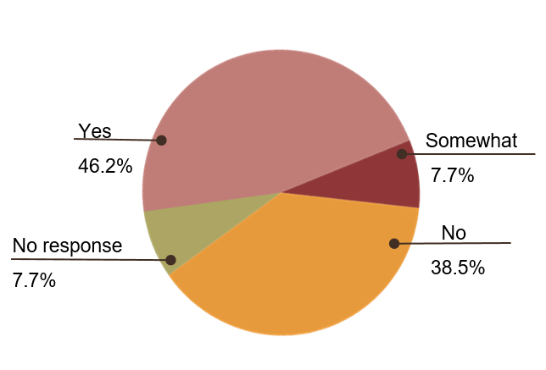
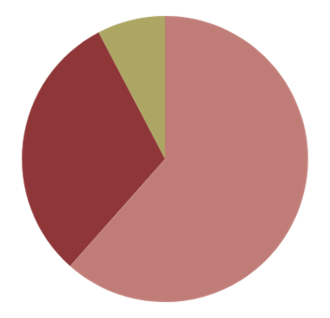
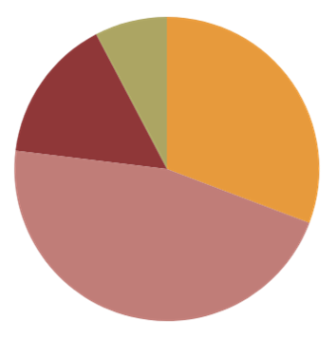
Texas Study Results
How often do you experience stress in the workplace?
How often do you think about work when you are not working?
Do you feel like you have experienced secondary trauma as a Specialist?
Never
7.7%
Never
7.7%
Occasionally
15.4%
Always
30.8%
Occasionally
30.8%
Often
61.5%
Often
46.2%
Notes:
Summary
The majority of survey respondents reported feeling stressed in the workplace and thinking frequently about work when not actively working
In an open ended question regarding staff’s use of PTO in response to stress, 9 respondents reported having used PTO at least once in response to stress
Additional information provided by 2 respondents indicated that staff feel encouraged by CCYP to take PTO for this reason given the demanding nature of the job and need for mental breaks
1st Graph
61% experienced stress in the workplace​
2nd Graph
46% think about work when not working​
3rd Graph
46% say they have experienced secondary trauma as a specialist​
For survey purposes, we used Bruce Perry’s definition of trauma as a psychologically distressing event that is outside the range of usual human experience, often involving a sense of intense fear, terror, and helplessness.
Secondary Trauma was defined as indirect exposure to trauma through a firsthand account or narrative of a traumatic event.

Slide 15
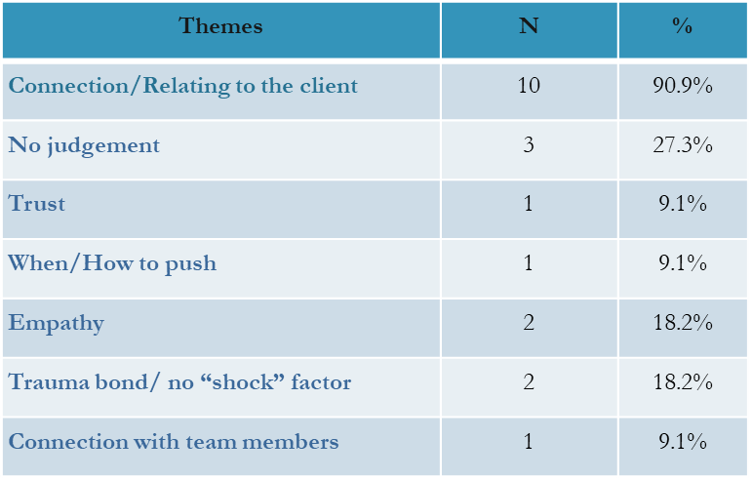
How Lived Experience Impacts
How Lived Experience Impacts Specialists Roles?
What benefits, if any, does lived experience bring to your case management?
Total # of respondents = 12
Notes:
1st Table
Staff say lived experience is essential to this part of work, helps better support clients, motivates clients to participate and provides tools to perform better​
Fuels connection between clients and specialists
2nd Table
Specialists expressed that the benefits of lived experience allows them to develop deep connections with clients
They feel like they are easy to relate to which helps further develop their relationship
That said, one can also see how this could impact Specialists own mental health

Slide 16
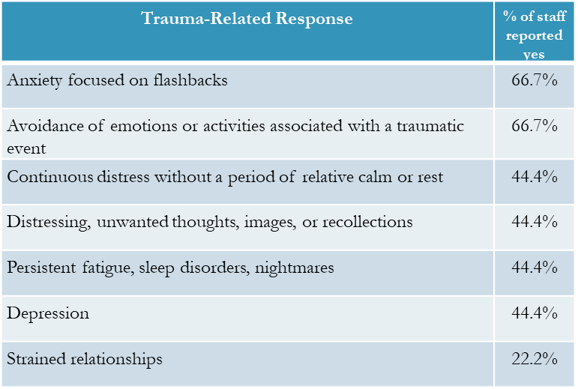
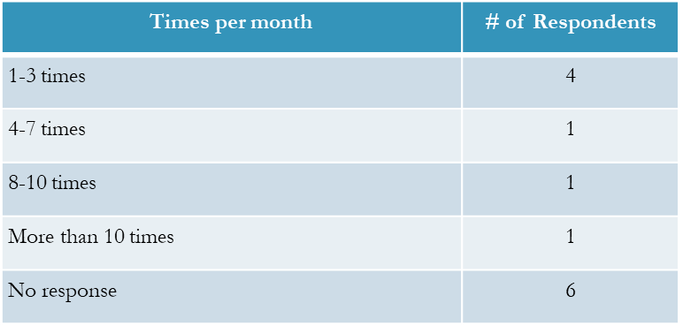
Staff Experience with Secondary Trauma​
Have you experienced any of the following responses to trauma as a Specialist?
How many times a month do you experience secondary trauma symptoms while at work?
Notes:
1st Table
Summary: Among the respondents who reported experiencing secondary trauma, all but one reported feeling multiple trauma-related symptoms, with 3 respondents reportedly experiencing 5. ​
​
2nd Table
Among the respondents who opted to share an example of the secondary trauma they’ve experienced at CCYP, responses included trauma related to: exposure to crisis situations, the inability and sense of helplessness with regard to meeting client needs, reliving of shared experiences with clients.

Slide 17
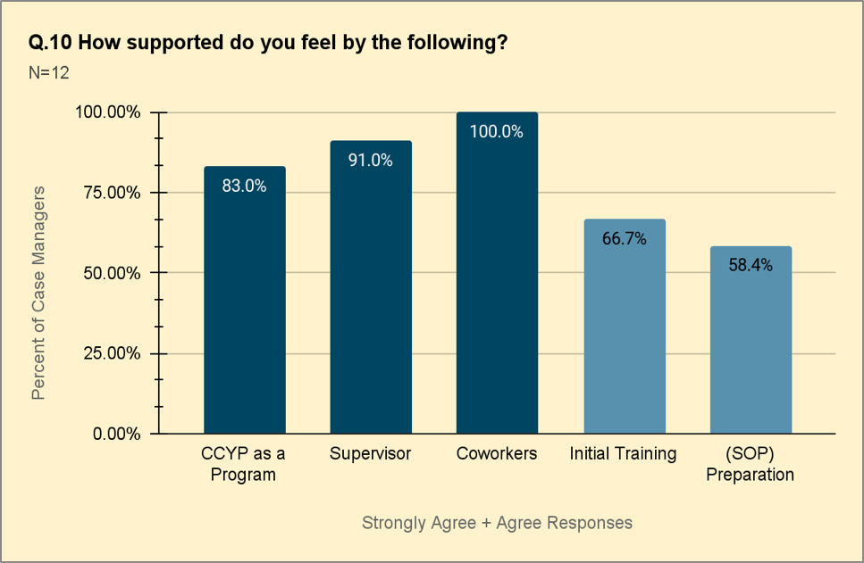
Organizational and External Support
Based on their responses, it is clear that the staff feel supported by the CCYP Program, their Supervisors, and by their co-workers
It is in the latter two of the support systems, that a noticeable dip can be seen in both Initial Training and the (SOP) Preparation.
Notes:
Jessica Presenting
100% specialists feel supported by their team, 91% felt supported by supervisor
Being the introductory question to this section, it sets president for a theme that is seen throughout this section of the survey:
Based on their responses, it is clear that the staff feel supported by the CCYP Program, their Supervisors and by their Co-workers.
It is in the latter two of the support systems, that a noticeable dip can be seen in both Initial Training and the (SOP) Preparation.

Slide 18

When our Specialists speak we listen…
Policies Changes
  Additional SOP training
  Official onboarding process
  Standard Trauma Informed Training
  Additional Benefits
Notes:
Jessica & Anthony Presentation
Policy Changes
CCYP provided additional SOP Training
FAC created a standard onboarding process over the past 2 years
FAC standardized the trauma informed training
FAC provided additional EAP Benefits

Slide 19
Key Takeaways
How lived experience plays a vital role in the day-to-day operations of the program
How support is needed when supervising those with lived experience from the top down
Identify different tools to provide direct services and supervision
Obtain the knowledge and tools on how to replicate the program through FosterAdopt Connect

Slide 20
Questions?
Jessica Funk
jessica.funk@fosteradopt.org
(816) 656-8426
Anthony LaBellarte
anthony.labellarte@fosteradopt.org
(417) 450-4572

