Slide 1
Unconditional Care vs. Wraparound
Karl W. Dennis
Ira S. Lourie
Sue Smith

Slide 2
What is Unconditional Care
Stories by Karl Dennis from Everything is Normal Until Proven Otherwise, 2nd Edition
How We Started Doing this Strange Job, an excerpt from Chapter 1.
This story is attached at the end of this presentation

Slide 3
Development of Unconditional Care at Kaleidoscope
Care the people we serve as we would care for our own children
No Reject/No Eject (No Decline/No Punitive Discharge)

Slide 4
What is Wraparound – I
Started in Willie M. Program in North Carolina
Keeping the most seriously affected youth out of residential treatment and in their communities by wrapping services around them and their families
Became an intervention modality used across the country to better meet the needs of these families as systems of care were instituted

Slide 5
What is Wraparound - II
Wraparound became better defined as having the underpinnings of 10 basic elements as defined in the first edition of our 2006 book, Everything is Normal Until Proven Otherwise: a book about Wraparound Services:
Unconditional Care
Individual strength-based approaches
Family-driven and Family strength approaches
Individualize treatment approach
Emphasis on serving families in their communities

Slide 6
What is Wraparound - III
Commitment to culturally competent care
Care driven by Child and Family Teams
An emphasis on interagency collaboration
A net result of cost effectiveness
An outcome driven process

Slide 7
The Essence of Unconditional Care and Wraparound
Stories by Karl Dennis from Everything is Normal Until Proven Otherwise, 2nd Edition
Cindy’s Story, an excerpt from Chapter 2., about The Essence of Unconditional Care and Wraparound
This story is attached at the end of this presentation

Slide 8
Where Is Wraparound Today
The diminution of Unconditional Care as the under pinning of Wraparound: Unconditional Care vs Persistence
The failure of Wraparound to be funded beyond small grant driven programs
The ability of Unconditional Care non-wraparound approaches to reach wraparound fidelity

Slide 9
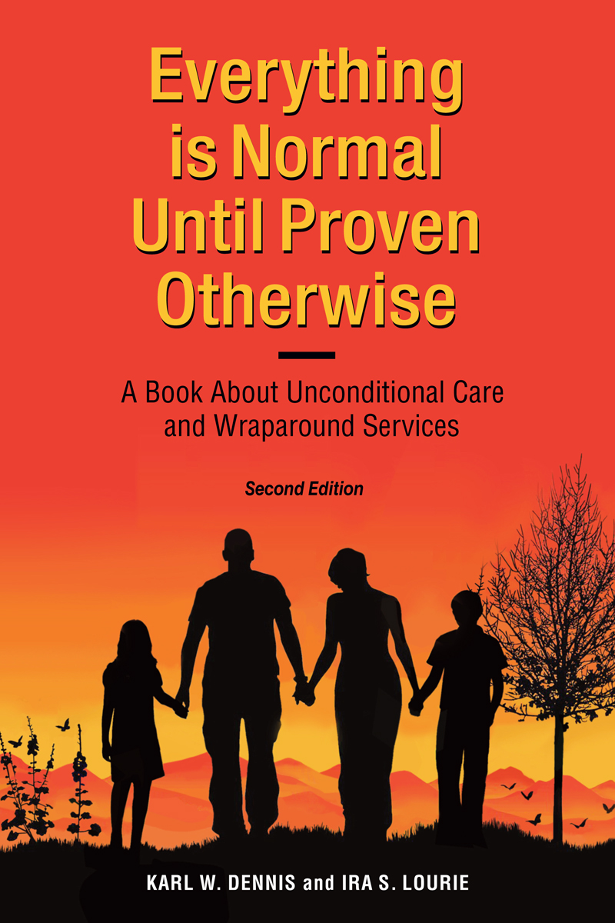
Why Are We Here Today - I

Slide 10
Why Are We Here Today - II
The diminution of Unconditional Care as the under pinning of Wraparound: Unconditional Care vs Persistence
The failure of Wraparound to be funded beyond small grant driven programs
The ability of Unconditional Care non-wraparound approaches to reach wraparound fidelity

Slide 11
Reclaiming and Reformulating Unconditional Care
We have taken the element formerly called Unconditional Care and reimagined it as having three qualities that we feel define the essence of Unconditional Care
No Reject, No Eject
Forming a Helping Bond
Never Give Up

Slide 12
Redefining Our Approach To Families
We have expanded the concept of Strength-based approaches to include a stronger focus on the Strengths of Families
We have redefined the concepts of family-driven services to reflect the new call for Family Voice and Choice in the care of their children and youth.

Slide 13
Unconditional Care is a Philosophy
Unconditional Care is not a practice, it is a philosophy
Wraparound is the most prominent and tested way of providing Unconditional Care
There are other ways to provide Unconditional Care
Anyone can make or expect their care to be more Unconditional, and if so, that care will get better

