Slide 1
Child Welfare League of America
April 2023
Whatever It Takes -- The Power of Prevention

Slide 2
So Happy To Be Here!
Social Worker -- 25+ year career serving kids and their families in various formal systems
Driven by determination to alter the experience families have with these systems
Driven by those who come into this work committed to impacting the lives of others

Slide 3
Warm Up Activities
Who is in the audience?
Setting the stage activity
Notes:
Activity -- What were you hoping to bring to this work? Have a few share!

Slide 4
Presentation Core Value
All families deserve opportunities to build access to what they need emotionally, socially and physically in order to parent their children well!

Slide 5
JusticeWorks History
Serving youth and families since 1999
Serving CO, PA, OH, SC, MD, FL
Headquarters in Allegheny County, PA
Notes:
Tell a little about the commitment to working with the disenfranchised
Importance of the family

Slide 6
Mission Driven Organization
“Do Whatever it Takes” ideology
Family-centered -- Ecology Focused
Strength-based
Solution-focused
Trauma-informed
Notes:
Ethical practice & service delivery
The importance of relationships

Slide 7
Measuring Successful Delivery
JusticeWorks!
Client success
Organization success

Slide 8
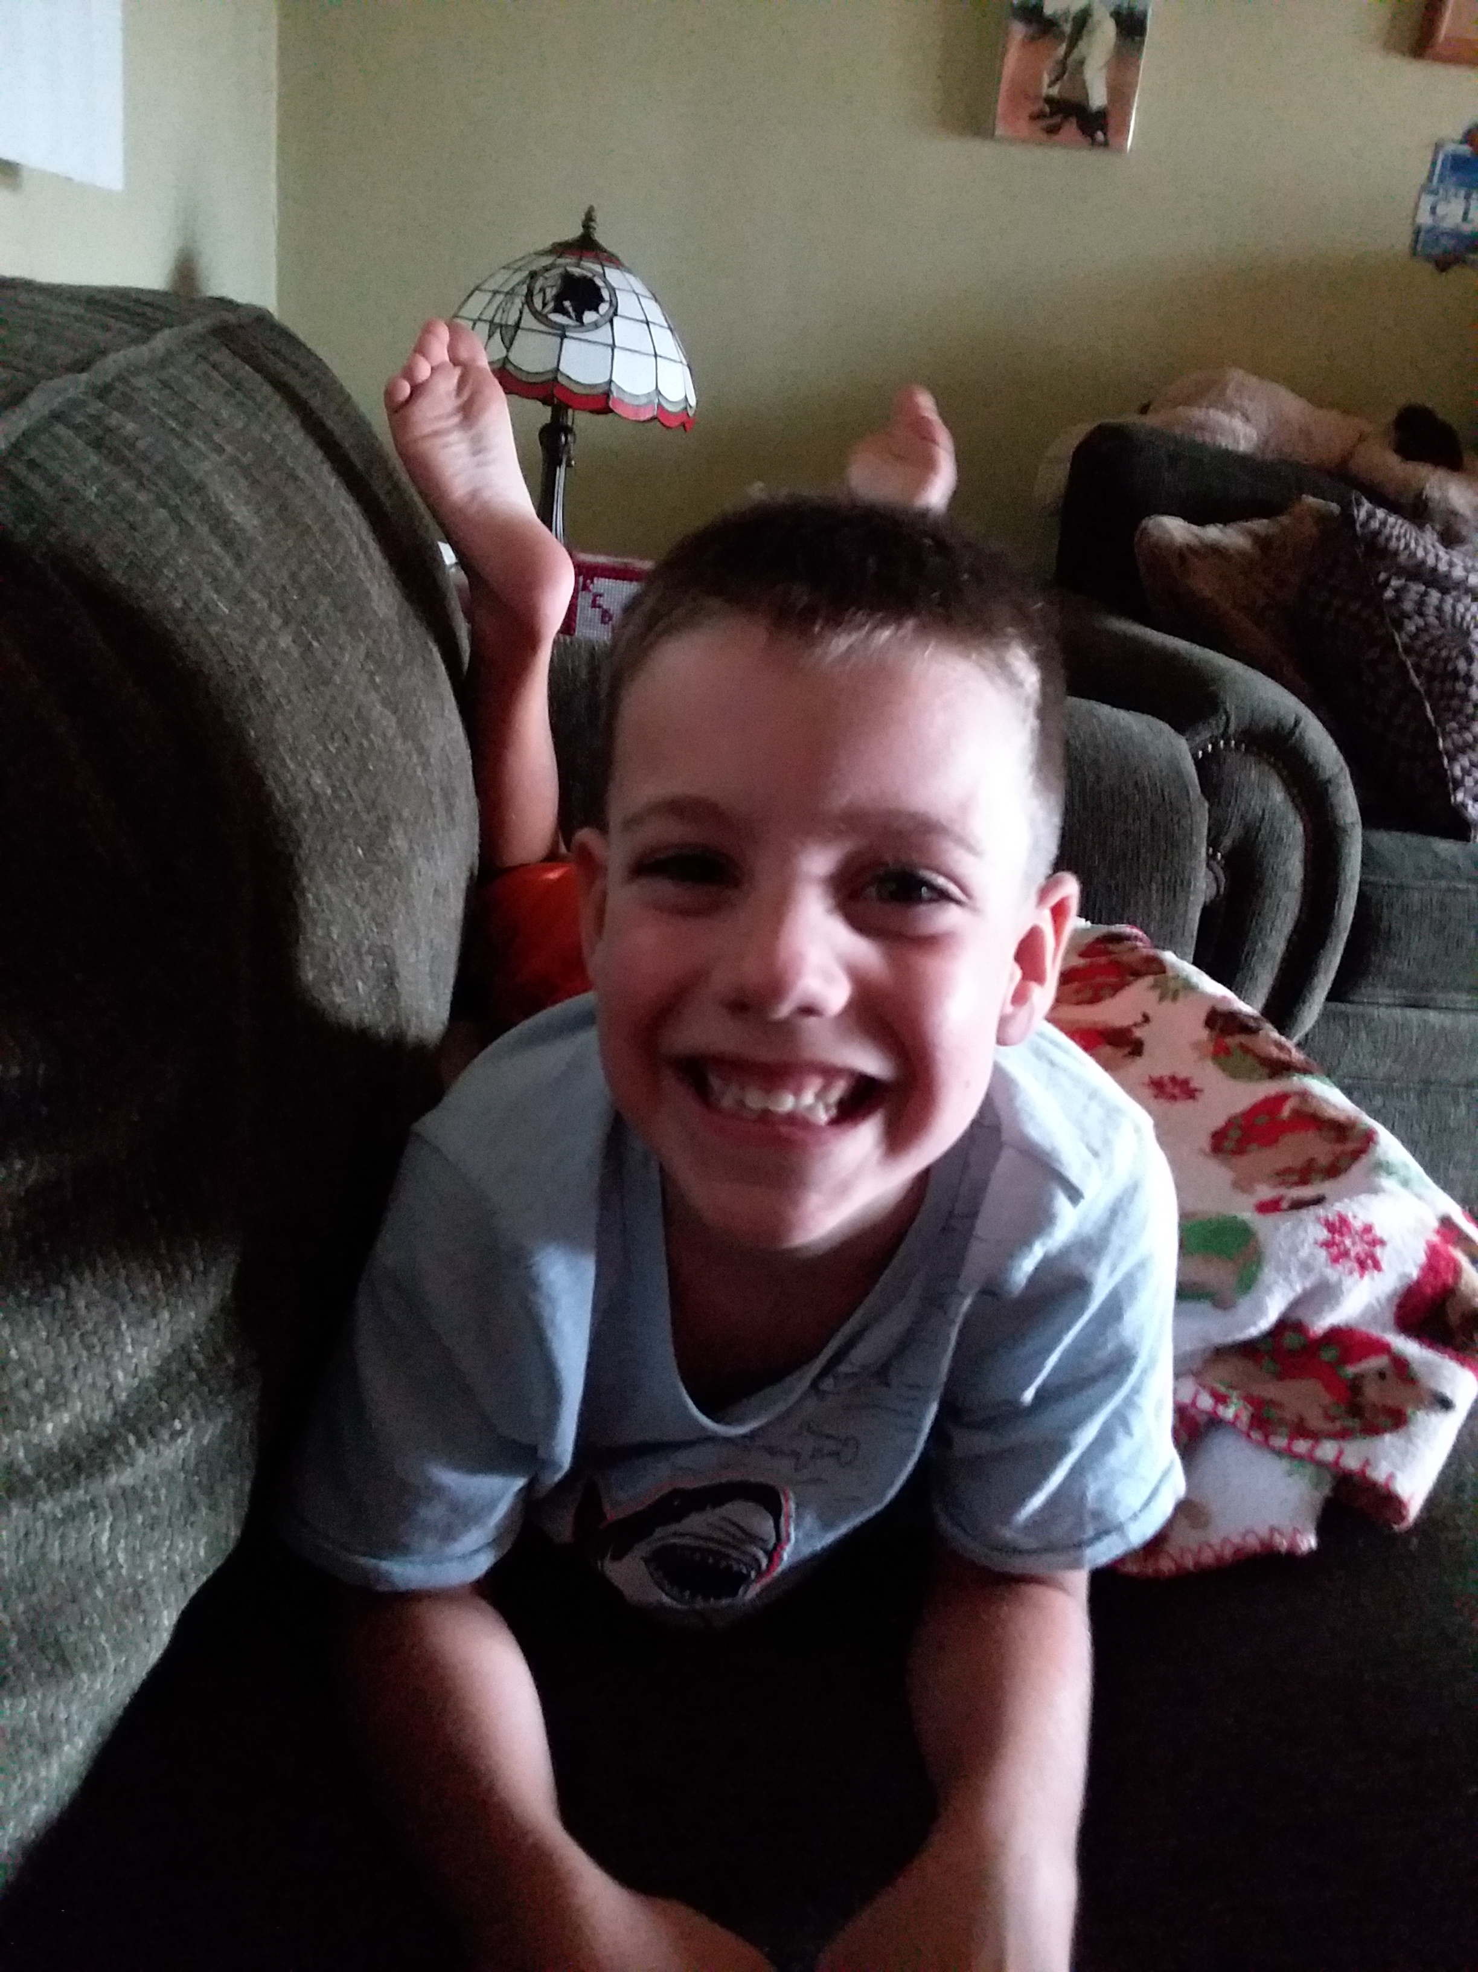
Family First ACT
Long-overdue historic reforms to help keep children safely with their families and avoid the traumatic experience of entering foster care, emphasizes the importance of children growing up in families, and helps ensure children are placed in the least restrictive, most family-like setting
Notes:
What impacts have you seen so far from this well intended change?

Slide 9
Framework of Approach
Person Centered Engagement

Slide 10
Imagine……
Notes:
Activity -- worst day of your life -- imagine having to share over and over again, exposure to humiliation, anger

Slide 11
Basic Premise of this Framework
***

Slide 12
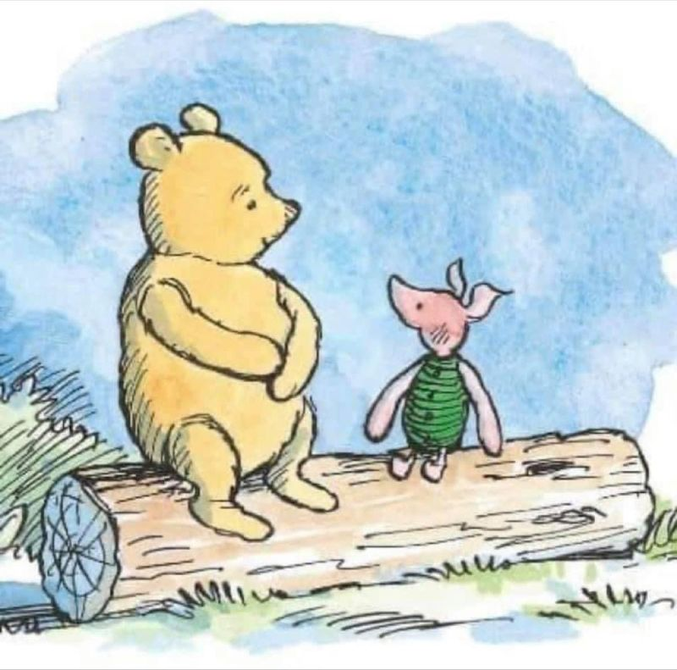
“ A Difficult Day”
"Today was a Difficult Day," said Pooh. There was a pause. "Do you want to talk about it?" asked Piglet. "No," said Pooh after a bit. "No, I don't think I do." "That's okay," said Piglet, and he came and sat beside his friend. "What are you doing?" asked Pooh. "Nothing, really," said Piglet. "Only, I know what Difficult Days are like. I quite often don't feel like talking about it on my Difficult Days either. "But goodness," continued Piglet, "Difficult Days are so much easier when you know you've got someone there for you. And I'lI always be here for you, Pooh." And as Pooh sat there, working through in his head his Difficult Day, while the solid, reliable Piglet sat next to him quietly, swinging his little legs. He thought that his best friend had never been more right.

Slide 13
Communication!
Communication Comes in Many Forms
Notes:
What factors do you take into account when determining what form of communication is best?

Slide 14
People Heal When……..
Their basic needs are met and they have the emotional and physical capacity and bandwidth to begin to heal.

Slide 15
Social Determinants of Health
Economic Stability
Educational Opportunities
Quality Health Care
Safe Neighborhoods and Living Environments
Social Capital

Slide 16
Do we get sidetracked by behavior and away from what is important?
JusticeWorks Believes…….
Understanding what is beneath the behaviors is what will drive change!
Understanding what is underneath the behaviors is what will drive Understanding what is underneath the behaviors is what will drive change. change.
Notes:
Respond to question --

Slide 17
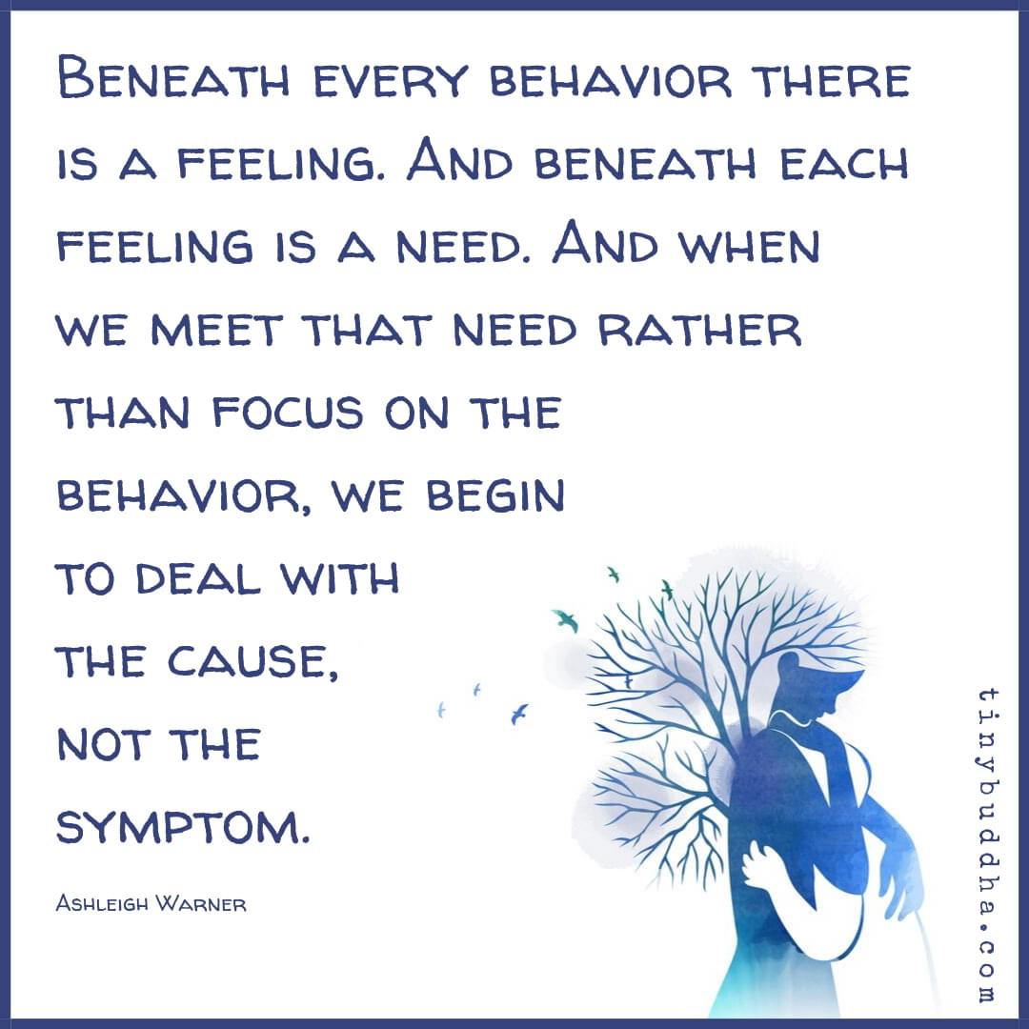
***
Instead of focusing just on behavior,
we focus on
what is at the core of such! Feelings and Needs
Instead of focusing just on behavior,
we focus on
Feelings and Needs

Slide 18
Inspiring Change!
People don’t change their behavior when they feel shame or judged.
“People change their behavior when they feel heard and understood.
Growth and change require connection and compassion.”

Slide 19
FAMILY ENGAGEMENT
Family engagement is a strengths-based, anti-oppressive approach to child welfare and juvenile justice work whereby families are empowered as partners in setting goals, developing case plans, finding solutions, making decisions, and keeping children and youth safe.
Effective family empowerment is the act of engaging, involving, and lifting up the voice of families throughout the child welfare continuum – at the practice and system level.

Slide 20
Prevention
Assessment
Primary prevention
Secondary prevention
Tertiary prevention

Slide 21
Our Signature Programs
Justice Works Signature Programs serve proactively using family and youth strengths to overcome challenges and remove barriers

Slide 23
VISIT COACHING PROGRAM
Visit Coaching is a supportive approach to assist parents while visiting with their children who are in out-of-home care. The approach was developed by Marty Beyer, PhD, a nationally recognized child welfare and juvenile justice consultant.
Visit coaching is fundamentally different from supervised visits because of the focus on the strengths of the family and the needs of the children.
Visit Coaching supports families to meet the unique needs of each child during their family time

Slide 24
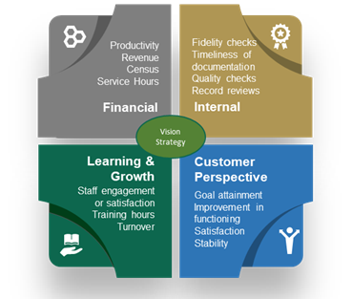
Quality Assurance
We actively engage in quality assurance endeavors to ensure adherence to policies, practices, and procedures in the delivery of services using a variety of methods and strategies to determine what the current performance levels are and where improvement may be needed.
*Outcome Reports Available
We actively engage in quality assurance endeavors to ensure adherence to policies, practices, and procedures in the delivery of services using a variety of methods and strategies to determine what the current performance levels are and where improvement may be needed.

Slide 25
The Tiny Desk
What would you leave?

Slide 26
Q & A Phase
Questions?
Comments?

Slide 27
Thank you!
www.justiceworksyouthcare.com
Contact:
Angela Walters Lytle
awalterslytle@justiceworksco.com

