Slide 1
Filling in the Cracks: A coordinated community response to children experiencing domestic violence
Brittany Vera, LCSW, Domestic and Sexual Violence Services
Tanya Powers, MSW, Children, Youth, and Families
Fairfax County Department of Family Services
Notes:
Notes:
I think the fact that we have a coalition to address Child Witness is unique (though you would know better than me if I am wrong!). So, I think it would help the group to hear how the Coalition got started, why we thought it was important to create Step Up 4 Kids, and what the Coalition has done so far. This could also be a good opportunity to learn if there are groups that we should involve that we haven't thought of, since that is something we are discussing on teh Steering Committee.
Good introduction of speakers

Slide 2
Goals for Today
Understand the historical challenges with child welfare and DV cases and best practices to address the challenges
Identify manifestations of domestic violence (DV), the cycle it can take in relationships, and the challenges in creating safety for families
Understand the key elements of a successful coordinated community response to children experiencing DV
Identify how DV impacts children and affects their development and health
Identify benefits of collaboration between child welfare and DV agencies
Notes:
Tanya -
Ground ourselves in dynamics of domestic violence, talk about challenges and best practices in the work, and understand the importance and key elements of a successful coordinated community response.
our real hope is that this presentation gets you thinking how you can make positive changes in your system and the lives of our families experiencing DV.
Whether that's how to better engage with and support families experiencing violence
Or having discussions with your agency and community partners on how you can improve your training and collaboration.
Brittany will share a bit about who we are and why our system is unique in Fairfax.

Slide 3
Who We Are
Department of Family Services
Children, Youth, and Families
Domestic and Sexual Violence Services
Public Assistance and Employment Services
Adult and Aging
Notes:
Brittany and Tanya- introduce ourselves
Most DV/SV agencies are standalone nonprofits
Good explanations for agencies
→add Adult & Aging to box
→add slide for objectives

Slide 4
With a colleague, discuss the following questions?
Do you know who your local DV provider is?
Do you have a relationship with them?
What are things you already do well regarding DV?
What are some challenges you have regarding DV?
How does your agency currently account for DV in a family?
Do you have a way to assess with every family, every time?
Notes:
Add…if you’re not able to answer any questions, do you know where to go to ask?
By a show of hands…
How many of you have a relationship with the DV agency in your jurisdiction?
How many of you identified some things you do well related to DV?
How many identified some areas of growth?
No agency is perfect and there is always room to grow! As we move through this presentation, hopefully there will be something that resonates with you that will help you in your practice!

Slide 5
Understanding the dynamics of domestic violence

Slide 6
Language matters
People experiencing violence
Survivor
Victim
Client
Petitioner
People using violence
Offender
Parent using violence
Abuser
Batterer
Defining the issue
Domestic violence
Intimate partner violence
Coercive control
Family abuse
Notes:
Brittany
The language we used has changed over the course of time to describe people who experience violence and those who cause violence. Specific systems might use specific terminology. Survivor is empowering and strength-based for some people, but others feel it’s important to acknowledge they were the victim of a crime. We will use victim today because people experiencing DV may not always have been seen as victims by other providers.
People using violence first referred to as batterers or abusers because those were the nature of their actions. It doesn’t create a lot of space for hope or change, both for us as professionals or the people themselves. We are going to refer to them today as parents using violence.
When we think about the issue we are discussing, we are going to talk about domestic violence, but it really is intimate partner violence. We use the terms interchangeably in Fairfax.

Slide 7
Defining Domestic Violence
Fairfax County Domestic and Sexual Violence Services defines domestic violence as:
Behavior that hurts a former or current spouse, dating partner, family member, children or other members of a person’s household and community. This can include many different forms of harm and violence.
Definitions and responses to domestic violence are wide and varied based on culture, values, and many other factors. Due to histories of oppression and marginalization, victims/survivors and people who cause harm require responses that are not based on one approach
Notes:
DSVS has recently gone through a process of creating a more inclusive definition of domestic violence that allows who seek our services to see themselves reflected in the definition.
This national organization also defines domestic violence as:

Slide 8
National Domestic Violence Hotline Definition
Domestic violence is a pattern of behaviors used by one partner to maintain power and control over another partner in an intimate relationship.

Slide 9
Why are We Talking about this?
Victims’ experiences of violence is multifaceted
Leaving a relationship does not always create safety and it often is unrealistic
Child welfare needs to have a multifaceted response to be able to assess for domestic violence, collaborate with victims to establish safety and create accountability for parents using violence
Victims have a lot of different ways of keeping their children safe in the context of a violent relationship
It does not stop the use of violence or victims’ experiences of violence
Notes:
Brittany- new slide
Ultimately, we don’t want to have a one-size fits all approach when it comes to child welfare and DV
Creating a new paradigm

Slide 10
Domestic Violence Can Be…
Physical violence
Emotional/Psychological violence
Verbal abuse
Financial abuse
Anything that jeopardizes sense of physical safety
Limiting access to medication or mobility aides
Commonality of different forms of isolation of the victim
Not paying court-ordered support, taking a lower paying job to lower payments
Including eroding parental authority in the home
Notes:
Brittany
It’s important to recognize that the physical violence is just the tip of the iceberg. We are going to talk about the cycle of violence and what it may look like in relationships. While survivors vary in the types of violence they experience, most survivors report experiencing isolation in some way shape or form. Whether it’s that a survivor cannot leave the home at one end of the spectrum, or feels like they can’t tell anyone what is happening because no one will be believe them at the other, isolation is present.
Physical violence is anything that makes a victim feel physically unsafe- including withholding mobility aids and medication or not allowing access or controlling access to doctors.
Emotional: isolation maintains power and control, it’s the common factor
Sexual violence includes reproductive coercion and abuse. Some survivors report that they have been ready to leave a relationship, are then coerced or forced into having sex, and then become pregnant and feel forced to stay in the relationship due to the pregnancy
Spiritual/religious violence is when someone is essentially forced to choose between their or their children’s physical and/or emotional safety and well-being, or practicing their religion in the way they believe they need to in order to adhere to their faith. An untenable choice
Nice highlighting and touch on manifestations
→reformat; add a couple of additional slides perhaps

Slide 11
Domestic Violence Can Also Be…
Spiritual/Religious
Using culture and identity
Using technology
Using children
Forcing a victim to choose between practicing their beliefs and keeping themselves and children safe
Member of a minority group or immigration status or other cultural norms
How is technology used in all the different types of violence described?
Sexual violence and reproductive coercion
Forced to have children, birth control sabotage or lack of access
Notes:
Culture and identity includes immigration or status as a member or a minority community, whether LGBTQ, disability, etc.
Use of technology means the way technology is used to carry out every single form of violence on this list, it’s not just “cyber stalking” anymore. We all have tiny computers in our pockets

Slide 12
Using Children in Abuse
As a Pawn
Parent using violence may threaten to take children away from victim
Flee to home country
Demeans victim as a parent
Belittles or abuses victim in front of children
Tells children not to listen to victim
Attempts to gain allegiance of children
Use them to spy on victim
Participate in abuse by calling the victim names, refusing to listen or respect their authority
Tell them the victim is at fault for abuse
Alienating child against victim, belief victim cannot protect them or will hurt them
Direct victims of abuse
Means of torturing victim
Instilling fear, domination
Notes:
Not every family is going to look the same. But we hear some of these categories with alarming frequency, especially in the child welfare realm.
I want to highlight demeaning the victim as a parent. Think about cases where you’ve seen a parent that seemed like they were ineffective as a parent, couldn’t set boundaries, or didn’t have the authority in their home. Are we asking questions like “How did it get that way?” Being curious.
Separation changes the dynamics significantly with children and puts them in the middle of the parents in a way that adds the potential for additional emotional abuse. Victim may not be able to protect them in the same way because they are not with them all the time.
When we see children participating in the abuse, it’s important to recognize the children are aligning with the parent they think can keep them safe.
30-60% of cases…
Transition: The question becomes is there any research to tell us what the impact is of experiencing this trauma? We have something called the ACE study

Slide 13
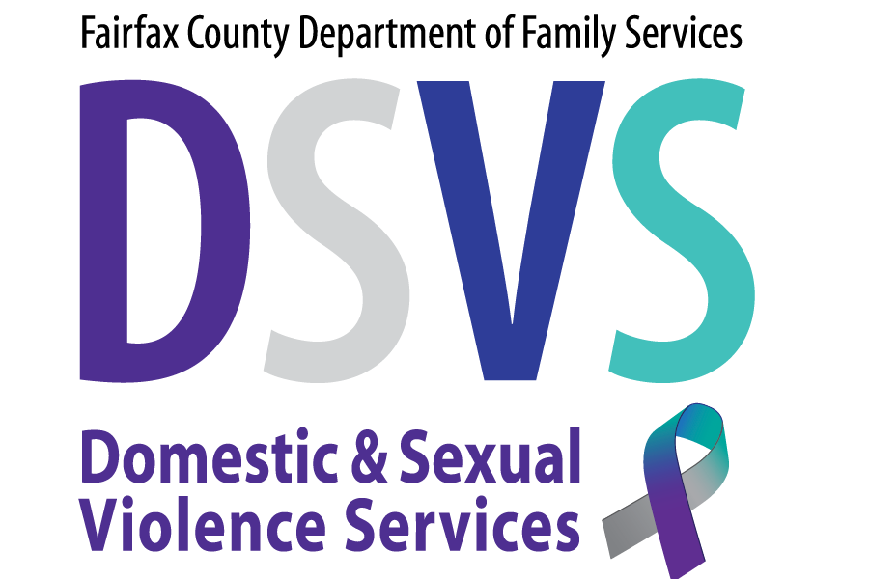
What it looks like over time: Violence on a continuum
End
Survivor at increased risk for illness, injury, death
Violent incidents increase in severity
Violent incidents become more physical
Victim isolation increases
Victim takes blame
Person using violence defines reality
Beginning
Notes:
This what the waves look like over time.
Note that “normal changes”, never returns to same as beginning of the relationship, begins to seem “normal” at the time. This is the frog in a pot of boiling water.
Think back to when you first met a partner, spouse, or good friend? Would you want to be in a relationship where the person introduced themselves and promised to be emotionally abusive, isolate you from family and friends, and blame you for everything that goes wrong in the relationship?
We cannot assume that we would know what we would do if we were in a situation like this. DV happens to people across all ages, races, socioeconomic statuses and levels of education. We are going to talk a bit more about trying to put ourselves in the shoes of victims to understand the reality of their experiences
Good flow and seamless segue into this slide from previous slide

Slide 14
What it looks like
Incident
Incident
Remorse/
blame
Remorse/
blame
Tension
building
Tension
building
Tension
building
Same Old Stuff
Same Old Stuff
Notes:
The wave starts small; each crest represents an abusive episode, after which the violence decreases for a while before building again.
Over time, the abuse becomes more intense, as the survivor’s threshold gets pushed further away from her/his original tolerance.
This diagram is more useful for understanding how difficult it is to sense a pattern, since the wave is unpredictable. It is also much harder for people to make decisions about leaving when they don’t know what to expect in their home from one day to the next.
The Hearts and Flowers phase is often what the survivor feels is the “real” relationship, and that the abuse is an aberration – most often someone in a DV relationship wants the violence, not the relationship to come to an end.
Note the crest of the wave says an “incident” because this could be physical in nature or some other expression of power and control over the survivor.
After that incident, some parents using violence will apologize for their behavior, promise to change, but others will blame the victim for the outburst. “If you had just done what you’re supposed to do, I would have to yell and scream at you, that is the only way you will listen.”
At the end of the day, what we hear from victims is that they don’t want the relationship to end, they want the violence to end. They truly love the person they are with in many cases.
Well done…

Slide 15
Considerations for safety
Fear
I’m worried they’ll hurt me.
If I leave, they’ll hurt themselves.
If we separate, they will be alone with kids and I can’t protect them
Isolation
No one will believe me.
My friends and family don’t talk to me anymore.
People will think I’m weak for staying so long.
Children need both their parents in their lives.
Children
They’ve said they’ll take the kids and I’ll never see them again.
I need to be there to protect the kids from them.
Hope
We love each other and can make it work.
Things have never been this bad before.
They said they’re sorry and it’s going to get better.
Economics
I can’t afford to stay in the house if they get arrested.
They wrecked my credit and got us evicted from the last place we lived/
If I kick them out, they’ll be homeless.
Legal
What if the court gives them the kids?
If I report, they’ll call my probation officer and I’ll get locked up.
I don’t want to tell what happened to me in front of all those strangers.
Culture
Ostracization from community
Familial norms about violence, power, and control
Systematic oppression/ racism of some communities
Notes:
Many people ask, why don't they just leave?! The reality is that it's just not that easy.
Survivors have to weight the cost of leaving with cost of staying.
Each individual has a unique set of circumstances in their lives as to the challenges they may face if they pick the path to safety. It is especially important as a child welfare practitioner that we understand the barriers because they can also be opportunities for intervention and support. We should be asking them what they are worried will happen if they leave, or what challenges will they face?
Children: the victim may feel the need to protect the children from the parent using violence.
Hope: The victim believes that the love is real and the violence is an anomaly. They hope things will get better.
While these show some general barriers, people may have additional intersections in their lives that could make their decision more complex.
For example: someone from the LGBTQ community, a person with a disability, or even someone in the military.

Slide 16
The Most Dangerous Time in Relationships…
The most dangerous point in a relationship where there is domestic violence is when the victim decides to leave.
The parent using violence is no longer in control, the degree to which they care about following society’s rules will predict the lengths they will go to try to get their partner and children back.
Consider the number of homicides that happen during the exchange of children or visitation with them.
Notes:
While each abusive incident is a risk to either physical or emotional safety, the most dangerous point....
We cannot deny the statistics around this. If a victim is in danger, so are the children. Slide # 3
As a system, we are sometimes asking people to leave the relationship. How can we collaborate with the victim around planning for their safety knowing that leaving is the most dangerous time?

Slide 17
The Not-So-Simple Process of Change
“They don’t hit me in front of the kids.”
“They would never hurt the kids.”
““It’s my fault they get angry”
Our system response: Hold space for the victim and not shame them for not acknowledging the problem
Contemplation: Maybe there’s a problem
“Their behavior is problematic and troubling”
“I don’t know how to get him to stop”
“I might want to leave but it will make it worse/don’t have the support.”
Our response: provide information, education, and do not let the victim’s ambivalence impact how we perceive them.
Pre-contemplation: Living in the River, a.k.a “Denial”
Notes:
It can be helpful to think about what we are asking clients to do from the lens of the Stages of Change. For those of you who are familiar with this model, it’s used for people changing behavior around substance use. It can be applied to the idea of changing behavior around a relationship.
When we think about the process of making a change in our lives, think about when you’ve decided to make a change in your own life, whether it’s starting a diet, a new exercise routine, moving, or getting a new job. That isn’t a simple over night thing. But when we enter into victim’s lives, that is essentially what we are asking them to do. With a relationship, we need to factor in the attachment and genuine love and care for their partner, and if children are involved, that is another complicated layer for victims.
Victim’s feelings of self-sufficiency, decision making, self-esteem all directly targeted by abuser directly and indirectly- factors in change process
Precontemplation- see as a coping skill, protective factor. Things are too overwhelming. How to make them less overwhelming for client. Joining with the client where they are to build trust and rapport
Contemplation- tricky stage because of ambivalence of leaving or staying. It’s hard for us as professionals to hear someone go back and forth so we really need to be checking our own biases around what we want to have happen, versus what the victim thinks is safest for them. We need to give permission for clients to have both feelings so they can work through them.

Slide 18
The Not-So-Simple Process of Change
Preparation: “There’s a problem and I can decide what actions to take.”
Victim still may be uncertain of change at times
“I want to leave but I’m not sure I can manage without them, but I’m willing to try.”
“Tell me what the best option is.”
Our response: Give victims all the information about ways to create safety; collaborate and view the victim as the expert
Action: “I’m going to make a change in this relationship.”
Making decisions for oneself is key!
“This is the decision that is safest for me and my children.”
Our response: Believe and support the victim and hold the parent using violence accountable in a wide range of ways
Notes:
Preparation- difficult because victim has to trust self to take action- depending on the response they receive from the system, whether CPS, shelter, the court system or police, it may prompt them to stop or keep going. Figuring out own wants and needs for safety can be difficult. Important to acknowledge with victims how scary it feels and that you’re there to walk through it with them.
Action- big motivating factor is often kids and impact on them. Uncertainty can bubble up again, stalling progress. Might need a lot of support to find voice, feel effective, recognition of not being alone
More emphasis on the “your action” statements

Slide 19
The Not So Simple Process of Leaving
Maintenance: “I’m continuing to make difficult decisions to keep myself and my kids safe as I know how, even thought there’s no more threat.”
“I’m really scared/angry/nervous about these changes, but I’ll keep doing it.”
“It’s weird to live without the constant chaos and threat in my home, I don’t trust it.”
Emotions can change quickly
Our response: help victim re-evaluate safety. Continue to engage parent using violence
“Reconsideration”: “It’s not to my benefit to continue these actions. I’m in more danger, it’s too hard, I don’t have enough finances.”
“He’ll lose his job if I follow through with this protective order.”
“I can’t afford childcare, work my job, and take care of my kids without him.”
“They are threatening to kill me or bad mouth me to my community if I don’t go back to them.”
Our response: Continue to offer our belief that what the victim reported is true and we are available to help.
Notes:
Then we get to a point of Maintenance- stability can sometimes feel scary for victims who have a history of own childhood trauma, used to living with chaos. Brain can’t trust calm. Our role is to provide support, help client recognize positive changes and benefits of their actions.
Reconsideration. This is thought of relapse in the traditional model, but the article I sourced this from calls this reconsideration, I would add reconsideration of safety. Difficult for us as providers because it seems like backwards progress/regression. Maybe things are a little safer than they were if the client goes back, has resources. Be curious about the client’s logic- don’t ask why- ask “tell me about how this makes sense” How dangerous

Slide 20
Counterintuitive Victim Behavior
Maintaining a relationship with the parent using violence
Allows victim to be aware of where their partner is emotionally and mentally, which allows her to better plan for her and her children’s safety.
Encouraging the person using violence as parent
Makes children safer than they would be if she did not encourage him
Survivor’s lack of cooperation
It’s easier for the victim to be angry at the system than the abuser for the abuse (that’s not safe) or angry at herself
Victim recantation
Allows them to re-establish the previous status-quo in the relationship
Notes:
Tanya
As Brittany just talked about, the process of leaving is just that, a process. Where the victim is in that process may determine how they engage with the system around them.
Sometimes Victim's act in ways that don't make sense to us. It's what we call counterintuitive victim behaviors. it isn't what most people think as being logical. But it is, in the context of trauma. They are survival skills.
This can be what makes this work very difficult

Slide 21
The Better Questions to Ask
Instead let’s ask:
How can I support this survivor in feeling safe (here and now)?
What does the victim want for themselves and their child?
How can we support them in obtaining it?
Are there policies or practices that need to be adjusted to account for safety, power and control?
How can we maintain an open, safe dialogue with the child and victim?
How can we hold the parent using violence accountable for their behavior while maintaining safety for the child and victim?
How do services need to shift when we realize there are forms of domestic violence present?
How can we ensure the parent using violence receives services to prevent future violence
Notes:
Tanya
The responsibility for violence doesn’t lie with the victim, it lies with the offender. Every person has the right to exist without violence.
What are some things we can ask our victims, ourselves, and our systems?
What trainings are needed to ensure our practitioners are able to engage and support families experiencing domestic violence?
What relationships do we need to begin to build to ensure our families get the services they need?

Slide 22
Complexity Requires Creativity
Safety planning
For the victim
Services
Holding the parent using violence accountable by having them participate in violence intervention services
For the children
For when the Victim chooses to leave in the future.
Providing ongoing support and monitoring
For the children who have been exposed to the abuse/violence
Providing education around the dynamics of domestic violence
For the victim
Notes:
As Brittany mentioned earlier, most people don't want the relationship to end, but they want the abusive behavior to stop. As a system, we may not have enough to intervene through the courts to mandate one parent leave.
While there are certainly going to be very high risk situations where a parent leaving is the only safe option, that is not the solution in every case, every time. We need to shift our belief as a system that leaving is the only safe option and develop the capacity to work with our victims where they are, in a way that maintains safety. So how do we do this?
Safety planning:
We need to understand the importance of safety planning. In order to do this, we need to recognize that the victim is the expert of their family and their safety. We want to collaborate with them and assess what they may already be doing to keep themselves and their children safe and then build upon this. We need to have open dialogue and discuss how realistic any safety plan may be and critically think about how any part of that plan could jeopardize their safety.
So what does this actually look like in practice?
Victim – Help them identify any patterns that may be present that could indicate things may escalate. Are here people they could call to help defuse the situation, or is there somewhere they can go until things calm down?
Children – This can be a little bit more complex when involving children in the safety plan. We have to critically think through the family dynamics that may compromise safety. For example, does the child align more with the parent using violence? If so, including them in the safety plan could further jeopardize the safety of the victim.
If safety planning is the best option, we need to figure out what will be safe for the children without putting them in harms way.
developing a plan about where the children could go inside or outside of the home when things escalate. Letting them know the violence is not their fault and they should never intervene.
Services:
We want to make referrals to prevent future acts of violence from occurring and that hold the parent using violence accountable for their behaviors. Don’t put the responsibility on the victim. Consider putting in violence intervention programs (formally batterer’s intervention program), if they will be staying in the relationship.
Connecting the victim to counseling/advocacy.
Sometimes we can be so focused on the parents, that we forget about how we can best support the children. Brittany will be talking a bit more about the ACES and the impact being exposed to DV can have on a child. Are there groups or therapists who are avaliable in your community who can work with children who have experienced violence? By providing services, this is an opportunity to mitigate some of the risk factors child will face.
Finally, Its important to recognize that People are more likely to engage in services when they see themselves reflected in the people providing services. So if you are working with someone who is from the latino community, are there more culturally sensitive providers that can work with those families.
Ongoing:
Consider the use of ongoing case management or services to support and monitor the progress in the family. It would be important to continue to check in with the victim to ensure there is progress, safety, and stability for the family.
Providing education: Our families may never follow through with advocacy services, so we want to provide them with as much information possible about the dynamics of domestic violence and the impact it can have on their children so that they can make educated decisions for themselves and their families. This could also help them plan on ways to better keep themselves safe.
We understand that all these conversations can be difficult and time consuming for practitioners who may feel overburdened by the system already. They may also feel unequip to have these complex conversations. Start to think what training or education your agency may need to be creative in how we work with families.

Slide 23
Children Experiencing Domestic Violence: The Gateway to Adverse Childhood Experiences
Notes:
Tanya just talked about the creativity that is working with families experiencing DV. But why are encouraging all this creativity and engagement with the family? What’s at stake if we don’t do this? We’re going to turn now to the impact of trauma on children, specifically about the impact of witnessing DV.

Slide 24
Adverse Childhood Experiences (ACE) Study
ACE score of 4 or more put people at risk for premature death: 12.4% of original participants had this score
Original study: 12.7% of participants reported their mother was treated violently
60% of survey participants had at least one ACE
Asked about experiences in childhood that might objectively cause a level of trauma but are also considered preventable (did not ask about parents dying suddenly or other accidents)
Notes:
How many of you knew about the ACE Study? How many of you knew the ACE Study asked about witnessing DV?
Hopefully everyone is familiar with the Adverse Childhood Experiences Study published in the late 1990s. If you’re not, it’s a study that changed the course of how we understand the impact of traumatic experiences in childhood and how they have the potential to affect our physical health throughout our life time. The sample size was so large (10k people) that it allowed the researchers to assert that the health concerns and diseases people had as adults came directly from experiencing these ACEs in childhood
The study found that 60% of people had at least one ACE, which in the 1990s was shocking to most people. The study found that once people experienced four or more ACES it put them on a very concerning trajectory that, without intervention, could lead to premature death by almost 20 years. They are dying from things like coronary heart disease, diabetes, ischemic heart disease, which can lead to early death in some cases, things we didn’t think had any connection to childhood trauma; 12.4% had this score
The ACE study asked about witnessing a parent or caregiver treated violently by their partner. 12.7% of participants had this score. Notice how close this is to the 12.4% who had four or more ACEs.
Can this be more concise?

Slide 25
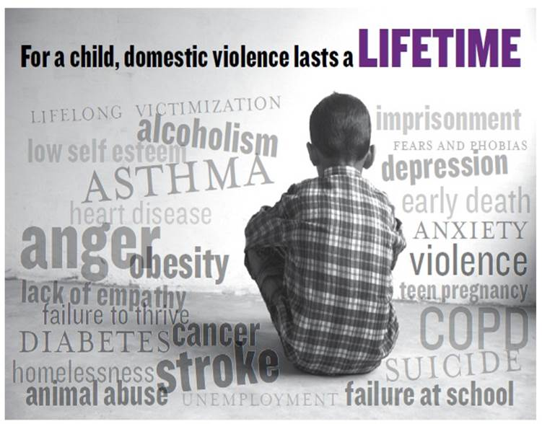
The ACE Questionnaire
The ACE Questionnaire asks about:
Verbal abuse
Physical abuse
Sexual abuse
Emotional neglect
Physical neglect
Separation or divorce of parents
Exposure to domestic violence
Use of drugs or alcohol
Caregiver with mental illness or suicide attempts
A caregiver going to jail
Notes:
Brittany
These are the specific adverse childhood experiences that were studied. It asked about forms of abuse, neglect, and household dysfunction.
If we start with witnessing DV, it’s easy to assume that there is likely some verbal abuse, some emotional neglect, and in 30-60% of cases, physical abuse. So we are at 4. If the police have been called, it’s possible someone is going to jail. If the parent using violence is ordered out of the home due to a protective order or by CPS, there’s six ACEs due to separation. There are many cases where one or maybe both parents are using substances, maybe to cope with being a victim, or someone has a mental health concern. That’s 8 ACEs. So let’s return back to those two data points, the number of people who had 4 or more ACES and the number of people who witnessed DV. Now you see why these date points mentioned earlier are so close.
The study found that 12.7% of people witnessed DV, and as the frequency with which they witnessed violence, so did they likelihood they would experience every other form of ACE. This was especially prevalent among those participants who reported witnessing violence “often or very often,” but compared to nonvictimized peers, this phenomenon of increased exposure held true.
Let me say a word about the ACE score at this point. Take a breath if you’re mentally calculating your ACE score and noticing it’s getting high. We need to also factor in the support you might have had throughout your life. The original authors of the ACE study now say that there needs to be a more nuanced discussion around the ACE score. If you have an ACE score of one, but it’s for sexual abuse, that’s a pretty traumatic event, whether it happened once or multiple times. The ACE score doesn’t account for age at the time of exposure, whether it was multiple exposures or just one, (but this was studied and accounted for) and the level of support people had access to after or during the traumas.
Positive thing to remember is that there are opportunities for intervention to try to mitigate impact of ACEs

Slide 26
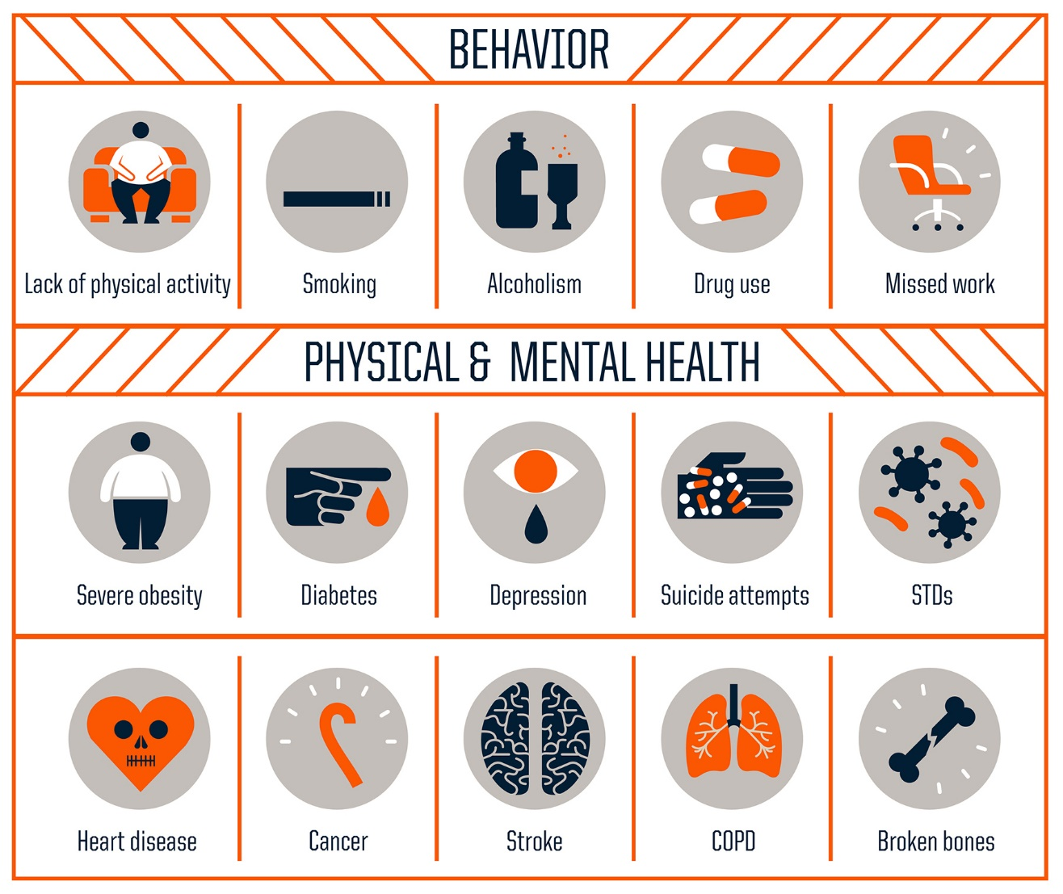
Adverse Childhood Experiences
(ACEs): The Impact
Robert Wood Johnson Foundation
www.rwjf.org/aces
Notes:
Brittany
These are the different conditions that the researchers connected to the ACEs studied.
ACE score of 4 or more:
2.5 more times likely for hepatitis or chronic obstructive pulmonary heart disease
4.5 more times likely to develop depression
12 x’s more likely to commit suicide
7 Or more:
Triple lifetime risk of lung cancer or ischemic heart disease, the number one killer in America
Not studied, but we also know they are more likely to become victims or use violence in relationships.
Now Tanya is going to take us on tour of some of the reasons why this work is so complex and challenging, the historical context of the two differing points of view for this work.

Slide 27
The Historical Context for Domestic Violence and Child Welfare
Notes:
So what do we do about this as a system? In order to understand what we do about it, we have to understand where we came from

Slide 28
Historical Differences of Domestic Violence and Child Welfare Work
Advocacy is voluntary, respects the autonomy of the victim
How to create safety for a child when there is a mandate to do so and the victim sees their safety differently?
Seeing survivors as alleged perpetrators for “Failure to protect”
Child welfare is a mandate, governed by laws of the state
Confidentiality constraints
Mutuality is helpful, but not always feasible due to competing laws
Confidentiality constraints of Violence Against Women Act (VAWA) versus state mandates
Notes:
Tanya
Historically there have been differences between how advocacy and child welfare specialists view and work with families.
Advocacy tends to focus on the safety of the survivor, whereas child welfare's focus is on the safety of child.
It can be challenging to assist a survivor in creating safety for their child when the survivor see's their safety differently.
Sometimes as a system, we unintentionally we revictimize the survivors, mandating that they hold the parent who uses violence accountable and ensure they keep their kids safe. This is difficult when they have little control or power of the person who is choosing to use the violence.

Slide 29
Challenges of the Work
Perceptions of (frequent) reports identified as “custody issues”
Building knowledge of DV for child welfare practitioners
Child welfare practitioners often have to be a jack of all trades, but often see DV as a “specialty issue”
Staffing capacity
Cases involving DV take more time, take longer to build rapport, and need more resources.
Notes:
Tanya- move this slide up to counterintuitive victim behavior
We, as the system, want to believe that we can help people. It’s what we strive for. But you’ve seen the cases where we fall short because of the limitations of our system.
Advocates may also want to stay separate from the child welfare case due to concerns of damaging the relationship with the victim.
This is an opportunity for discussion maybe within your agency of how advocacy can talk with victims about how they can advocate with the child welfare worker and explain how the child welfare worker may be able to be helpful.
Custody – are we allowing this judgement that this is a custody case to cloud our ability to remain open minded or ask the questions to understand if there is real abuse or power and control dynamics?
Parents using violence can also use our system and the children to maintain control over the victim.
This could look like constant frivolous custody hearings, malicious calls to CPS.
Just like sex abuse, people often see DV as a "specialty issue"

Slide 30
Challenges of the Work, continued
Data Collection
When do we note the presence of domestic violence?
It can show trends that may be occurring in your community
Maybe limited by state databases
Data collection may be limited by state databases
Impacts funding and allocation of resources
Notes:
Tanya
How are we gathering and documenting the presence of DV? What are the barriers to gathering Data in your jurisdiction?
It's important to recognize that there are a lot of implications for safety in the intersections of DV and child welfare, perhaps more so than any other agency working with families experiencing DV. We know families experiencing DV are seeking for and using services in other places and spaces.
Next we are going to talk about how we as a community started to build a response that encapsulated our entire community in which child welfare played a critical role.

Slide 31
Building a Coordinated Community Response
Notes:
Brittany
We know that child welfare systems are not the only ones who struggle to respond when their clients are experiencing DV. The response to DV has historically been seen as the work of domestic violence crisis response agencies, but in order to prevent and end domestic violence, we cannot do it alone. We need everyone in the community.

Slide 32
Building Recognition of the Issue
Development of workplan using best practices from Attorney General’s National Taskforce on Children Exposed to Violence in 2012
In Fairfax: growing recognition of need for services accounting for DV for children
Board of Supervisors provided funding to Domestic and Sexual Violence Services to create the Child Witness to DV Coordinator position
Countywide Child Witness to Domestic Violence Coordinator hired in FY2019
Use of existing coordinated community response bodies, including senior county and nonprofit leaders to advocate for services
Notes:
This has been a marathon, not a sprint, even thought we’ve had a lot of recent success and activity.
In 2012, we had individuals from our two divisions who collaborated around this topic because of the growing recognition that families experiencing domestic violence didn’t always receive the nuanced support they needed from different systems. They knew that families experiencing DV were not just showing up in child welfare or in DSVS, but throughout county services, in schools, and other places in the community, like daycares and hospital settings.
These two individuals raised awareness and educated child and family serving professionals throughout our community. They formed a workplan using recommended best practices and goals from the Attorney General’s National Taskforce on Children Exposed to Violence in 2012.
The two advocates were well positioned to leverage the leadership of existing coordinated community response bodies that worked with senior county leaders to raise awareness about how the community was being impacted by this issue. That led to Domestic and Sexual Violence Services being able to request and receive funding from the Board of Supervisors for the Countywide Child Witness to DV Coordinator. This is how our community decided to address the issue, but there are a lot of other ways that it could be addressed, including workgroups of existing multidisciplinary teams, or an existing group addressing domestic violence response at a systems’ level.
.

Slide 33
Developing a Mission
The mission of the Step Up 4 Kids Initiative is to improve the short-term and long-term outcomes in the lives of children who have witnessed domestic violence by improving the government and community response, enhancing clinical intervention services, and providing opportunities for individual impact.
Notes:
Fairfax County has a strong, robust coordinated community response to domestic violence from senior county and nonprofit and community leadership all the ways to direct service providers from agencies throughout the community. We have multiple CCR bodies, and so we needed to establish a body that would focus its work on children, and the Step Up 4 Kids Initiative was created. We wanted to work across all levels of intervention and throughout the community, from policy, to direct service, to individuals in the community who might support children, including their own parents who might be victims or the one using violence.

Slide 34
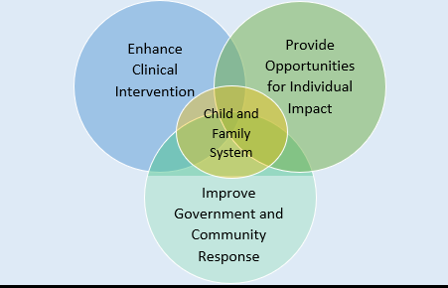
Notes:
We had three many areas of focus and we wanted to keep the child and family at the center of our work. This is a visual representation of the mission statement. The reason that we specifically highlighted clinical interventions is due to the fact that we had been hearing for quite some time that there were not enough mental health services for children who needed them after experiencing DV, especially in the private sector. When families did find therapists in the private sector, they would sometimes report that they didn’t feel the therapist understood the violence or would have a hard time getting therapy because of the consent required from the other parent.

Slide 35
Critical Partnerships
What agencies do similar work in responding to DV?
Where are you trying to deepen relationships?
Where are the people you are trying to reach?
Who are the trusted, culturally specific providers in immigrant or BIPOC communities?
Faith community partnerships
Trusted and unexpected messengers
Which programs and agencies play a role in protecting children
Including working with those who use violence (family violence intervention/batterer intervention programs)
Notes:
People with decision making ability- not another direct service body and not a high level senior official body
Able to speak to the policy and practice of their organizations
Consider the position, not the person
Are there leaders in the community or formal local leaders who can amplify and carry your message?
We then had to think about who would be around the table to help us accomplish this work. Obviously, child welfare partners would have a seat at the table because of the nature of their work and history of our partnership. We are going to talk more specifically about that partnership, but it’s important to understand the larger context in which the work is taking place, because no system works in isolation.
Similar work- think about how it differs and how it connects- once a child experiences DV
Historically as an organization where do relationships need more attention?
Who has the trust of the community? Think beyond community organizations- Mattie Palmore
Faith community- difficult subject. Find allies
Unexpected messengers
We considered agencies, organizations, community spaces that serve children and families where children already gather naturally and are being served by different agencies, not just for DV. Thought about how to engage the community and how it might be done. Sometimes don’t know what is possible until you start doing the work and people bring resources to the table (GAL training)

Slide 36
Who’s at the Table?
Domestic Violence Programs (county and nonprofit)
Public Schools- Social Work Services
Domestic Violence Shelter
Immigration legal and social service providers
Juvenile and Domestic Relations Court
Police Department, Victim Services Division
Court Appointed Special Advocates (CASA)
Community centers, cultural, and recreational youth serving staff
Child Advocacy Center
Athletic Council
Health Department- Maternal-Child Health
Fairfax-Falls Church Community Services Board
Community Members/Adult Survivors
Youth Mental Health Systems of Care & Private Mental Health Providers
Child Welfare Programs (Investigation, prevention, and Fatherhood/family engagement)
Notes:
Made it a point to include those who work with fathers in the conversation. One group that work with fathers has since disbanded
Sought partners who were at a manager or supervisor level who would be able to have some decision making and authority about what would happen in their programs and organizations. Group has found this help and critical to success.
Membership from orgs serving culturally specific communities
Partners who did similar work and could be brought into the work more closely, already very aligned but not our traditional partners, CASA and SafeSpot
Partners who were doing very similar work with trauma and mental health- TICN and Healthy Minds
Partners who are responsible for the DV response within a large system, such as the schools- social workers
Partners who were the unexpected but credible messenger- Athletic Council
Open membership is helpful in some circumstances, but work can stall, people don’t attend regularly
Looking to expand membership to include diverse communities and survivors, young adult or adult
Took long time to get here. Move?

Slide 37
Goals of the Step Up 4 Kids Coalition
Goal 1: Increase community responsiveness through awareness raising, education, and opportunities for engagement
Goal 2: Utilize and expand the existing CCR teams by improving the community-wide response to children who have witnessed DV through education, and strengthening policies, procedures, and practices.
Goal 3: Expanding allied professionals’ capacity to screen and identify children exposed to DV through training and skill building
Goal 4: Provide trauma-informed and culturally relevant interventions for DV-exposed children and their parents
Goal 5: Through prevention education, change social norms about violence to prevent future children from witnessing violence
Notes:
These goals were developed based on the best practice recommendations by the National Taskforce on Children Exposed to Violence
These goals helped us work across the different areas we identified from the previous slide. We wanted to ensure there was an element of primary prevention, which is why we have goal five included. We created different objectives within each of these goals to break things down into more manageable elements.

Slide 38
The Challenges of a Coordinated Community Response
Level setting and helping everyone get on the same page
Different mandates for work
Limited time and resources
Competing priorities
Size and diversity of the community
Hard to scale things “up and out”
Need to ensure equitable access, belonging
Notes:
The benefits far outweigh the challenges, but if you can anticipate the challenges, you will be well equipped for the work. Consider the degree to which you will need to level set and get everyone one the same page. Consider the perspective everyone comes from as it relates to their mandate. People are already doing an incredible amount of work. How can you combine resources and forces
If things seem like competing priorities, where can you find alignment and intersections? We try to align initiatives that focus on childhood wellbeing and building resiliency. (TICN and DV Network/Step Up 4 Kids)
Size and diversity can go both ways- need to ensure people are represented the work you are doing is accessible

Slide 39
Benefits of a Coordinated Community Response to Children
Shared language and understanding related to:
The impact of DV on children, victims, and parents using violence
Better coordination and communication across the community
Desire and advocacy for specialized services for children
What children need in response and the multifaceted ways to support safety
Agreement on the role of government agencies, schools, nonprofits, and the community in response
Leverages the diversity of the community as a strength and an asset
Notes:
Shared language and understand is key once you have it. I joke that half my job is to get everyone running the same plays at the same time. It would be a different story if everyone didn’t understand the plays already and know how to run them. This leads to better coordination and communication. When people understand all these things, they want and advocate for specialized services for kids. You can also leverage the diversity of the community as an asset. You can draw on the community to draw people in, share knowledge and resources. *Lead with Race

Slide 40
The Impact for Children and Families
“No wrong door”
Families learn about what children need and the impact of DV from many different places and spaces
Relationships across agencies
Coordinated responses and resources
Families are directed to identified resources
Improve collaboration and communication for service providers
Expanded capacity to problem solve and be creative
Expanded and enhanced services
Notes:
It is easier for people to be connected to services and supports. If anyone across our community can recognize what a family is experiencing and point them towards the resources they need, it doesn’t require people to self-identify get randomly connected to the resources.
When they do get connected to those resources, they are coordinated in nature. They take the unique needs of the family into account and are reading from the same playbook about how we respond. The improved relationships creates lines of communication that allow for collaboration around the needs of the family and help us think outside the box. And some times, this coordination leads to expanded or enhanced services. Our child advocacy center committed to providing forensic interviews for children who had witnessed severe physical assaults or homicides and might need to testify in some capacity or give statements to police

Slide 41
Recommendations for Starting the Work
Start with your community’s strengths
Identify key partners and stakeholders, especially those connected to the strengths
Identify where you want to be in six months, one year, three years, and five years
Consider county, nonprofits, local community members
Consider how you will collect data and evaluate success
Give yourself some easy wins and low-hanging fruit
Think about activity versus impact
Don’t do something for the sake of doing it- how to measure change in knowledge and engagement
Start your group small and then re-evaluate to expand
Notes:
Obviously we want to build a strength-based response. Consider asset mapping if you’re not sure where these lie. Consider those stakeholders connected to the strengths. It’s okay to start your group on the smaller side and then expand. You don’t want to start something with too unwieldy. Our group started with about 20 people. Big enough we could break into small groups and do some brain storming, form a few workgroups, but not be unwieldy in a meeting of the whole team.
Set short, medium, and long term goals and start with what is easily accomplished quickly
Also consider how you will ensure what you do is meaningful. In our division, we think of this as activity versus impact. You can do something for the sake of doing it. But if you can’t measure its impact, how meaningful will it actually be? So the thing to consider is how you will collect data and evaluate the success of what you do.

Slide 42
Best Practices for Child Welfare and Domestic Violence
Notes:
Now that we have discussed the particular challenges of the work, and the key elements to a coordinated community response, we want to give in a little deeper about what does best practice look like from the child welfare realm as it relates to engaging with families experiencing violence?

Slide 43
It Starts with You as the Practitioner!
Experiences - What is your own history or experience with domestic violence?
Bias- What bias may you have about victims or parents using violence?
Comfort level - How comfortable do you feel dealing with DV dynamics?
Knowledge - What areas do you feel competent and where do you need some more education or support?
Notes:
Before we get into some of the best practices, we have to recognize that this work starts with us. We all have our own stuff that we bring to this work every day. We are human, and sometimes the things that we hear, or see can have an impact on us. It is important that we understand how our own experiences, biases, and feelings may have an impact the work that we do. Make sure you have a person that you can go to to talk about these things.
We have to be okay ourselves before we can help others.

Slide 44
Best Practices for Child Welfare and DV
Have a model or framework in child welfare that accounts for DV
Co-located or embedded DV advocates for survivors
Having referral pathways when there isn’t an embedded worker
Identify how/that the model addresses the dynamics of DV
Warm handoffs/Collaboration
Survivor understands reason for referral
Differential response: family assessments vs. investigations
Ongoing training for child welfare practitioners
Collaboration between child welfare and DV agencies and advocates
Notes:
Tanya
Model that allows for exploration and discussions around the complex issues and dynamics of domestic violence. In Fairfax, we use the safe and connected model. If you don't have a model, what can you do to be deliberate in having discussions around these complex dynamics.
Differential response – family assessment track highlights our belief in the importance of engaging and supporting families in a non punitive way.

Slide 45
Best Practices for Child Welfare and DV
Linking the safety of children to the safety of survivors whenever possible
Making sure the safety of both child and adult victims are not compromised by the safety plan- critical thinking about how safety plan will potentially compromise safety
Use safety plans to hold the parent using violence accountable
Recognizing the most dangerous point in time is when a survivor leaves a relationship
Recognizing the limitations of traditional systems of response (protective orders)
Does the safety plan unintentionally collude with the parent using violence
Building all the above into policies and procedures
Educate caregivers about the impact of violence on children
Notes:
Tanya
The victim is the expert in their relationship, so we need to be collaborating with them when we are planning for their safety.
Collude, putting things such as parenting or mental health services on the safety plan for the victim and then giving access of the safety plan to the parent using violence. This can be used against them in court potentially.
The victim may not be ready to leave, and we may not have enough evidence to obtain a court order. How can we as child welfare practioners help them plan for themsleves and their chidren's safety moving forward.
Practitioners can be the intervention, no guarantee that the survivor will engage with DSVS

Slide 46
Best Practices for Assessment
Responding out as close to the incident
Assessing every family for the presence of domestic violence, regardless of reason for initial report
Consider if there is an expiration of the protective order
Consider how you will make your initial contact
Use evidence-base screening tools combined with critical thinking
When is the victim most likely to be open to change?
It can take multiple interactions to build trust with victim
Talk with parents separately
Notes:
Response time:
tend to be more forthcoming about what occurred, maybe they are still angry or scared.
The parent using violence may be out of the home
Opportunity to connect them supports to assist with extending the protective order
While most families come to our attention due to physical violence, Brittany talked about the fact that DV is more than that. We need to make sure we are asking questions to assess for those control dynamics.
How are decisions made in your family? Does anyone tell you where you can go or who you talk to.
It will take multiple interactions because CPS is often threatened by the parent using violence, or misperceptions of CPS

Slide 47
Best Practices for Assessment
Avoid revictimization of a survivor
Consider teaming up with other providers involved so the victim doesn’t have to retell their story
Collaborate with a victim to identify what will help create safety
Using evidence-based questions to assess for lethality when the presence of violence is determined
Power differential**
Notes:
Have they been strangled, has the parent using violence threatened to kill them, their children, or themselves? Have they used or threatened to use a weapon? Brittany will talk a little about the LAP assessment (lethality assessment protocol) later in the presentation.

Slide 48
Enhancing Practices: Division of Children, Youth, and Family
Notes:
We have come a long way in Fairfax, but there is always room to grow. We are striving to be better for our families by continuously assessing our practices, policies, and partnerships. We have done a few things in DFS to enhance our practice and how this relates to a coordinated response for families.

Slide 49
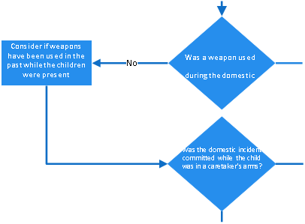
Statewide Screening and Decision-Making Tool for Domestic Violence
SCREEN OUT and REFER
(Refer screened out reports to prevention response and/or another community partner where appropriate)
The LDSS may want to consider the investigation track if one or more of the following are present:
Use of a weapon
Involvement of law enforcement or courts to protect child or caretaker
Physical injury resulting in medical treatment
Co-occurring mental health or substance use
Yes
Yes
SCREEN IN*
*Consider screen-in for physical abuse, physical neglect and/or mental abuse
Yes
SCREEN IN*
ⁱⁱ Close proximity definition: Children were aware, witnessed, or heard the domestic incident
Yes
SCREEN IN*
Notes:
Tanya
In Virginia, the state developed a tool to assist with consistency of screening decisions around domestic violence.

Slide 50
Factors Considered by the Tool
Proximity of the child to the violence
Caregiver unable to protect themselves or child
Other factors: mental health, substance use, stalking behaviors, abduction, abuse of animals
Injury to child (physical or emotional)
Use of weapon in the incident or in the past
Child attempted to intervene
Child in the arms of the caregiver/survivor
Child called for help during incident
History of DV, law enforcement involvement, or protective orders
Increasing frequency or severity of violence
Notes:
Tanya
Proximity = Children were aware of, witnessed, or heard the violence.

Slide 51
Considerations of the Tool
Does the tool determine response time?
Does it consider active protective orders?
Reporter doesn’t have the information
Consideration of high lethality indicators (i.e., strangulation)
How frequently is the tool used? During initial intake call and throughout the case
Notes:
Tanya***
The tool is only as good as the information that is gathered, and sometimes, that information is limited.

Slide 52
Other CYF Enhancements
Formal training on DV for child welfare practitioners
During new employee training
“Learning circles”: facilitated discussions guided by the participating practitioners, based on their needs
No learning circle ever looks the same
On an ongoing basis
Separate learning circles for front line staff and supervisors
Facilitated by domestic violence clinical staff until child welfare practitioners could facilitate independently
Development of formal referral pathways to domestic violence services for advocacy and counseling, and violence intervention services
Notes:
Tanya
We had developed formal referral forms for advocacy, counseling and violence intervention services, utilize the safe and connected framework to staff challenging cases with advocacy, we have gone to court to support staff

Slide 53
Enhancing Practices: Domestic and Sexual Violence Services

Slide 54
Strengthening the Response to Children
Strengthening of protocols for mandated reporting off DSVS Hotline and LAP Line
Formal screening questions- proximity of child to incident,
Balance survivors right to self-determination when we are engaging with them alongside our mandates
Screening for DSVS services
Data now captured and tracked
Training for Crisis Line Team (staff and volunteers) to screen for children needing services and provide formal and community supports
Crisis line staff or advocates will take a question from the field to respond to questions about how to support victims, and vice versa
Notes:
Brittany

Slide 55
Step Up 4 Kids Accomplishments
Professional Resource Card: Mandated reporting role and connection of survivor and child to DV services
Police Resource Card: Increased collaboration and effectiveness with CPS
Increasing public awareness and engagement
Public Awareness Campaigns
Social Media Toolkit and Step Up 4 Kids Day on social media
Strengthen policy, procedure, and practice
Caring 4 Kids Videos
Notes:
Brittany

Slide 56
Step Up 4 Kids Accomplishments
Expand capacity of allied professionals to respond to child witness- all connected to child welfare
Training for Guardians ad litem
Training for mental health clinicians
Training for student social workers in Title IVE programs
Provide trauma informed and culturally relevant interventions
Federal OVW Grant: Children and Youth Exposed to Violence
Individual counseling
Group counseling for children and survivor parents
Training for professionals
Prevention workshops for children
Delivered by culturally specific provider, trusted in the community
Training for Court Appointed Special Advocate Volunteers
Notes:
Brittany
Consider deleting next two slides

Slide 57
Questions?

Slide 58
Contact
Tanya Powers, MSW,
Child Protective Services Supervisor
703-237-6084
Tanya.Powers@farifaxcounty.gov
Brittany Vera, LCSW,
Child Witness to Domestic Violence Coordinator
703-324-3586
Brittany.Vera@fairfaxcounty.gov

Slide 59
References
Bragg, H.L. (2003). Child Abuse and Neglect User Manual Series: Child protection in families experiencing domestic violence. Retrieved from https://www.childwelfare.gov/pubPDFs/domesticviolence2003.pdf
Child Welfare Information Gateway. (2020). Domestic violence: A primer for child welfare professionals. Retrieved April 12, 2018 from https://www.childwelfare.gov/pubPDFs/domestic_violence.pdf
Dube, S.R., Anda, R.F., Felitti, V.J., Edwards, V.J., & Williamson, D.F. (2002). Exposure to abuse, neglect, and household dysfunction among adults who witnessed intimate partner violence as children: Implications for health and social services. Violence and Victims, 17(1), 3-17.
Felitti, V.J., Anda, R.F., Nordenberg, D., Williamson, D.F., Spitz, A.F., Edwards, V., Koss, M.P., Marks, J.S. (1998). Relationship of childhood abuse and the household dysfunction to many of the leading causes of death in adults: The Adverse childhood experiences (ACE) Study. American Journal of Preventative Medicine, 14(4), 245-258. https://doi.org/10.1016/S0749-3797(98)00017-8
Futures Without Violence: Promising Futures. (2016). Effects of Domestic Violence. Retrieved February 22, 2018 from http://promising.futureswithoutviolence.org/what-do-kids-need/get-the-facts/effects-of-domestic-violence/

Slide 60
References
Ganley, A., Schechter, S. (1996). Domestic Violence: A National Curriculum For Child Protective Services. Family Violence Prevention Fund.
Johnson, R.M.; Kotch, J.B., Catellier, D.J., Winsor, J.R., Dufort, V., Hunter, W., Amaya-Jackson, L. (2002). Adverse behavioral and emotional outcomes from child abuse and witnessed violence. Child Maltreatment, 7, 3, 179-186
Safe & Connected™ Practice model. (2022, June 15). KVC Health Systems. Retrieved April 5, 2023, from https://www.kvc.org/the-safe-connected-model/
Understanding relationship abuse. (2022, February 3). National Domestic Violence Hotline. Retrieved April 19, 2023, from https://www.thehotline.org/identify-abuse/understand-relationship-abuse/

