Slide 1
Child and Family Well-Being System Development: The Centrality of Community Leadership
Janese Evans, Associate Policy Analyst, Chapin Hall
Melissa Hall Sommer, Senior Vice President, Brighton Center
Angela Anderson, Coordinator, Brighton Center
April 28, 2023

Slide 2
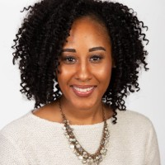
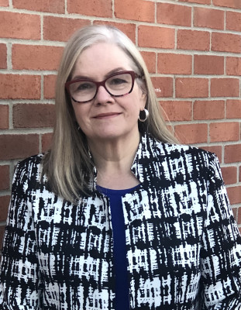
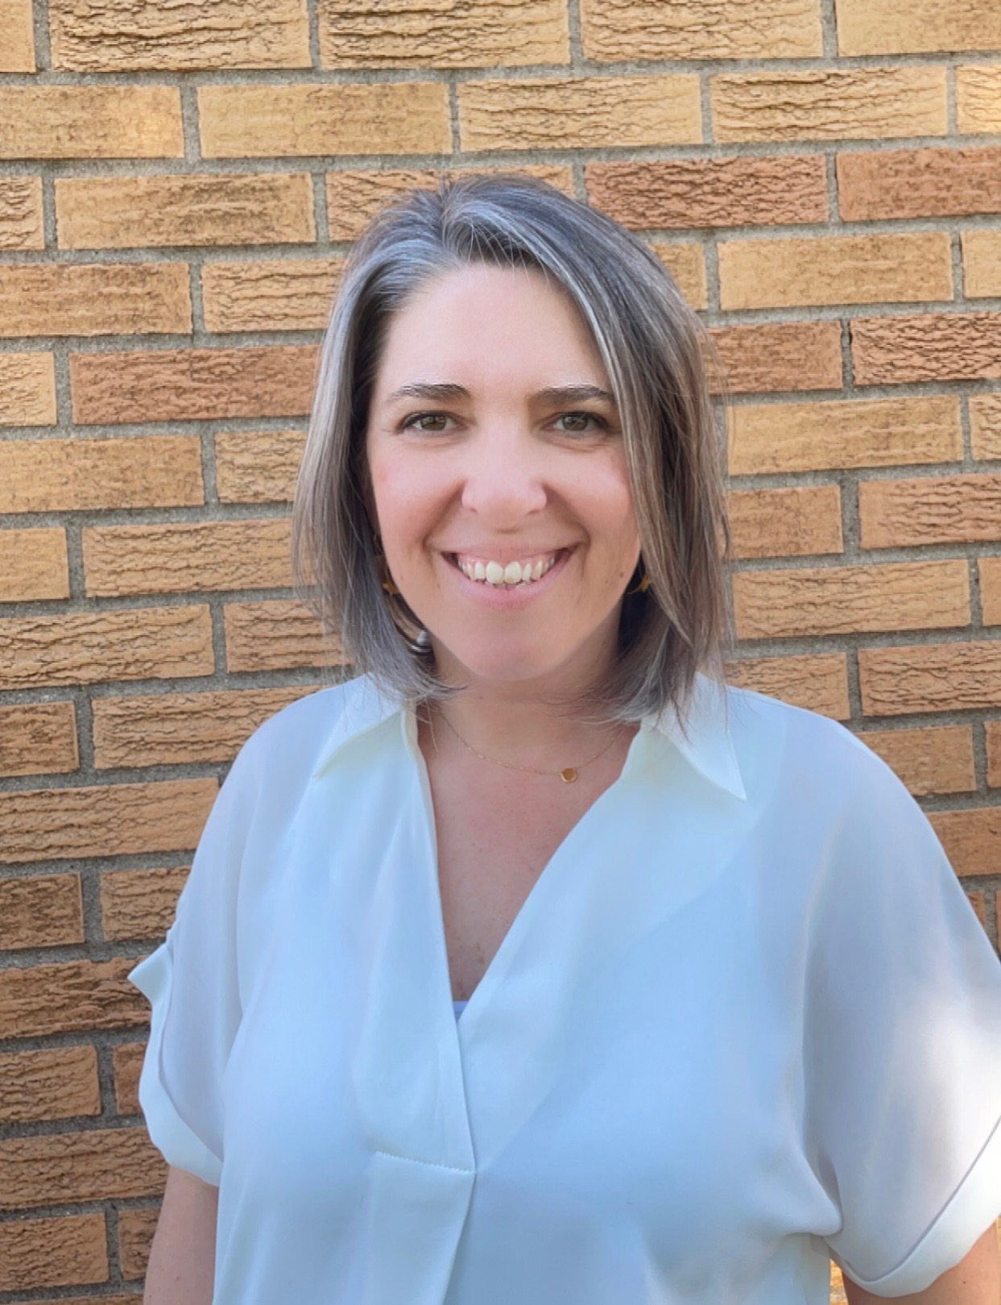
Presenters
Janese Evans
Associate Policy Analyst
Chapin Hall
Melissa Hall Sommer
Senior Vice President
Brighton Center
Angela Anderson
Building Community Well-Being Coordinator
Brighton Center
Notes:
Janese, Melissa, and Angela
2min = 2/75 minutes

Slide 3
Desired outcomes
This session will highlight Kentucky’s Building Community Well-Being Among Families initiative and discuss how the project aims to co-create a robust primary prevention system focused on child and family well-being in partnership with families, communities, and system representatives.
Learn about the successes and lessons learned applying community leadership strategies in the project and think through how these strategies can be applied in your own work.
Provide tools and resources to apply a system change framework and prevention strategy in your system transformation work
Notes:
Melissa
3 minutes = 5/75
As promised the desired outcome for this session falls in three buckets. I will read these three. In the end it is important that the time you invest in this session meets outcomes and more importantly meeting your expectations. So what brought you to this session?

Slide 4
mentimeter poll: Why this session?
Notes:
Janese will run the poll
3 minutes = 8/75

Slide 5
Building Community Well-Being Among Families Project
Notes:
Melissa

Slide 6
What is the Building Community Well-being Among Families grant?
A federal grant aimed at developing a comprehensive child and family well-being system building off the Thriving Families, Safer Children initiative to better address social determinants of health and improve individual and family protective factors.
Notes:
Angela
Aim 1 – discuss co-creating a primary prevention system
3 minutes = 11/75
-Family Support through Primary Prevention grant came across our desk ; opportunity to look at the PPS ; the many parts that we knew existed but did not function together to support our families their desired outcomes around SDoH. Transform child welfare system into a family well being system focused on prevention.
-Only part of system; 4 core partners BC: project lead ,focuses on a whole family 2 gen approach, families know their situation best as they work . CH: rigorous research methods and real world policy expertise; evaluators FNC: private non-profit dedicated to ending cycle of child abuse DCBS: part of the Ky dept for Health and Family Services
-5 years; 1 yer planning 4 years implementation
2 prong approach
Center and apply voices of families with lived experience with the child welfare system
No wrong door approach for engagement
Provide primary prevention strategies through engagement, training, and concrete services

Slide 7
A system rooted in primary prevention that is equitable and inclusive…
Meets families’ basic needs and addresses social determinants of health through robust network of place-based and population-based strategies
Strengthens and builds protective factors, including economic supports
Is co-designed by families, community-driven, and culturally responsive with services and supports reflective of the social context & diverse needs of the community
For example, how does accounting for a child and their family's race/ethnic background change what is considered a "basic" need?
Focuses on achieving equitable outcomes
Changes norms & values, reduces stigma, and promotes inclusivity
Notes:
Angela
Aim 1 – discuss co-creating a primary prevention system
2 minutes = 13/75

Slide 8
Central to primary prevention are services, resources, and supports that are…
Offered on a voluntary basis
Commonly place-based and centrally located within the communities where families live, ensuring easy accessibility
Aligned with community values, norms, and culture
Commonly offered by a public, nonprofit, faith-based or private provider, that may receive funding from the state or county child protection agency, but operates independently of government
Available to anyone that lives in the community, not just to families deemed to be at risk and are offered in normalized, non-stigmatizing ways
Focused on enhancing parental protective factors
Inclusive of concrete supports (limited financial assistance, food assistance, housing assistance, legal services, respite or childcare), clinical services, and peer mentoring or support services and activities
Provided through braided funding including flexible funding, such as CB’s title IV-E waiver demonstration authority, along with state, county, city and private funding.
Source: ACF Information Memorandum ACYF-CB-IM-18-05
Notes:
Angela
Aim 1 – discuss co-creating a primary prevention system
4 minutes = 15/75

Slide 9
To transform the system, we need to change the conditions that typically hold a social problem in place.
Source: The Water of System Change; https://www.fsg.org/wp-content/uploads/2021/08/The-Water-of-Systems-Change_rc.pdf
Notes:
Melissa
Aim 1 – discuss co-creating a primary prevention system
4 minutes = 19/25
The importance of a framework for system change is central to the effectively develop a project where foundation and framework meets strategy and practice to have lasting impact.
We chose the Waters of System change primarily because it addresses Structural, Relational, and Transformational Change. This leads to ultimately a change in Mental Models. Our efforts in this project must lead to a sustainable system change. This model provides that opportunity for true sustainability.

Slide 10
Moreover, a successful prevention strategy includes a set of actions across multiple levels to target these conditions and achieve desired outcomes.
The Spectrum of Prevention
Influencing Policy and Legislation | Developing strategies to change laws and policies to influence outcomes
Changing Organizational Practices | Adopting regulations and shaping norms to improve health and safety
Fostering Coalition and Networks | Bringing together groups and individuals for broader goals and greater impact
Educating Providers | Informing providers who will transmit skills and knowledge to others
Promoting Community Education | Reaching groups of people with information and resources to promote health and safety
Strengthening Individual Knowledge and Skills | Enhancing an individual’s capability of preventing injury or illness and promoting safety
Source: Prevention Institute’s A System of Prevention: Achieving Health, Safety, and Wellbeing for All. https://www.preventioninstitute.org/projects/advancing-system-prevention-achieve-health-equity
Notes:
Janese
Aim 1 – discuss co-creating a primary prevention system
4 minutes 23/75

Slide 11
If we successfully transform the traditional child welfare system to a child and family well-being system rooted in primary prevention, equity, and inclusion, we expect to see…
Improved family well-being
Reductions in child maltreatment and removals from home
Decreased racial disparities
Notes:
Janese
Theory of Change
Aim 1 – discuss co-creating a primary prevention system
3 minutes = 27/75

Slide 12
INPUTS | ACTIVITIES | OUTPUTS | OUTCOMES
 |  |  | Structural Changes: Indicators of improved cross-system infrastructure that facilitates primary prevention | Relational Changes: Indicators of improved relationships, increased collective responsibility, & shared power | Transformative Changes: Indicators of shifting mental models around prevention-oriented norms & values | Long-term Changes: Indicators of a shift to a child and family well-being system
Facilities Computers Supplies Grant staff trainings: Racial equity Ethics & boundaries Mandated reporting CQI Motivational Interviewing Diversity Awareness Family Centered Coaching Self-Sufficiency Matrix CPR/First Aid & Naloxone Service Excellence Positive Youth Development Community Well-Being Alliance Infrastructure & Workgroups Implementation Team Parent/Youth Advisory Boards Evaluation & CQI | Engage Families in: Parent Partners Parent and Youth Coaching Academies Parent Pods Parents and youth in advisory boards | Number of parents connected to Parent Partner Number of parents and youth who go through Parent/Youth Coaching Academy Number of parents with lived experience holding leadership roles as Parent Partners in the primary prevention system Number of parents attending Parent Pods | Families’ protective factors are strengthened | Increased voice, leadership, and power of parents and youth Families serve as resources to other families Families feel less isolated and have greater social connections Prevention system partners will gain an understanding of the perspectives of families and gain respect for the role the individual represents in the system | Families express help-seeking behavior | Increased family well-being Reductions in child maltreatment & removals from home Decreased racial disparities
 | Train Providers in: Racial Equity Well-Being Ideal Norms Family Centered Coaching KYNECT Resources Families in: KYNECT Resources | Number of providers trained in: Racial Equity Well-Being Ideal Norms Family-Centered Coaching The KYNECT system Number of families trained in the KYNECT system Development of a Resource Directory and Regional Web-Based Platform | Families have an increased understanding of prevention resources available and how to navigate the system Providers have increased knowledge of prevention resources that address SDoH in the community | Increased ability of providers to communicate and engage with families through mutual trust and respect Families interact with diverse service providers Families experience anti-racist and equitable services and supports | System partners have a greater understanding of poverty-driven neglect and preventative role of concrete supports Increased prevention-oriented mindset & readiness to change among providers Shift mandated reporter practices to mandated supporter
 | Support Prevention System through: Alignment of prevention efforts across organizations and around well-being Dissemination of PCA Toolkit and information on “Lean on Me” mandated supporter information Establishing prevention referral processes Families through: Parent Cafes Family Coaching Parent Coaches Self-Sufficiency Assessments Concrete Assistance | Extent to which cross-section providers, CBOs, and other organizations (e.g. schools, faith-based, etc.) engaged with Community Well-Being Alliance and Implementation Team Creation of a Regional System Journey Map/ Prevention Alignment Matrix | Increased communication, access, data linkages, and functionality across systems Expanded community-based service options that address social determinants of health | Increased resource sharing | Providers have a greater understanding of poverty-driven neglect and preventative role of concrete supports Increased prevention-oriented mindset & readiness to change among providers
 |  | Number of Parent Cafes held Number of parents attending Parent Cafes Number of families receiving family coaching Number of families receiving a parent coach Number of families assessed for self-sufficiency Number of eligible families receiving concrete assistance Development of a Well-Being Matrix Number of resource coordinators and school staff in NKY school districts reached with mandated supporter information Establishment of process through which to direct hotline calls from the child welfare agency to Brighton Center and partners | Safety net system is resourced to provide concrete assistance Families’ basic needs are met through concrete assistance provided by the Safety Net Alliance | Common well-being outcomes, defined by families, used across the prevention system Families trust resources available to them Families feel valued and affirmed by their service providers | Shift mandated reporter practices to mandated supporter Reduced feelings of stigma by families
Notes:
Janese

Slide 13
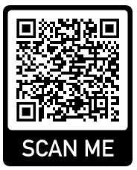
SYSTEM TRANSFORMATION THROUGH COMMUNITY LEADERSHIP​ BRIEF
Source: Kugley, S., VanMeeter, M., Dierksheide, E., & McDaniel, M. (2022). System transformation through community leadership: Strategies for building effective partnerships with Black and Brown communities: Methods report. Chicago, IL: Chapin Hall at the University of Chicago.
Notes:
Janese
3 minutes = 37/75

Slide 14
Mentimeter poll: What system change tools are you interested in?
Notes:
Janese will run the poll
3 minutes = 40/75

Slide 15
Community Leadership Strategies aligned and activated in practice and the road map to follow
Notes:
Melissa
Introduce the road map handout will be used to walk the attendees though concrete strategies used, to align framework described above, and the impact of this alignment.
4 minutes = 44/75

Slide 16
Phase 1: Changing organizational culture
Disrupt system mindsets and habits
Develop and implement a racial equity lens
Come to terms with where we are as an organization models the opportunity to face where we are as a community
Critically identify where systematic racism shows up in the systems that families are navigating
Centering the voice of families to understand strategies to challenge systems and impact the practices that surround the systems
Shift expectations about timelines and outcomes
Shifting expectations of strength through shifting mental models
Lifting the impact of deficit-based models and the role this plays in holding current power dynamics in place.
Notes:
Melissa
8 minutes = 52/75
Develop and implement a racial equity lens.
We are striving to offer a system that "bakes in" racial equity. What does that look like? Level setting with Ground Water and developing a region wide explicit commitment to racial equity.
Develop and implement a racial equity lens
Come to terms with where we are as an organization models the opportunity to face where we are as a community
Brighton Center's journey
Critically identify where systematic racism shows up in the systems that families are navigating
Development of racial equity principles and a corresponding assessment to be used with currents systems and services
Centering the voice of families to understand strategies to challenge systems and impact the practices that surround the systems
Stories from the families and the communities on how this shows up
Shift expectations about timelines and outcomes
Shifting expectation expectations of strength through shifting mental models
Without minimizing the need for benchmarks and outcomes shifting mental models is about stories and strengths.
Lifting the impact of deficit-based models and the role this plays in holding current power dynamics in place.
Lift up expamples

Slide 17
Phase 1: Changing organizational culture
Reimagining community engagement
Prioritize community relationships and trust
Evaluate what barriers to relationship and trust look like
Be Accountable for those barriers
Broaden the decision-making table
Parent and Youth Advisory Boards
Create various, accessible, and substantial engagement opportunities
Parent Cafes
Parent Pods
Primary Prevention Credential
Notes:
Angela
8 minutes = 52/75
Mission and vision statement:

Slide 18
Stories from the Work – Organizational Perspective
Notes:
Melissa

Slide 19
Phase 2: power sharing
Position community to take the lead​
Opportunity and understanding how power shows up in systems​
Create opportunities to build social capital​
Recognize and cultivate community strengths and skills​
Start from existing community expertise and assets​
Create opportunities for leadership and technical skills development
Notes:
Melissa
8 minutes = /75
Position community to take the lead
Opportunity and understanding how power shows up in systems
The difference in allowing power and releasing power
Create opportunities to build social capital
Who defines what this is and how this happens
Recognize and cultivate community strengths and skills
Start from existing community expertise and assets
The power of family led mapping
Create opportunities for leadership and technical skills development
Families determine the guardrails and paremeters

Slide 20
Stories from the Work – Family Voice
Notes:
Angela and Family video
We've talked a lot about centering and applying the voices of our parents and caregivers with lived experience but have yet to bring those voices here.
Larika: CET, BCWB

Slide 21
Stories from the Work – Partner Voice
Notes:
4 minutes = 72/75

Slide 22
Phase 3: Shifting resources to empower and sustain community leadership
Transform systems with community in the lead
Establish community ownership over system responses and resources
Transfer of Power
Community Response
Scale up and share out
Notes:
Angela
8 minutes = /75
Transfer of power every one has power identifying space where power can be exercised. RFP had oppression had language of oppression within it.
Scale up and share out : State wide initiative but started grassroots building that by saying this is how parents are interfacing and built out this how parent "if this than that".
This is what I'm doing

Slide 23
Phase 3: Shifting resources to empower and sustain community leadership
Build collaborative infrastructure
Commit to continuous learning and evaluation
Embed community leadership and adapt
Notes:
Melissa
8 minutes = /75

Slide 24
Presentation takeaways
System transformation tools
The Water of Systems Change
Tools for championing community leadership in system transformation
Lessons learned and challenges
Currently in year 2 of the grant and initial phase of implementation
Sharing power and adapting engagement strategies take time to implement and see change
Next steps
Chapin Hall evaluation process - Evaluation process designed to be participatory and centering community & families; lessons learned from CQI efforts
Brighton Center implementation process – continuing to fall forward; understanding how we should be led by families and the community; looking for opportunities to share power
Notes:
Janese & Angela
3 minutes =70/75
Takes time, takes vulnerability
Meeting families where they are, sometimes in crisis
Building staff capacity and Parent engagement capacity

Slide 25
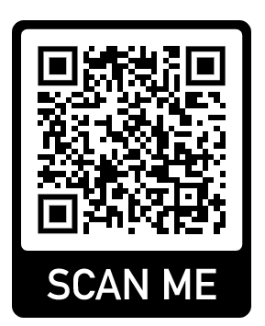
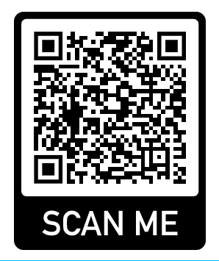
System transformation tools
The Water of Systems Change
Toolkit for championing community leadership in system transformation

Slide 26
Q&A
Now it is your turn … what questions do you have?

Slide 27
Questions or comments? Please reach out to: Janese Evans (jevans@chapinhall.org) Melissa Hall Sommer (msommer@brightoncenter.com) Angela Angerson (aanderson@brightoncenter.com)
Chapinhall.org
Notes:
(Include presenter contact information here)

Slide 28
Thank you!!

