Slide 1

Early-Adolescent Attachment: The Second-Most Critical Attachment Period and an Opportunity for Permanency
Adrienne Miller, Ph.D..

Slide 2
Learning Objectives
explain why early adolescence is the second-most critical attachment period.
describe what early adolescents need to achieve secure attachment post-placement.
list three ways they can ensure early adolescents entering placement are set up for secure attachments.
As a result of attending this presentation participants will be able to:

Slide 3
Attachment is the relationship or bond that develops over time between a parent and a child or between two people.
WHAT IS ATTACHMENT?
Infant /Toddler
Parent only
Adolescent
Parent and Peer
Adult
Peer Only

Slide 4
History of Attachment
Bowlby
Ainsworth
Main & Solomon
Bartholomew & Horowitz
Fraley
Disclaimer …
4 Categories of Attachment
Secure Autonomous
Insecure Anxious/Preoccupied
Insecure Avoidant/Fearful
Insecure Disorganized/Dismissive

Slide 5
Infant/Toddler | • express upset when mother is gone and greet her when she returns. • use mother as a touchstone while playing
Adolescent | • seek independence, but know when to go to caregivers
Adult | • more likely to be committed to relationships. • have better coping skills and are less likely to exhibit depressive or mental health concerns. • more likely to display appropriate parenting skills from the onset of child’s birth.
Secure Autonomous

Slide 6
Infant/ Toddler | • Doesn’t explore and remains by mother’s side, but takes no comfort from her proximity. • Cried when mother left the room, but expressed anger upon her return and didn’t gain comfort from attempts to soothe, but tried to move away.
Adolescent | • Reluctant to be independent • Maintain that caregiver’s beliefs are always true and correct. • Incorrectly interpret social/peer cues and expressions.
Adult | • More likely to be constantly worried about self-worth and assessing their relationships. to base their worth on whether they have a relationships. • more likely to be overly permissive parents to gain child approval.
Insecure – Anxious/Preoccupied

Slide 7
Infant/ Toddler | • Did not use mother as a touchstone, explored on their own with no check-ins with the mother. • Showed no distress when mother left the room and no reaction when she returned.
Adolescent | • Youth already avoids the primary caregiver, during this time they disengage completely. • More likely to engage in risk-taking behavior to establish themselves as independent from the caregiver and an emancipated individual. • Views themselves to be irrelevant to social relationships which are treated as an unnecessary annoyance.
Adult | • Little tolerance for intimate relationships and are unlikely to have more than perfunctory friendships. • Desire relationships, but will end relationships before getting too close to avoid getting hurt. • More likely to be strict as a parent with thoughts of keeping a child from getting hurt.
Insecure – Avoidant/Fearful

Slide 8
Infant/ Toddler | • Showed characteristics of other two insecure categories but was afraid or confused. • Behavior had no clear goal (i.e. comfort or avoidance) and child appeared disoriented. • This attachment style was most often seen in children who have experienced maltreatment.
Adolescent | • May display any of avoidant or anxious characteristics or a combination of both, but due to trauma/maltreatment, the cause behind actions and reactions is different. • May have extreme fear/anger in conjunction with anxious/avoidant behaviors, to the point of behavioral disorders or dissociative disorders.
Adult | • More likely to have mental health concerns, substance use, and physical health concerns than securely attached adults. • Have little to no meaningful relationships and are more likely to be in a violent relationship, either as the recipient or perpetrator. • More likely to have dissociative disorders and more likely to use dismissive attachment characteristics with their own children.
Insecure – Disorganized/ Dismissive

Slide 9

Last Items
FUNCTIONALITY
DESIRE ATTACHMENT
ARE NOT SET IN STONE

Slide 10

Body
Brain
Cognitive
Social-Emotional
Early Adolescence (10-14 years old) = Second-Most Critical Attachment Period
PARENTS
PEERS

Slide 11

Body/brain
Puberty
Hormones – Dopamine
Brain Cell Production/ Neural Pathway Reconstruction
Mirrors….

Slide 12

Cognition
Concrete → Formal Operational
Egocentrism
Risk-Taking

Slide 13

Social-Emotional
Self Worth
Self-Regulation
Coping/Resiliency

Slide 14
Body
Brain
Cognitive
Social-Emotional
Early Adolescence (10-14 years old) = Second-Most Critical Attachment Period
PARENTS
PEERS

Slide 15
Why This Study
Lack of Early Adolescent research re Foster Care
Attachment Post-Placement IS possible
Every child deserves the best possible outcome

Slide 16
Components of the Study
Young adults (ages 18-24)
Placement setting (foster or kinship care/ group home/ residential care)
Sibling placement (did they have siblings and if so, were they placed together)
Age at first only placement (early adolescence or not)
Attachment style (Adult Attachment Scale)
Quantitative (SPSS v. 25)

Slide 17
Participants of the Study
Young adults (ages 18-24) nationwide
Total number of participants = 83
Medium/moderate effect size
Completely Anonymous
Questions Via Online Survey

Slide 18
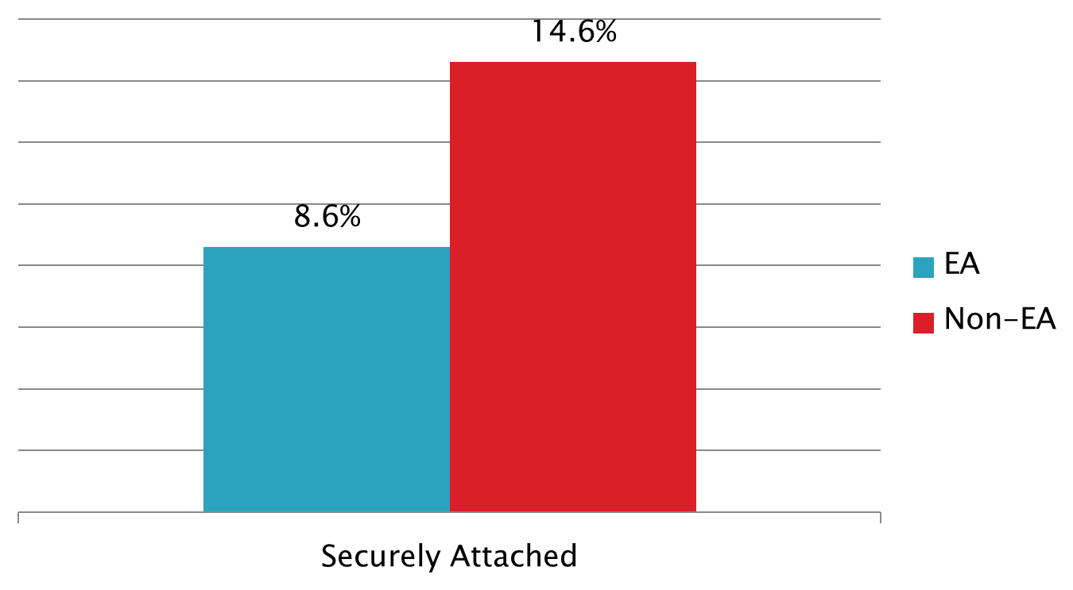
results
Participants who had been removed during early adolescence were almost half as likely to be securely attached compared to those removed at other time periods.

Slide 19
results – all participants
Placement
90% of securely attached individuals lived in FH/KH
Siblings
100% of securely attached individuals had siblings
70% lived with them
New information- no individuals without sibs were securely attached

Slide 20
Results – early adolescent specific
According to research, EA need balance of Parent and Peer
Majority of insecurely attached EA in FH/KH also had sibs living with them (65%)
So, What Happened??

Slide 21
Results – early adolescent specific
Back to the Literature...
EA have difficulty attaching (the perfect storm)
If foster/kinship homes have training specific to
Early Adolescent Development/Attachment
AND
Trauma resiliency
THIS CAN OVERCOME THE YOUTH FACTORS

Slide 22
What can you Do?
Place siblings together as often as possible
Place early adolescents (and their siblings) in foster homes/and kinship homes.
If a child is an “only child”, ensure they maintain connections with peers
Offer Foster and Kinship caregivers training on trauma, attachment, and early adolescent development (i.e. all the information you have learned today)
Check-in on what the early adolescents and the FP/KPs need
Spread the word!

Slide 23
Conclusions
Early Adolescence = 2nd most critical attachment period
FH/KH = best placement option
Siblings are critical, so critical that no individuals without siblings were securely attached.
EA need attachment to both adults and sibs
FP/KPs need trained on EA development/attachment & trauma for best likelihood of attachment post-placement

Slide 24

QUESTIONS?

Slide 25
Contact Info
ADRIENNE MILLER, PH.D.
amille13@heartlandforchildren.org
Adrienne.miller@uagc.edu
850-300-9655

