Slide 1
Working Across Systems to Understand Early Childhood Education Participation for Children in Foster Care
Amy Dorman, MPP, Kristine Piescher, PhD, Traci LaLiberte, PhD
Center for Advanced Studies in Child Welfare
University of Minnesota

Slide 2
Study Background
This study is a partnership between the Center for Advanced Studies in Child Welfare and the Center for Early Education and Development, in consultation with the Minnesota Departments of Human Services and Education.
The study period is from June 2022-June 2023. Additional qualitative data will be collected through the end of April 2023.
For the purpose of this study, “early childhood education” includes Early Head Start, Head Start, Early Childhood Special Education programs, Early Childhood Screening, Early Childhood Family Education, Voluntary Pre-Kindergarten programs, School Readiness and School Readiness Plus programs, and ECE programs covered by Early Learning Scholarships in Minnesota.

Slide 3
Issue Overview
Early childhood education and care (ECE) participation has significant benefits for young children and families with child welfare system involvement and may help reduce disparities over the lifespan.
Yet, ECE participation of children in foster care remains consistently low, despite federal efforts to prioritize their enrollment.
Despite the categorical eligibility and low participation rates of young children in foster care, existing research on ECE participation has rarely focused on young children in foster care and their families.

Slide 4
Objectives
The purpose of this mixed methods study is to:
Quantitatively assess rates of ECE participation of young children (0-5 years of age) in foster care, by race/ethnicity, age, and geography.
Qualitatively understand barriers and facilitators of participation in ECE programs for young children in foster care in Minnesota.

Slide 5
Quantitative Methods
The quantitative findings are based on data contained in the Early Childhood Longitudinal Data System (ECLDS).
The purpose of the quantitative analysis was to provide counts and rates of participation in early care and education (ECE) programs by young children (aged 0-5) who have experienced foster care and, to the extent practicable, to disaggregate the counts and rates of participation by children’s race, ethnicity, age, and county of residence.
To facilitate the analysis, data were integrated, cleaned, and analyzed by the Minnesota Departments of Human Services and Education; findings were provided to the University of Minnesota research team for interpretation.
Given state agency concerns around COVID-19’s impact on data reliability for academic years 2020 and 2021, data from academic year (AY) 2019 were analyzed to provide a pre-pandemic snapshot of ECE participation for young children in foster care.

Slide 6
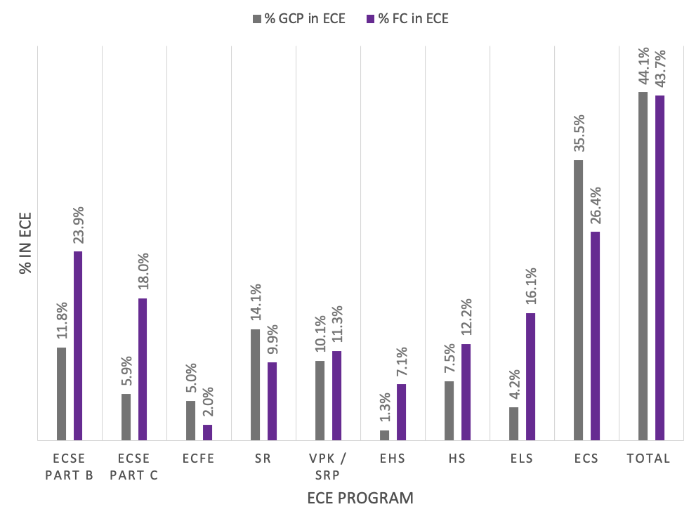
Quantitative Findings
A majority (56.3%) of young children in foster care were not enrolled in any ECE program in academic year 2019.
Participation rates for young children in foster care (43.7%) were comparable to participation rates of the general child population (44.1%) in Minnesota.
ECE Participation for Young Children in Foster Care Compared to the General Child Population, by Program, during AY 2019.

Slide 7
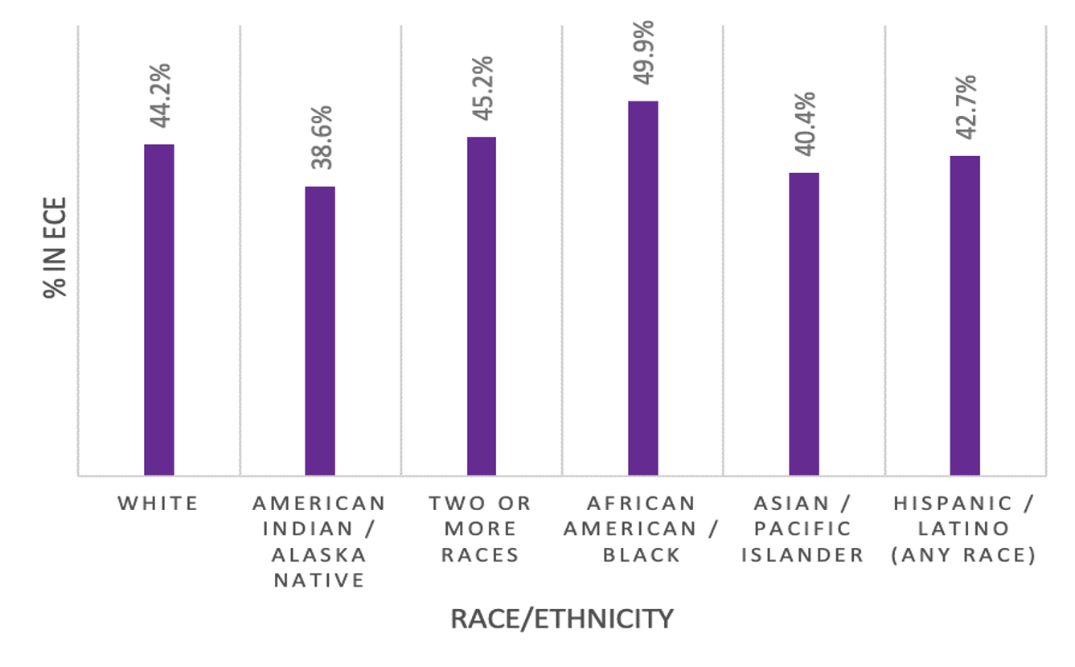
Quantitative Findings
ECE Participation for Young Children in Foster Care by Race and by Ethnicity (percent) during AY 2019.
African American/Black children in foster care had the highest rates of ECE participation (49.9%) and American Indian/Alaska Native children in foster care had the lowest rates of ECE participation (38.6%).

Slide 8
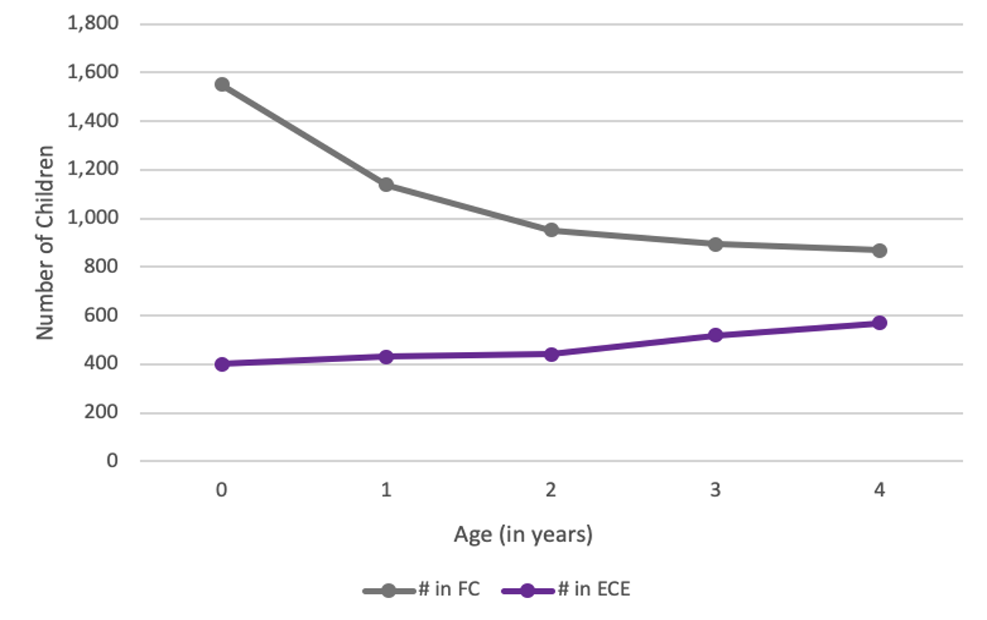
Quantitative Findings
ECE Participation for Young Children in Foster Care by Age during AY 2019.
Although children less than one year of age were the largest age group in foster care in Minnesota, they had the lowest rate of ECE participation (25.9%).

Slide 9
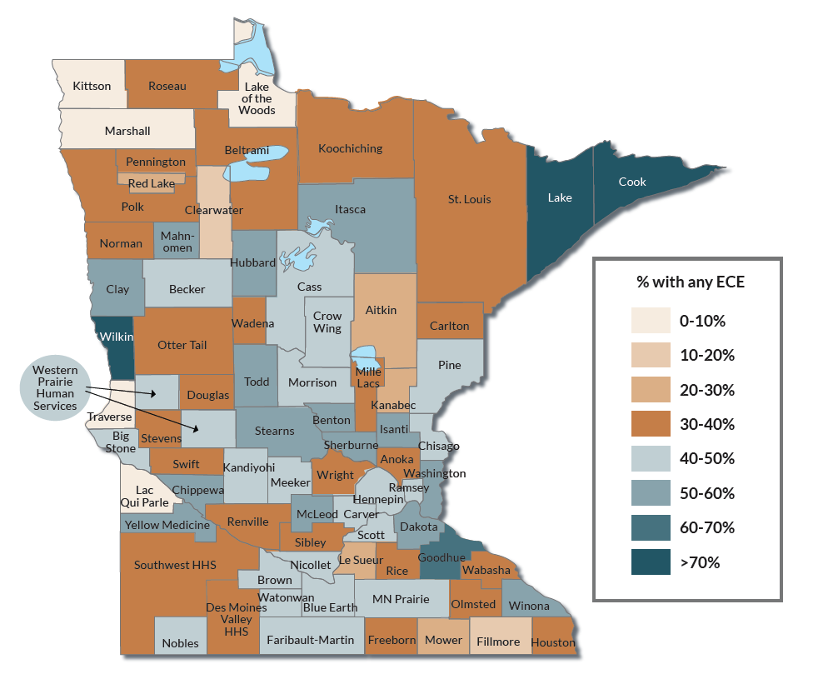
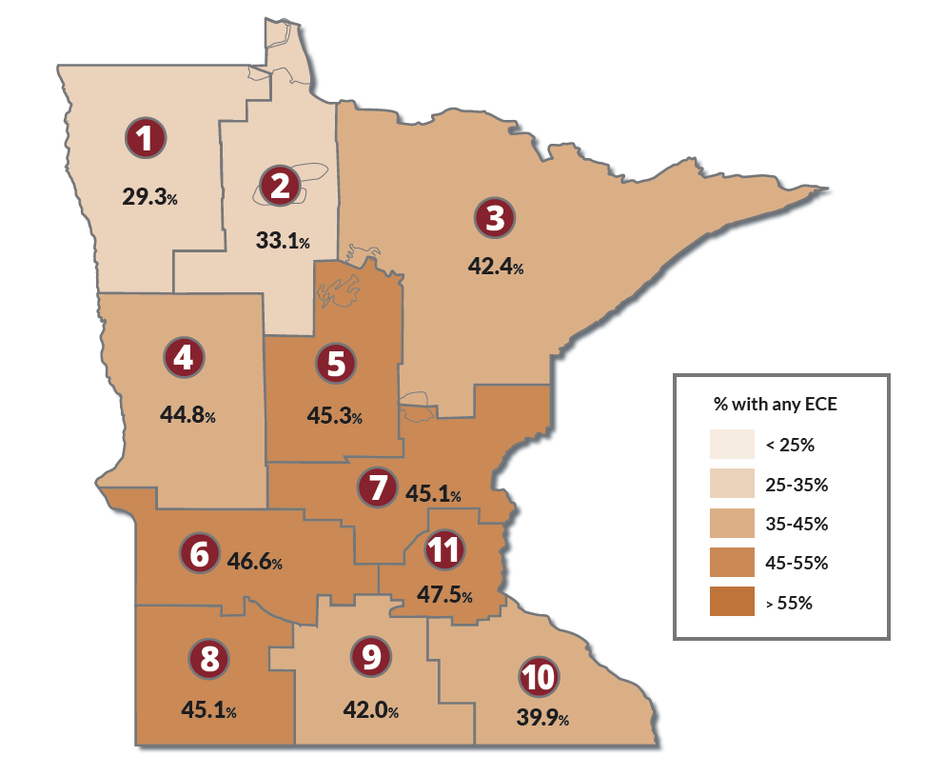
Quantitative Findings
Most counties (72%) had ECE participation rates for children in foster care under 50%.
ECE Participation Rates for Young Children in Foster Care by County during AY 2019.
ECE Participation Rates for Young Children in Foster Care by MACSSA Region during AY 2019.

Slide 10
Qualitative Methods
Policy-level interviews:
In Fall 2022, the research team conducted 18 interviews with 19 professionals from the Minnesota Department of Human Services, the Minnesota Department of Education, and relevant community organizations.
Interviewees were asked about their professional background and current role as it relates to ECE participation and foster care, as well as broad-level (e.g., policy) barriers and facilitators to participation in ECE programs for young children in foster care in Minnesota and recommendations to increase participation.
Interviewees with administrative data experience were also asked about their understanding of the strengths and challenges of working with state administrative data systems relating to ECE participation for this population, and recommendations to improve current administrative data systems.

Slide 11
Qualitative Methods
Family and frontline staff interviews:
In January 2023, the research team developed a sampling methodology using federal Rural Urban Commuting Area codes to identify counties across Minnesota for outreach.
Foster family, biological family, and child welfare staff and ECE admin participants were recruited across 10 counties. Participants engaged in a role- and county-specific focus group or interview.
Additional statewide recruitment began in March 2023.
Participants were asked about barriers, facilitators, and recommendations related to enhancing ECE participation for young children in foster care.
To date 30 family participants and 33 staff participants have been engaged in the study.
Data collection will conclude at the end of April 2023.

Slide 12
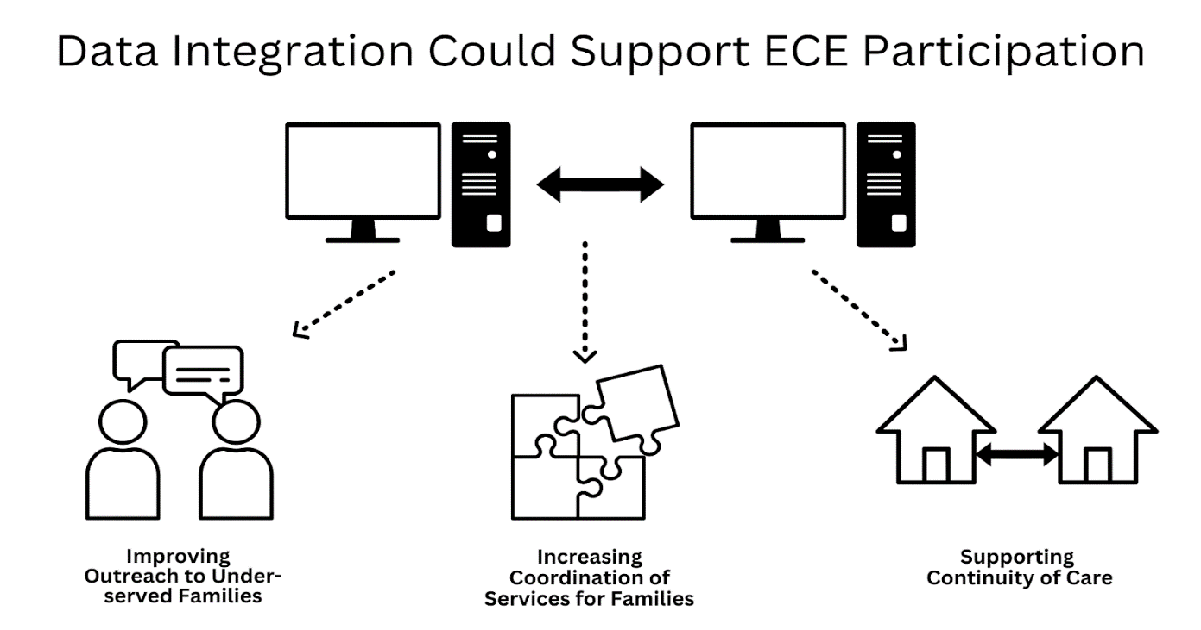
Qualitative Findings
There is a need for increased and improved data collection and integration to help local and state authorities better reach, serve, and support families in accessing ECE.

Slide 13
Qualitative Findings
Barriers to ECE participation vary across locations because counties, districts, and programs often operate differently and have access to different resources.
Every county operates a little bit differently, even though they're also doing the same according to statute. That has often been a struggle that has been articulated by school districts: There isn't a uniform way of managing that communication [around children in foster care] and clarity in guardianship [for those children].
If you're in very rural outstate Minnesota, there may not be options. Maybe there's one provider or no providers, and if there's one provider, they're full. Whether a kinship [family] or someone else, they can't [transport the child to the ECE program] because of a work commitment or whatever the reason is. Then the child loses access.
It's county property dollars that are determinative around the level of support that's accessed within each county of origin, and that's a system that is unfair. That leaves the state in a challenging place of having authority, but little actual practical support.

Slide 14
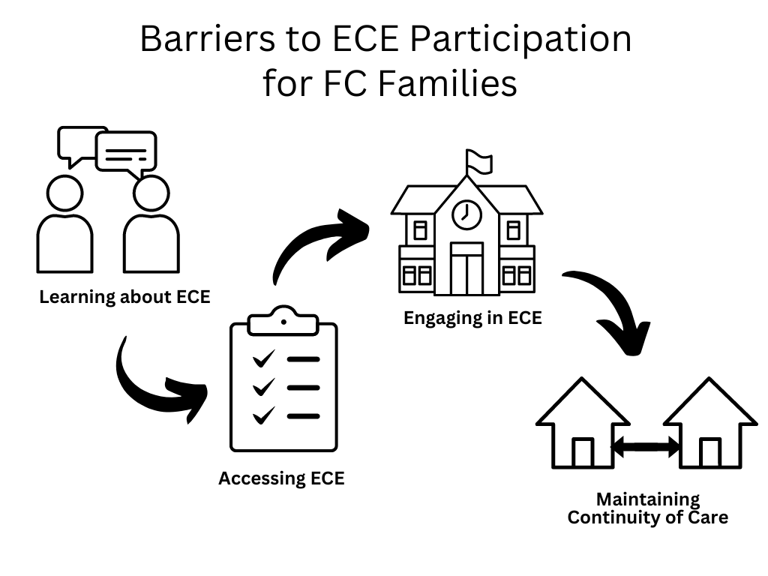
Qualitative Findings
Families may experience barriers to ECE participation across multiple points in the process, including barriers to:
Learning about ECE
Accessing and enrolling in ECE
Engaging in ECE after enrollment
Maintaining continuity of care

Slide 15
Qualitative Findings
At this point in the study, families have identified several specific barriers to ECE participation, including:
Transportation
Hours of operation
Waitlists and program availability
Costs associated with childcare
Limited readily available information on ECE programs
Daycare was gonna kick him out, so I kept asking for help and asking for help, and I'm like, I have a job, I have to keep my job, I lost two promotions because I wasn't at work enough. I'm having to work late at night or early in the morning, to make sure that I get my hours in and get my job done because of all this transportation.
The one thing that has come up over and over again is transportation. And there's no money, and I don't know what the answer is, but that was the biggest, biggest thing that I have seen with myself, my foster kids and even some of my grandkids that live in this area.
It was a good chunk of my stipend to pay for two boys in daycare, 'cause even though the one was in Head Start, I still had to pay a full-time price for him to go to daycare.

Slide 16
Qualitative Findings
Families may experience these barriers to ECE participation in different ways based on family type (e.g., foster families, kinship or relative caregivers, biological families) and the unique needs of the children in their care.
If you want a child to be with kin, and the kin doesn't live within that service area, what do you do? You really need the child to go to live with their kinfolk, because that is less traumatic when you're placing the child. So then if you want to keep this child in their educational setting, then the child is going to need transportation.
Kids with trauma, including separation from being in foster care, need even more control of their lives than typical for children their age... So [as a foster parent], when you're weighing all of that on top of the visitation and private services and even getting into the doctor and sometimes having higher medical needs and needing to go from multiple appointments, [ECE participation] just doesn't fit well.

Slide 17
Qualitative Findings
Facilitating factors for families include:
Cross-system collaboration and coordination
Relationships: between ECE or child welfare staff and families, and within informal networks of families
Individual advocacy, knowledge, and prioritization: by families, by individual staff members
One of the indicators we hear about that makes coordination work best on a local level is when there's an ability to draw on pre-existing relationships and trust in the other partners.

Slide 18
Conclusions and Opportunities
Prioritization by individuals, programs, agencies, and state and federal policy helps create momentum for positive change.
We often don't make progress because we give an issue attention, think that something has happened, and then it goes back to the status quo after a few years. How is [ECE participation for young children in foster care] being sustained in Minnesota as far as it being a topic that needs to be addressed?

Slide 19
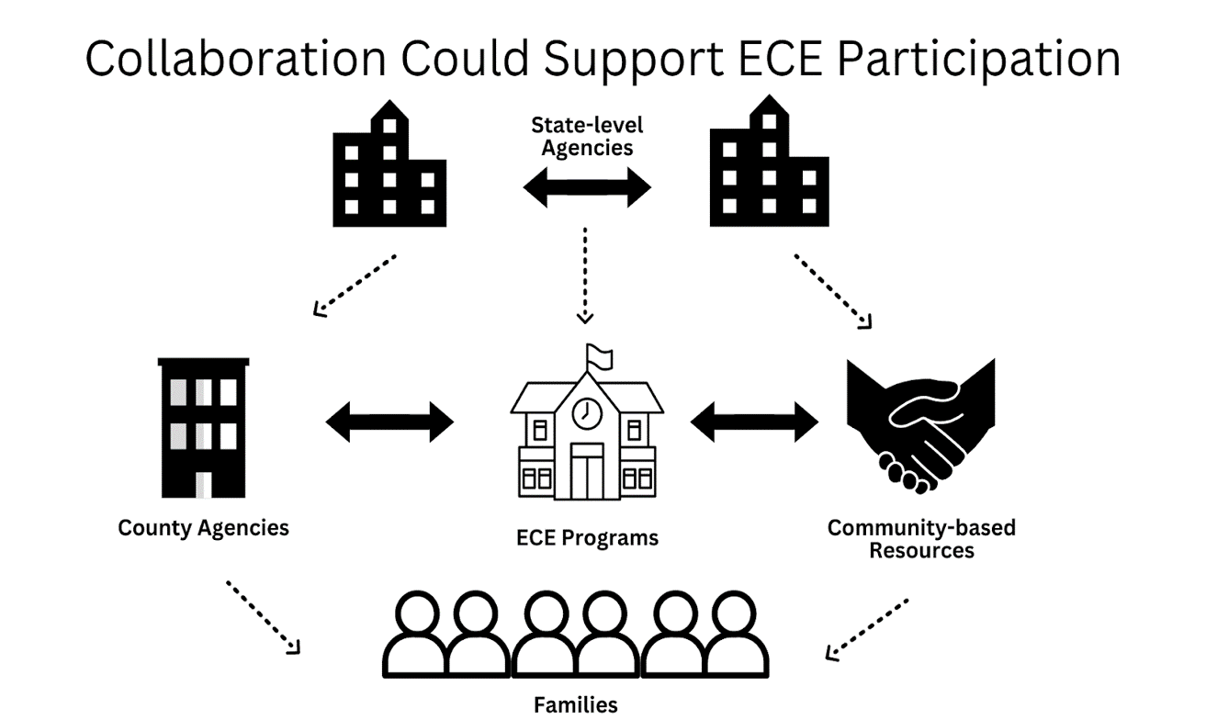
Conclusions and Opportunities
Collaboration is key to success in siloed and/or county-administered systems.

Slide 20
Conclusions and Opportunities
There are opportunities to:
Build upon current efforts and policy frameworks, including eligibility and service coordination activities.
Enhance training 1) on ECE benefits and resources for child welfare staff and administrators and 2) on the unique needs of children in foster care for ECE staff and administrators.
Ensure that prioritization efforts are well-funded and sustainable long-term.
It's critical to build capacity from all parties [child welfare workers and ECE program staff] that are involved in the work of supporting children to understand what each other's roles and responsibilities are.

Slide 22
Web: cascw.umn.edu
Email: cascw@umn.edu
Sign up for CASCW Connect newsletter (visit out home page at cascw@umn.edu and complete short form)

