Slide 1
The Impact of Enhanced Kinship Navigation on Caregivers and their Children

Slide 2
agenda
Introductions 3
History 5
Essential components 11
Overview of outcomes 12
What can you take home 24
Notes:
overview of the impact of an enhanced Kinship Navigator program
essential components of the enhanced model
overview of both quantitative and qualitative outcomes
Attendees will be invited to reflect on opportunities to enhance Kinship Navigator programs in their own communities.
Attendees of this session will:
Understand the design and key elements of Washington State’s Kinship Navigator program
Understand the outcomes of the enhanced program model for kinship caregivers and their children
Understand the current funding model for Kinship Navigator programs and the potential implications of programs being able to draw down Title IV-E funds
Apply the lessons learned from Washington’s program design and evaluation results to Kinship Navigator programs in their own communities.

Slide 3
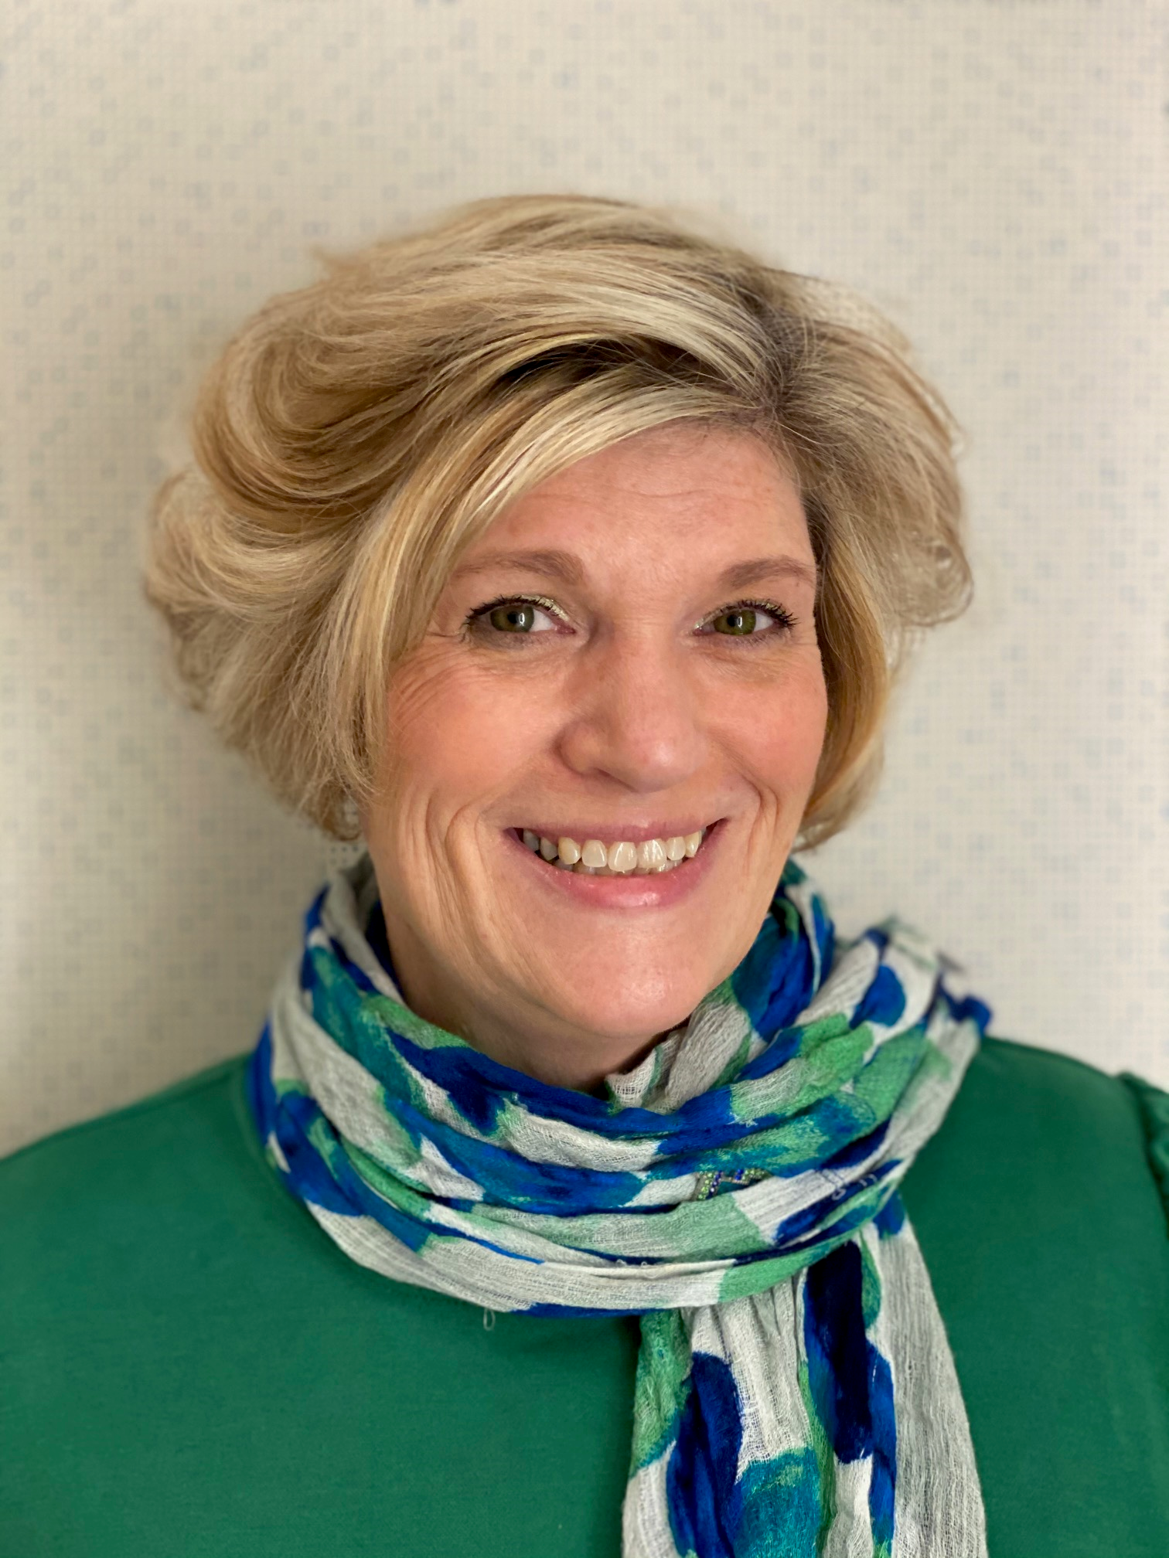
meet our presenters
Geene Delaplane
Rosalyn Alber
Angelique Day
PhDc, Kinship Care and Guardianship Program Manager
Kinship Program Manager
PhD, MSW
Associate professor University of Washington

Slide 4
What is kinship care?
Full-time care by relative or family-like connection
Caregivers are most commonly grandparents
Caregivers tend to be women and lower-income
Kinship care has benefits for children
Most kinship caregivers aren’t involved in the child welfare system
Notes:
Benefits for children:
1. Sib groups together
2. Less placement disruption
3. ties to cultural roots
4.ETC
What is a typical grandparent and how is that changing
Most kinship caregivers aren’t involved in the child welfare system formal vs informal

Slide 5
Kinship Stats
 | 2018 | 2019 | 2020
Total population <18*
National | 73,385,501 | 73,088,675 | 72,822,113
Washington | 1,657,823 | 1,661,024 | 1,665,794
Living with neither parent*
National | 3,792,000 | 4,020,000 | 3,736,00
Washington | 75,000 | 77,000 | 78,000
Living with grandparent*
National | 2,787,000 | 2,791,000 | 2,531,000
Washington | 44,000 | 41,000 | 42,000
Children in Wa in out-of-home care ** | 9,185 | 9,160 | 8165
Kinship | 3,980 | 3,954 | 4,403
Non-Kinship | 5,205 | 5,206 | 3,762
*Data from the Annie E. Casey KIDS COUNT data center available at https://datacenter.kidscount.org/
**Data from Adoption and Foster Care Analysis and Reporting Systems; INFOFAMLINK Relative Versus Non-Relative Placements, January 29, 2020. Data reflects the number of children in out-of-home care as of January 29 of the indicated calendar year.

Slide 6
History
2004- 2 pilot sites (Yakima & King Co) were funded through Casey Family Programs.
2005-the 2 pilot sites were funded by state legislature ($100,000 per year).
2007-Leg increases Kin Nav funding ($400,000) for 4 additional Navigators and adds funding 2 positions to full time.
2008-Leg increases Kin Nav Program ($132,000) for 1.5 additional Navigators.
2016-WA State Legislature funded a Tribal Kinship Navigator initiative.
2023-Statewide advocates are seeking increased funding Kinship Navigator.
The Impact of Enhanced Kinship Navigation on Caregivers and their Children
Notes:
2005-the 2 pilot sites were funded by state legislature ($100,000 per year) ALTSA contracted with two AAAs (Aging and Disability Services-Seattle/King County and SE WA AAA in Yakima) to sponsor two kinship navigator positions in FY 2005 that were originally supported by Casey Family Programs.
2016-WA State Legislature funded a Tribal Kinship Navigator initiative which enabled eight Tribal Nations to develop a proposal and receive funding for SFY 2017. A half-time position at ALTSA was supported to guide kinship programs.
The advocates have asked the legislature for an increase to existing Kinship Navigator funding that was first allocated in 2009 to allow for COLA in 2023. They are seeking an increase to current funding for Navigator to Aging and Long-Term Support Administration (ALTSA) to $130,000 per Navigator (market rate salary - inclusive salary/benefits). This would cost $630,000 (Biennial amount). Give legislative update here
Currently there are only 14.5 Kinship Navigators covering Washington State and adding four and one half (4.5) additional positions would allow a minimum of at least ONE Navigator in each region across our State (as identified by the Area Agencies on Aging). This would cost $1,170m (Biennial amount) for the additional 4.5 Navigator FTEs @$130,000.

Slide 7
Kinship Navigator Programs Services as Usual
Kinship Navigator programs help caregivers navigate service networks and access resources
WA services as usual:
Navigators in 30 of 39 counties
Hotline model with no follow up
Comparison sites for research: 12 counties that continued providing Kinship Navigator services as usual
The Impact of Enhanced Kinship Navigation on Caregivers and their Children
Notes:
Hotline model also known as I&A/I&R

Slide 8
Enhanced Model
In 2018, three state agencies partnered to implement an enhanced model in 7 counties in Washington state
Pilot Sites: navigators complete a needs assessment and establish goals with the caregivers
Navigators and caregivers work together for up to 6 months to address needs and track progress towards goals set at intake
The Impact of Enhanced Kinship Navigation on Caregivers and their Children
Notes:
Seven counties across Washington state
Yakima
Benton
Franklin
Lewis
Mason
Thurston
Pierce
Three state agencies: DCYF, ALTSA, UW
Def. Needs Assessment and how it was developed with KCOC
Navigators, kin caregivers, and tribal members, as well as other stakeholders
Differences between two services models
Services as usual: Caregiver reaches out as needs arise
Navigators set up times to follow up with families

Slide 9
Research Design
Intake
Demographics
Needs assessment
Goal setting
Three-month follow-up
If caregiver still needs support, case stays open
Six-month follow-up
Case closed at this time, but can be reopened
Six-month post-close follow-up
Closed case form and satisfaction survey
Twelve-month post-close follow-up
Closed case form and satisfaction survey
The Impact of Enhanced Kinship Navigation on Caregivers and their Children
Notes:
Detailed family demographics
Six month follow up only happens if case stays open as goals are not yet met or new goals set

Slide 10
Intervention and Control/Comparison Site Selection Process
Selection was made by collecting information about services provided at each location including:
Kinship support groups,
Kinship Navigator,
Kinship Newsletter,
Legal Clinics,
Kinship Closets,
Kinship Collaborations,
Parenting Classes,
Spanish Speaking Navigators,
Kinship Website, etc.
Intervention sites provide 5 or more services from the list; control sites provide fewer than 5 services from the list.
Also used Census Data as part of strategy to ensure baseline equivalence

Slide 11
Data sources
Survey content area | Example question | Answer options
Children who left the home | Where did the child move to? | Returned to birth parent / Entered foster care / Moved to another kin caregiver / Aged out / Other
Caregiver physical health | In general, how would you rate your physical health? | 1 = Excellent to 5 = Poor
Behavioral health of children still in the home | Are your kinship child’s behavioral health needs being met? | Yes / No / Not applicable / I don’t know
Education of children still in the home | Has your kinship child been suspended or expelled? | Yes, suspended / Yes, expelled / No / I don’t know
Two surveys - child outcomes and caregiver outcomes six months after case closure
Administrative data:
Enrollment in benefits
Child-Only TANF
SNAP
Family referral to DCYF
Abuse allegations and substantiations
Caregiver race
Caregiver gender
Kinship Caregiver Support Program (KCSP)
Notes:
Sierra
Point out we also used admin data compiled by ALTSA and from AFCARS and NCANDS

Slide 12
Essential Components
2023
Notes:
Talk more about program design:
How the elements were selected: Based on previous focus groups and studies
What parts would they include in their own states?

Slide 13
Overview of Outcomes

Slide 14
Caregiver demographics
Intervention site caregivers (n=126)
Comparison site caregivers (n=126)
Census data for WA grandparents responsible for grandchildren
64% White
83% not DCYF involved
39% SNAP recipients
58 years old
22% Hispanic
6% Black
7% AIAN
71% White
84% not DCYF involved
40% SNAP recipients
58 years old
10% Hispanic
10% Black
6% AIAN
72% White
12% Hispanic
4% Black
6% AIAN
We used Propensity Score Matching (PSM) to control for caregiver race, age, and income
*Demographic data from satisfaction survey results
The Impact of Enhanced Kinship Navigation on Caregivers and their Children
Notes:
We used Propensity Score Matching (PSM) to control for caregiver race, age, and income

Slide 15
Enrollments and fidelity compliance
Goals at
Case Closure
Enrollments
Fidelity
172 cases met fidelity (81%)
Fidelity compliance improved after one year (94%)
Average number of goals: 3
91% of caregivers completed at least one goal
60% of all goals were completed
261 enrolled
48 withdrew (18%)
213 total valid enrollments
Notes:
Angelique Withdrawal reasons: Unable to contact (40%), child left home before case closed (27%), caregiver moved out of service area (11%), caregiver self-withdrew (11%)
Fidelity means completing the elements I listed on the last slide

Slide 16
Other Contributions to Increased Fidelity
Interns were used to help facilitate follow up calls.
Spanish speaking Navigators- we contracted with bilingual case manager to do post case management calls with Spanish speaking caregivers.
COVIDs impact- increased the ability for caregivers to utilize electronic methods of communication. We also found that during the lockdown, people were hungry to have conversations and were very responsive to phone calls.
One key to targeting populations was to have census data for each region in the project. This allowed project partners and the Navigators to target outreach to align with the demographics of each community.
Navigators have long term relationships with caregivers in their communities and assisted greatly with outreach and follow-ups.
Notes:
Roz
Example in Yakima being a high rate of monolingual Spanish speaking a navigator was hired that was a member of that community and bilingual.
Each region has support groups for caregivers to connect with one another through outreach

Slide 17
Significant Differences
The Impact of Enhanced Kinship Navigation on Caregivers and their Children

Slide 18
Caregiver access to services
Intervention caregivers were 9.4x more likely to say they used support groups
* Indicates a statistically significant result

Slide 19
Caregiver access to benefits
Intervention caregivers were 1.9x more likely to be enrolled in Child-Only TANF
* Indicates a statistically significant result
Notes:
KCSP=Kinship care support program

Slide 20
Caregiver wellbeing
* Indicates a statistically significant result

Slide 21
Child placement instability
Intervention children were 10x less likely to experience placement instability
* Indicates a statistically significant result
Notes:
Placement instability is defined as leaving the caregivers home for any reason including returning to birth parents

Slide 22
Reasons Child Left Home
birth parent

Slide 23
Summary of Results
Caregivers in the intervention sites:
Children in the intervention sites:
Had less ER visits in the past six months
Had greater personal wellbeing
Were more likely to enroll in Child-Only TANF
Had less placement instability
Were more likely to use support groups
​

Slide 24
Implications
Caregiver-focused interventions can improve both caregiver and child outcomes
Caregivers in both conditions had greater access to Child-Only TANF relative to the national average
Enhanced navigation may help caregivers find cost-effective resources that prevent ER usage
Support groups may enhance caregiver and child wellbeing
Submitting results to the Title IV-E Prevention Services Clearinghouse for consideration

Slide 25
Title IV-E funds
Case Management
Clearinghouse Submission
Navigator Program
Current funding is state funding
Evidence Based
Would allow for a 50% Federal reimbursement
All Pilot Sites
Case Management for all eligible kinship families
Statewide
Case Management for all eligible kinship families
Notes:
Understand the current funding model for Kinship Navigator programs and the potential implications of programs being able to draw down Title IV-E funds
50% federal match for caregivers who receive the case management model
This would provide funds to expand services to all eligible caregivers at each site
When the program has increased state funding statewide expansion of services as usual and case management

Slide 26
Questions
Tell us about the Kinship Navigator program in your area.
1
What will you take with you back to your community?
2
Notes:
Apply the lessons learned from Washington’s program design and evaluation results to Kinship Navigator programs in their own communities.

Slide 27
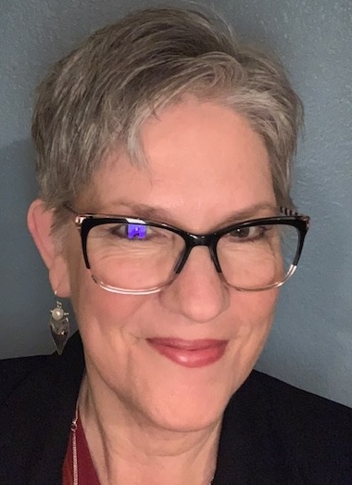
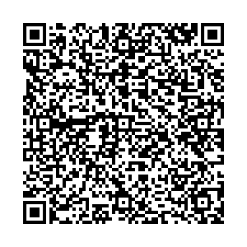
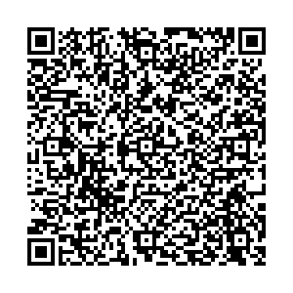
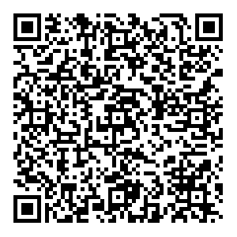
thank you
Geene Delaplane
DCYF Kinship Care and Guardianship Program Manager
geene.delaplane@dcyf.wa.gov
Rosalyn Alber
ALTSA Kinship Program Manager
rosalyn.alber@dshs.wa.gov
Angelique Day
University of Washington
dayangel@uw.edu
27

