Slide 1


Examining the Opioid Use Epidemic:
Challenges and Opportunities
Substance Use Disorder Treatment and Child Welfare Reform
Nancy K. Young, PhD
Executive Director, Children and Family Futures
Washington, DC | April 20, 2016

Slide 2


3
Kids
8.3 million children
* 2002 – 2007 SAMHSA National Survey on Drug Use and Health (NSDUH)
Notes:
http://www.samhsa.gov/data/2K13/CBHSQ128/sr128-typical-day-adolescents-2013.htm

Slide 3



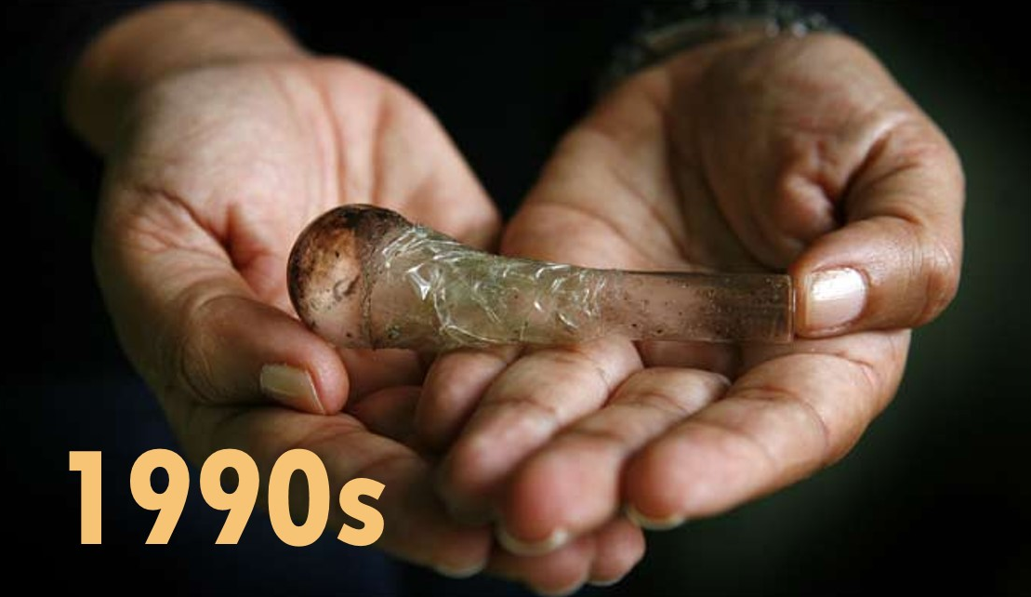
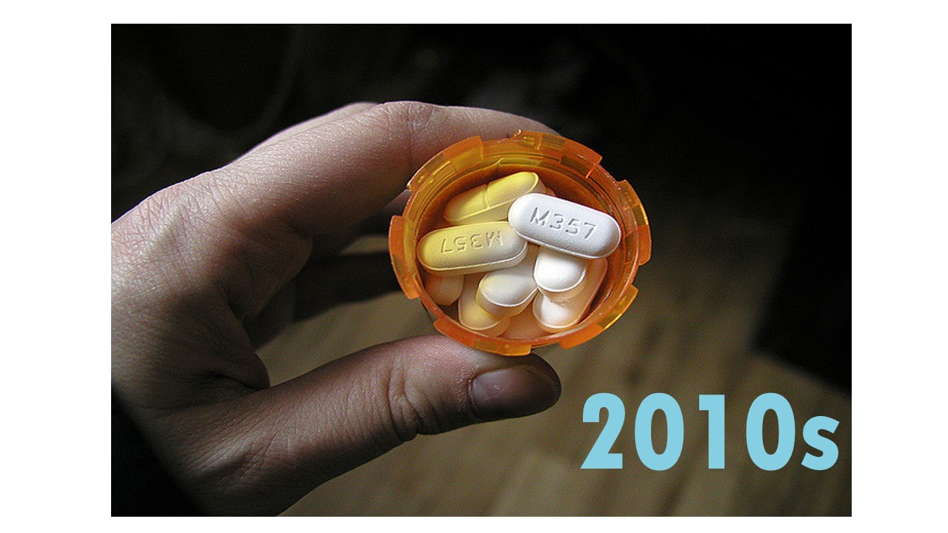
Drugs of the Decades
Notes:
Families and child welfare agencies have been affected by multiple drug epidemics over the past several decades—cocaine in the late 1980s, methamphetamine in the early 2000s and now opioids. In the cocaine epidemic, Congress enacted legislation to expand specialty treatment programs for women and their children and required that the Substance Abuse Prevention and Treatment Block Grant prioritize treatment admissions for pregnant and parenting women.

Slide 4

Addiction is a Brain Disease That Affects the Whole Family
The impact on child development is well-known: parents with a substance use disorder weakens relationships – which are critical to healthy development
Child-well-being – is more than just developmental milestones, safety and permanency – it’s about relationships that ensure family well-being
Impact of pre- and post-natal substance use exposure, combined with trauma of separation due to out-home custody can result poor child outcomes
Notes:
Relate treatment experience of teens in foster care

Slide 5


Two aspects of parental substance use that affect the child welfare system
Pre-natal opioid and other substance use exposure when it is determined that there are immediate safety factors resulting in the newborn being placed in protective custody
Post-natal opioid and other substance use that affects parents’ ability to safely care for their children
Notes:
Congress has been specific that hospital notification of cases of prenatal substance exposure is not substantiated child abuse or neglect. Rather, when these children come to the attention of the child welfare system, assessment of risk and safety are to be conducted and plans of safe care instituted to ensure the newborn’s well-being. Unfortunately, as the recent Reuters series made clear, often this is not happening (Wilson & Shiffman, 2015).

Slide 6
Estimated Number of Infants* Affected by Prenatal Exposure, by Type of Substance and Infant Disorder
Past Month Substance Use by Pregnant Women
Incidence of Infant Disorder
Includes nine categories of illicit drugs, including heroin and the nonmedical use of prescription medications.
*Approximately 4 million (3,952,841) live births in 2012
Estimates based on: National Survey on Drug Use and Health, 2012; Martin, Hamilton, Osterman, Curtin & Mathews. Births: Final Data for 2012. National Vital Statistics Report, Volume 62, Number 9;
*Patrick, et al., (2015). Increasing incidence and geographic distribution of neonatal abstinence syndrome: United States 2009 to 2012. Journal of Perinatology 35, 650-655
JAMA.2012.3951; May, P.A., and Gossage, J.P.(2001).Estimating the prevalence of fetal alcohol syndrome: A summary.Alcohol Research & Health 25(3):159-167. Retrieved October 21, 2012 from http://pubs.niaaa.nih.gov/publications/arh25-3/159-167.htm
Notes:
Among pregnant women, the highest rates of use continues to be the legal substances which have known detrimental effects on the neurodevelopment of the fetus. Among pregnant women aged 15 to 44, 5.4 percent were current illicit drug users based on data averaged across 2012 and 2013. This was lower than the rate among women in this age group who were not pregnant (11.4 percent). In the most recent year for which the data on specific substances are available, among pregnant women in 2011-2012, 18% reported using cigarettes, 9.4% used alcohol and 5% used illicit drugs; heroin use was reported by .2% of pregnant women and .9% non-medically used prescription drugs (SAMHSA, 2012).
of use continues to be the legal substances which have known detrimental effects on the neurodevelopment of the fetus.

Slide 7
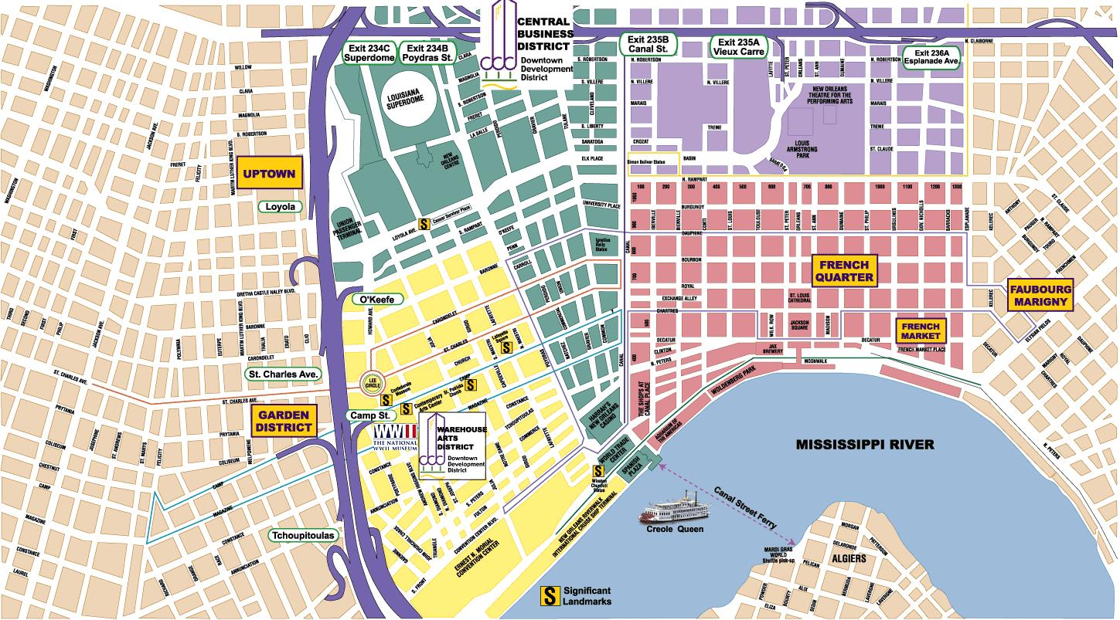
Estimated Number of Infants* Affected by Prenatal Exposure, by Type of Substance and Infant Disorder
Tobacco – 640,000
Alcohol – 340,000
Illicit Drugs – 240,000*
Binge Drinking – 108,000*
Heavy Drinking – 12,000*
FAS/ARND/ARBD – 30,000
About the population of the
City of New Orleans Born every year
Neonatal Abstinence Syndrome – 22,000
In 2014, 45,000 infants
Were placed in foster care
*Estimated – 360,000 infants/year
12.5% of the 360,000 were
Placed in protective custody
*Approximately 4 million (3,952,841) live births in 2012
Estimates based on: National Survey on Drug Use and Health, 2012; Martin, Hamilton, Osterman, Curtin & Mathews. Births: Final Data for 2012. National Vital Statistics Report, Volume 62, Number 9; Patrick, Schumacher, Benneyworth, et al. NAS and Associated Health Care Expenditures. Journal of the American Medical Association (JAMA) 2012; 307(18):1934-1940. doi: 10.1001/jama.2012.3951; May, P.A., and Gossage, J.P.(2001).Estimating the prevalence of fetal alcohol syndrome: A summary.Alcohol Research & Health 25(3):159-167. Retrieved October 21, 2012 from http://pubs.niaaa.nih.gov/publications/arh25-3/159-167.htm
Notes:
Among pregnant women, the highest rates of use continues to be the legal substances which have known detrimental effects on the neurodevelopment of the fetus. Among pregnant women aged 15 to 44, 5.4 percent were current illicit drug users based on data averaged across 2012 and 2013. This was lower than the rate among women in this age group who were not pregnant (11.4 percent). In the most recent year for which the data on specific substances are available, among pregnant women in 2011-2012, 18% reported using cigarettes, 9.4% used alcohol and 5% used illicit drugs; heroin use was reported by .2% of pregnant women and .9% non-medically used prescription drugs (SAMHSA, 2012).
of use continues to be the legal substances which have known detrimental effects on the neurodevelopment of the fetus.

Slide 8
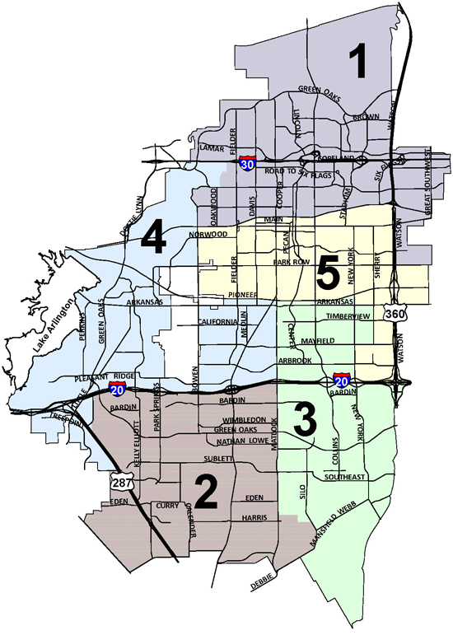
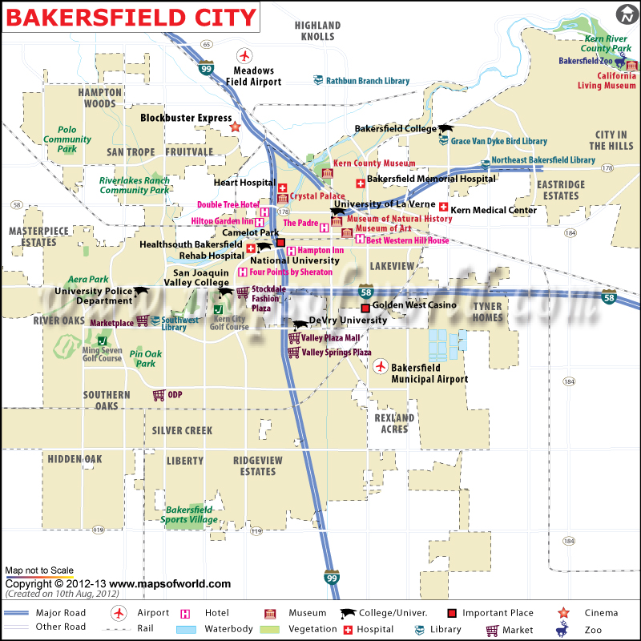


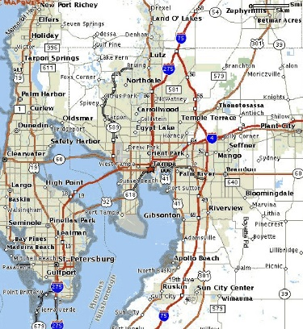
Estimated Number of Infants* Affected by Prenatal Exposure, by Type of Substance and Infant Disorder
Arlington, TX
New Orleans, LA
Notes:
Among pregnant women, the highest rates of use continues to be the legal substances which have known detrimental effects on the neurodevelopment of the fetus. Among pregnant women aged 15 to 44, 5.4 percent were current illicit drug users based on data averaged across 2012 and 2013. This was lower than the rate among women in this age group who were not pregnant (11.4 percent). In the most recent year for which the data on specific substances are available, among pregnant women in 2011-2012, 18% reported using cigarettes, 9.4% used alcohol and 5% used illicit drugs; heroin use was reported by .2% of pregnant women and .9% non-medically used prescription drugs (SAMHSA, 2012).
of use continues to be the legal substances which have known detrimental effects on the neurodevelopment of the fetus.

Slide 9
NAS in the mid 2010s
Synthetic Drugs: An Emerging, Evolving Threat
While states are focused on the opioid epidemic, they may not be paying enough attention to the lab-created drugs that are hard to control.
Governing, April 2016
Notes:
''People in their teens now are smoking cocaine, they are not doing heroin,'' said Mark Raskin, a spokesman for Daytop Village, a drug treatment center in New York City. ''Every generation wants to change. Our music changes. Our clothes change. Our drugs change.''

Slide 10

Neonatal Abstinence Syndrome
An expected and treatable condition that follows prenatal exposure to opioids
Symptoms begin within 1-3 days after birth, or may take 5-10 days to appear
Symptoms include blotchy skin; difficulty with sleeping and eating; trembling, irritability and difficult to soothe; diarrhea; slow weight gain; sweating; hyperactive reflexes; increased muscle tone
Timing of onset is related to characteristics of drug used by mother and time of last dose
Most babies exposed to opioids are exposed to multiple substances – Tobacco plays a role in NAS
NAS occurs with notable variability, with 55-94% of exposed infants exhibiting symptoms
Medication is required in approximately 50% of cases
Notes:
Neonatal abstinence syndrome (NAS) occurs in about half of babies with exposure to opioids during pregnancy. At this time, there are not clear data as to why babies do or do not experience the withdrawal syndrome. In a national study on the use of methadone and buprenorphine during pregnancy, researchers found that NAS did not appear to be related to the dose of these medications that are used to treat opioid dependence. But there were data suggesting that experiencing NAS was related to mothers who also smoked during pregnancy (Jones, 2015).

Slide 11
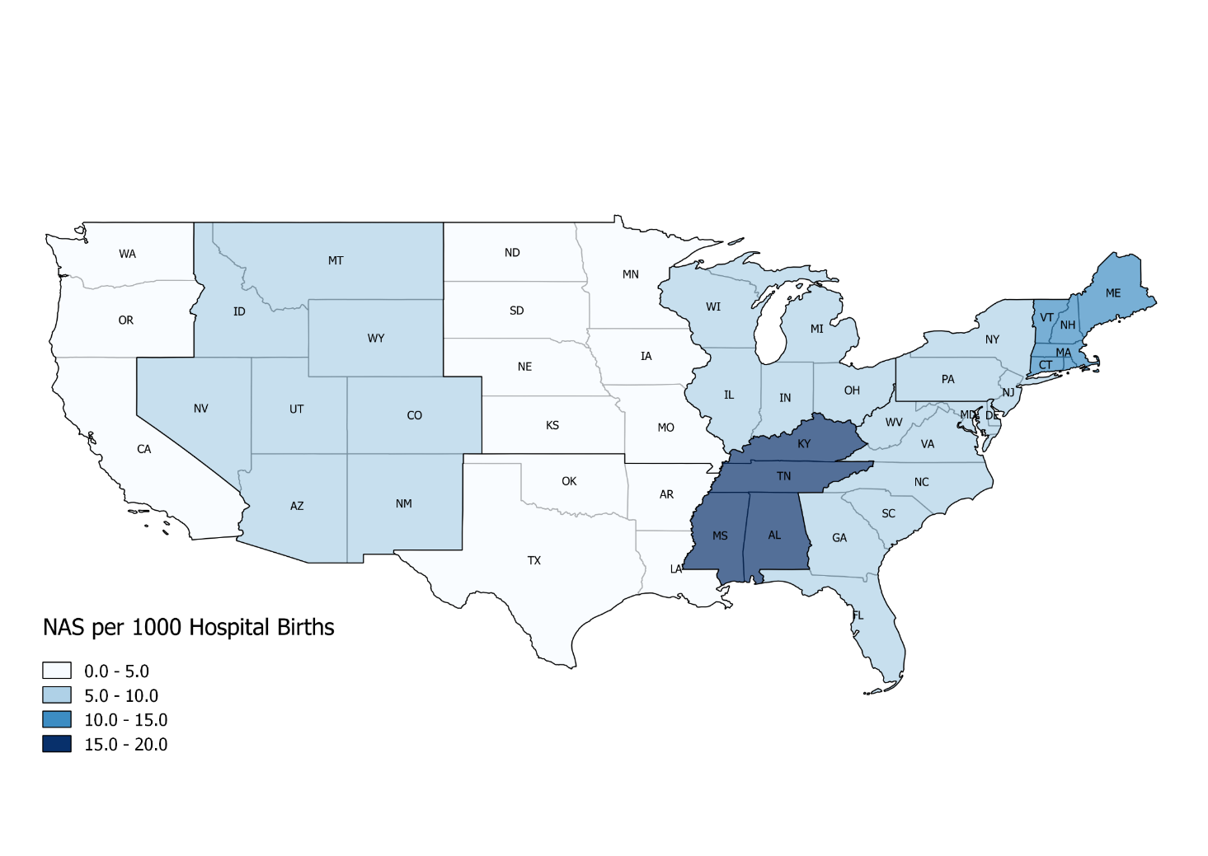
Veeral N. Tolia, M.D., Stephen W. Patrick, M.D., M.P.H., Monica M. Bennett, Ph.D., Karna Murthy, M.D., John Sousa, B.S., P. Brian Smith, M.D., M.P.H., M.H.S., Reese H. Clark, M.D., and Alan R. Spitzer, M.D. Increasing Incidence of the Neonatal Abstinence Syndrome in U.S. Neonatal ICUs. N Engl J Med 2015; 372:2118-2126May 28, 2015
Notes:
Dr. Stephen Patrick and colleagues (2016) have analyzed Medicaid claims data to monitor the trend of infants who are diagnosed with Neonatal Abstinence Syndrome. There is variation across regions in rates of NAS with the north-east and mid-south central regions experiencing the highest rates of diagnosed cases in Medicaid claims data.

Slide 12

Child Abuse Prevention and Treatment Act (CAPTA)
  “health-care providers involved in the delivery or care of substance exposed infants must notify child protective services, and a plan of safe care is to be developed for these infants.”

Slide 13

CAPTA 2010 Assurances
“an assurance in the form of a certification by the Governor of the State that the State has in effect and is enforcing a State law, or has in effect and is operating a statewide program, relating to child abuse and neglect that includes-
Policies and procedures (including appropriate referrals to child protection service systems and for other appropriate services) to address the needs of infants born with and identified as being affected by illegal substance abuse or withdrawal symptoms, resulting from prenatal drug exposure, or a Fetal Alcohol Spectrum Disorder.”

Slide 14
CAPTA 2010 Clarifications
“Except that such notification shall not be construed to—
  Establish a definition under Federal law of what constitutes child abuse or neglect; or
  Require prosecution
  for any illegal action.”

Slide 15

CAPTA 2010 Intent
To identify infants at risk of child abuse and neglect as a result of prenatal substance exposure, so appropriate services can be delivered to the infant and mother, ensuring the safety and well-being of infants, their mothers and their families

Slide 16

The Policy Challenge
Until the 2016 Program Instructions for annual reports released last week, there has been insufficient monitoring of these CAPTA provisions
Inconsistent practices about implementing the SEI provisions
Reuters article in December 2015 said “no more than 9 states were in compliance”
PI Does not yet require data submission
Notes:
Reuters says no more than 9 states were in compliance

Slide 17
The Policy Challenge
If CAPTA is not the vehicle to fund services
to protect these infants, what is?
Some more data…
Notes:
Reuters says no more than 9 states were in compliance

Slide 18
Source: AFCARS Reports, 2011-2014. Retrieved from http://www.acf.hhs.gov/programs/cb/research-data-technology/statistics-research/afcars
Notes:
While there is not a clear relationship of rates of NAS and the dramatic increase of infants being placed in protective custody, the trend of younger children in care and particularly the number of infants is alarming. After a decade of decreasing the number of children in out-of-home care, that trend began to reverse in 2012-2013. The total number of children in care are both new intakes as well as children who are remaining longer in care.

Slide 19
There has been an increasing trend in the percentage of child placement cases with prenatal alcohol or drug use as factors in the protective custody placement over the past 15 years. Due to identification and data entry complexities, there is great variability across states with States reporting less than 10% to some reporting more than 60%.
Notes:
Unfortunately, I cannot report reliable data that would indicate to what extent parental opioid or other substance use disorders are associated with the number of children in out-of-home care. The nation’s data system to monitor these factors does not require collection of parental substance use as factors in child removal, since those are voluntary collection items in the data system. However, our agency has been monitoring the available data for 15 years, and there has been a steady increase in reports of removals due to substance use by parents. Since 2009, states report a 19.4 rate of increase in parental alcohol or drug use as factors in the child’s removal.
However, we have been to all but one state in the country and asked child welfare professionals if they believe these data represent the prevalence of parental substance use in their cases. Not a single state believes these data accurately reflect their experience and tell us that these numbers greatly understate that the vast majority of cases in which a child is placed in protective custody are related to parental substance use disorders.

Slide 20
Parental AOD as a Reason for Removal, 2014
National Average: 31.8%
Source: AFCARS Data, 2014
Notes:
Denominator = total removal reason
AK (N=2,059)
AL (N=2,653)
AR (N=3,181)
AZ (N=4,379)
CA (N=9,963)
CO (N=3,506)
CT (N=1,902)
DC (N=227)
DE (N=67)
FL (N=14,446)
GA (N=4,341)
HI (N=568)
IA (N=4,323)
ID (N=943)
IL (N=531)
IN (N=9,553)
KS (N=3,969)
KY (N=3,223)
LA (N=492)
MA (N=4,069)
MD (N=1,827)
ME (N=1,376)
MI (N=6,316)
MN (N=3,737)
MO (N=7,714)
MS (N=6,072)
MT (N=1,341)
NC (N=5,067)
ND (N=718)
NE (N=1,651)
NH (N=65)
NJ (N=4,461)
NM (N=2,014)
NV (N=1,658)
NY (N=6,498)
OH (N=5,800)
OK (N=6,956)
OR (N=5,477)
PA (N=12,204)
PR (N=1,554)
RI (N=815)
SC (N=1,221)
SD (N=870)
TN (N=4,455)
TX (N=29,046)
UT (N=2,637)
VA (N=1,752)
VT (N=339)
WA (N=6,514)
WI (N =2,123)
WV (N=2,968)
WY (N=687)

Slide 21
Notes:
Of the nearly 265,000 children who entered care in 2014, the largest group were infants. The data are not available on the percentage of those infants who also experienced prenatal substance exposure, since they are not collected at the federal level nor by the majority of states. One might suggest however, that there are few underlying factors other than a parent’s substance use disorder that would disrupt the ability of a parent to care for their infant—particularly in areas of the country that are experiencing a profound opioid epidemic.
These trends are resulting in an increasing shift toward younger children making up a larger percentage of children in out-of-home care with children under six representing nearly 40% of children in care. These data indicate a short window of time for intervention with these children and families. This alarming rate of young children coming into care is especially troubling, as children ages 0-3 are especially vulnerable. Infancy and toddlerhood is a time of rapid development across all domains of functioning. The brain of a newborn is about one-quarter the size of an adult's and by the age of three, the brain has developed to about 80 percent of its adult size (Nowakowski, 2006). It is imperative that the development of that child take place in a stable environment with a caregiver who fosters mutual attachment with the child.

Slide 22
Percent of Children Removed from Parents’ Custody with
Parental Alcohol and/or Drug Use as a Reason for
Removal by Age, 2014

Slide 23
Source: AFCARS Data, 2014
Notes:
Among all reasons for child removal, drug abuse by parents was the largest rate of increase over the past five years. Child welfare professionals often tell us that neglect is the category that is checked in the data system but that neglect is almost always associated with parents’ substance use disorder.
These data are reflected in statements by child welfare agency professionals from around the country. Last week I spent 3 days in Ohio. I was told by a child welfare administrator from a county that borders Kentucky that 2015 was the first time ever that there were more children whose parents’ rights were terminated than were reunified. That small county had 70 terminations attributed to parents’ opioid use disorders. Child welfare officials reported that this trend is evident across the state. They report that over the past 5 years parents with opioid use disorders have increased the number of children placed in care at the same time that overall resources to serve families have decreased.

Slide 24
The Policy Challenge
Inconsistent Data
State variation is a function of both
lack of identification
inconsistent or lack of instruction about where to record it in the information system
There is no policy that requires these data to be collected

Slide 25

What Works for Families Affected by Opioid and Other Substance Use Disorders

Slide 26

Family Recovery, Parent and Child Well-Being
Parent Recovery
Focusing on parent’s recovery and parenting are essential for reunification and stabilizing families
Child Well-Being
Focusing on safety and permanency are essential for child well-being
Child and Family Well-Being
Because children stay home, go home, or find home
Notes:
Across child welfare programs, approximately 85% of children stay home, or go home, or in the case of children who are not reunified, they find home when they age out of foster care or become adults and access their adoption records. These realities make evident the imperative that child welfare service agencies, substance abuse treatment providers, and community partners work together to address the needs of parents to prevent placement, reunify with their children or potentially play another supportive role in their child’s life.

Slide 27

Keeping Kids Safely at Home
In-Home Cases represent the majority of the caseload of families in child welfare services, often about 70% of the state’s caseload
Notes:
During the methamphetamine epidemic, Congress made the largest ever investment through demonstration grants to find out what works to improve outcomes for these families and ensure child safety, permanency in caregiving relationships, and their well-being. A key shift in policy was that many of the communities that received these grants worked to prevent removal of children by providing services to children and their families while the children remained safely at home. States use different labels to refer to these “in-home” cases—protective supervision for example. But they represent the majority of the caseload of families in child welfare services, often about 70% of the state’s caseload

Slide 28
Federal Initiatives: Progress Since the
Adoption and Safe Families Act (ASFA)
National Center on Substance Abuse and Child Welfare
Children Affected by Methamphetamine Grants
Prevention and Family Recovery
Adoption and Safe Families Act (ASFA)
Regional Partnership Grants
RPG2
RPG3
1997
1999
2002
2005
2007
2009
2010
2012
2014
2017
Family Drug Court Grants
In Depth Technical Assistance Substance Exposed Infants
Substance Exposed Newborn Grants
Blending Perspectives and Building Common Ground Congressional Report
Fostering Connections Grants
FDC Statewide System Reform Program
Source: Children and Family Futures

Slide 29

Common Ingredients and Strategies
Identification
Timely Access
Recovery Support Services
Comprehensive Family Services
Increased Judicial Oversight
Cross-Systems Response
Collaborative Structures
Notes:
The demonstration grants included the Regional Partnership Grant Program (RPG) and SAMHSA’s Children Affected by Methamphetamine Program (CAM). The RPG and CAM programs documented a set of common ingredients and strategies leading to positive outcomes for families affected by substance use disorders. These strategies include:
Identification: A system of identifying families in need of substance use disorder treatment
Timely Access: Timely access to substance use disorder assessment and treatment services
Recovery Support Services: Increased management of recovery services and monitoring compliance with treatment
Comprehensive Family Services: Two-generation family-centered services that improve parent-child relationships
Increased Judicial Oversight: More frequent contact with parents with a family focus to interventions
Cross-Systems Response: Systematic response for participants based on contingency contracting methods
Collaborative Structures: Collaborative non-adversarial approach grounded in efficient communication across service systems and the courts

Slide 30
How Collaborative Policy and Practice Impacts
Recovery
Remain at home Reunification
Re-occurrence
Re-entry
5Rs
Notes:
Implementation of these common strategies for collaborative policy and practice has shown five core outcomes, the 5Rs:
Recovery: Parental recovery from substance use disorders
Remain at Home: More children remain in the care of parents
Reunification: Increased number and timeliness of parent-child
Reoccurrence: Decreased incidence of repeat maltreatment
Re-entry: Decrease number of children re-entering out-of-home care

Slide 31


Regional Partnership Grants (RPGs)
53 Grant Programs
17,820 adults
25,541 children
15,031 families
2007
Regional Partnership Grant Program
2012
Notes:
53 Grantee Awardees funded by Children’s Bureau
Focused on implementation of wide array of integrated programs and services, including 12 FDCs
The Child and Family Services Improvement Act of 2006 reauthorized the Promoting Safe and Stable Families program and provided a competitive grant program with funding over a five-year period to implement regional partnerships in states, tribes and communities to improve outcomes for children and families who were affected by parental substance use disorders.
In October 2007, the Administration on Children Youth and Families (ACYF), Children’s Bureau (CB) awarded grants to 53 partnerships across the country, including 7 tribes. Family Drug Courts were part of the initiative in 21 of the grantees. The outcomes of the grants were measured in a performance measurement system focused on documenting child safety, permanency, and well-being; systems improvement; and treatment-related outcomes such as timeliness of treatment access, length of stay in treatment, and parents’ recovery.
In September 2012, ACYF/CB awarded 17 new RPGs and 2-year extension grants to 8 of the 53 original grantees. This was made possible by Child and Family Services Improvement and Innovation Act (Pub. L. 112-34) signed into law in September 2011. In September 2014, four additional 5-year grants were awarded.

Slide 32
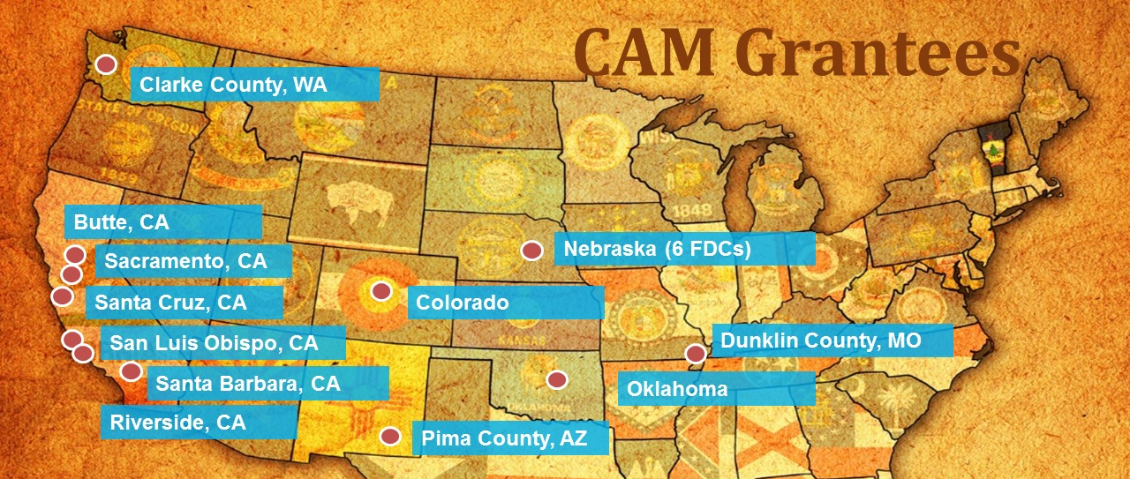

2010
2014
Children Affected by Methamphetamine Grant
Notes:
Funded through the Substance Abuse and Mental Health Services Administration (SAMHSA), the Children Affected by Methamphetamine (CAM) Grant Program focused on expanding and enhancing services to children and their families who are affected by methamphetamine and other substance use disorders. The Public Health Service Act of 2000 Section 509 provided funding from 2010-2014 to 12 Family Drug Courts to improve the well-being, permanency, and safety outcomes of children, who were in, or at-risk of out-of-home placement as a result of a parental methamphetamine or other substance abuse. The primary focus of the grant program was to provide services directly to the children and to provide supportive services for parents, caregivers, and families.

Slide 33

Recovery – Access to Treatment
Median of 0.0 days indicating that it was most common for adults to access care the same day they entered CAM services
Median # of days to admission
Notes:
If this graph references grantees’ comparison groups, the analysis is restricted to ((grantee_name = 'Iowa') or (grantee_name = 'North Range Behavioral Health') or (grantee_name = 'Sacramento') or (grantee_name = 'Santa Clara') or (grantee_name = 'Santa Cruz') or (grantee_name = 'Travis County')) because these six grantees implemented FDCs and reported A1 for their comparison conditions. The median time to Tx is 22 days for RPG participants (n= 1359 adults, 6 RPG grantees) and 45.5 days for adults in these grantees’ comparison conditions (n= 324 adults, same 6 RPG grantees)—data source “Only A1 Reporting w Site + Plan 3-28-14.sav.”
CAM
Adults admitted to substance abuse treatment the same day as or after CAM program entry accessed treatment within an average of 22.3 days (the median was 0.0 days indicating that it was most common for adults to access care the same day they entered CAM services).

Slide 34
Remain at Home
Percentage of children who remained at home throughout program participation
* This analysis is based on 8 RPG Grantees who implemented an FDC and submitted comparison group data
Notes:
CAM
Nearly than half of the children were in-home at the time of CAM enrollment and nearly all (91.5%) of the children who were in-home at the time of CAM enrollment remained in their home with their parent/caregiver throughout their family’s participation in CAM services.
Children Remain at Home While Participating in CAM Services (From Final Report, page 19)
Overall, nearly half (48.3%) of the children were in-home at the time of CAM enrollment (see figure 8). Nearly all (91.5% or 1830/1999) of the children who were in-home at the time of CAM enrollment remained in their home with their parent/caregiver through their family’s participation in CAM services. The percentage of children, by grantee, who remained in the home ranged from a low of 33.3% to a high of 97.6% (see Appendix C for site level summaries). The number of children in-home at CAM enrollment and remaining in-home is highly influenced by two of the grantees. More than any other grantees, these CAM projects are designed to reach a far larger number of families prior to the removal of their children. Can only be calculated for those families no longer receiving CAM services.
“Children Remain at Home” Graph:
Background. From R2C4: “Of the 11,938 children in-home at time of RPG Program entry, nearly all (92.0 percent or 10,977) remained in their parent’s or caregiver’s custody through RPG Program case closure.” Results indicating a greater proportion of children in the FDC condition remaining at home (slide 7 reports 80% FDC vs. 61.1% comparison) are inconsistent with the “eyes on” phenomenon.
If, however, “comparison” in this slide refers to the comparison groups associated with grantees that did implement FDCs, the analysis is restricted to: ((grantee_name = 'Iowa') or (grantee_name = 'Mendocino') or (grantee_name = 'North Range Behavioral Health') or (grantee_name = 'Sacramento') or (grantee_name = 'Santa Clara') or (grantee_name = 'Santa Cruz') or (grantee_name = 'Supreme Court of Georgia') or (grantee_name = 'Travis County')). Here, among RPG participants served by grantees implementing FDCs, 85.1% of the children remained at home through case closure (n= 1,652 children, 8 RPG grantees) compared to 71.1% of the children in the comparison groups associated with these grantees (n= 695 children, same 8 RPG grantees). This is a statistically significant difference in proportions; Χ² (1, N= 2,347) = 62.453, p < .001. (Data source is “Only C1 Reporting Closed Cases w Iowa Site 9-18-13.sav.”)
was 10.2 months (310.0 days). The median length of stay in

Slide 35
Remain at Home – Days in Foster Care
Notes:
“Days in Foster Care,” Graph:
Notes. Reanalysis conducted ONLY for rightmost set of bars (labeled RPG FDC).
Background: For children discharged from foster care, this indicator is defined as the average length of stay (in days) from date of most recent entry into such care until date of discharge, but has been reported as a median. Children discharged from foster care for all reasons combined in the RPG Program overall had a median length of stay in care of 11.1 months.
If “comparison” in this slide refers to the comparison groups associated with grantees that did implement FDCs, the analysis is restricted to: ((grantee_name = 'County of Lucas') or (grantee_name = 'Hillsborough') or (grantee_name = 'Idaho') or (grantee_name = 'Iowa') or (grantee_name = 'JJF') or (grantee_name = 'Mendocino') or (grantee_name = 'North Range Behavioral Health') or (grantee_name = 'Pierce County Alliance') or (grantee_name = 'Santa Clara') or (grantee_name = 'Santa Cruz') or (grantee_name = 'Supreme Court of Georgia') or (grantee_name = 'Travis County')). In this case among children discharged from foster care in the RPG condition, the median length of stay was 356 days or 11.7 months (n= 1,355 children, 12 grantees), compared to a median of 422 days or 13.8 months among children in the comparison conditions of these grantees (n= 513 children, same 12 grantees)—data source “Only C3 Reporting w Iowa Site 9-18-13.sav.”
CAM
Overall, the median length of stay in out-of-home care for all children receiving CAM services was 10.2 months (310.0 days). The median length of stay in

Slide 36
Reunification – Rates within 12 Months
Notes:
Background: As indicated in the fourth Report to Congress, 83.0 percent of children exiting foster care in the RPG Program overall were discharged to reunification.
Alternatively, if “comparison” in slide 9 refers to the comparison groups associated with grantees that did implement FDCs, the analysis is restricted to: ((grantee_name = 'County of Lucas') or (grantee_name = 'Hillsborough') or (grantee_name = 'Idaho') or (grantee_name = 'Iowa') or (grantee_name = 'JJF') or (grantee_name = 'Mendocino') or (grantee_name = 'North Range Behavioral Health') or (grantee_name = 'Pierce County Alliance') or (grantee_name = 'Santa Clara') or (grantee_name = 'Santa Cruz') or (grantee_name = 'Supreme Court of Georgia') or (grantee_name = 'Travis County')). In this case, 73.1% of the children discharged from foster care were reunified with their parents (n= 1,351 children, 12 grantees). In contrast, among the comparison conditions reported by these grantees, 54.4% of the children discharged from foster care were reunified (n= 509 children, same 12 grantees)—data source “Only C3 Reporting w Iowa Site 9-18-13.sav.”
CAM
The majority (84.9%) of children exiting out-of-home care were discharged to reunification. Only 5.0% of children receiving CAM services re-entered foster care within 12 months after being returned home. Nearly two-thirds of the children in their programs reunified within 12 months. Very few children were discharged to finalized adoption or legal guardianship within 24 months.

Slide 37
Re-occurrence of Child Maltreatment
Total RPG Children = 22,558
n = 4776
Notes:
CAM
Rates of maltreatment recurrence within six months of entering services were less than half of that which was seen nationally (2.3% vs. 6.4%).
Reoccurrence of Child Maltreatment (From Final Report, page 18)
Of the children served by the 11 grantees reporting on this indicator, 4.7% (224 children) were a victim of a substantiated or indicated maltreatment within 24 months following entry into the CAM program (see Figure 7; see Appendix C for site level summaries). One hundred and nine children, or 2.3%, were a victim of maltreatment within six months of entering into the CAM program. Two of the grantees had no reports of substantiated/indicated maltreatment post-CAM enrollment. This performance is especially favorable when considered in the context of the communities served by grantees where the average six-month recurrence rates are estimated to be nearly four percentage points higher (6.0%).
Can only be calculated for those families no longer receiving CAM services.
Contextual information is included for indicators where state or county-level measures are similar in definition and publicly available. More information about the sources of this information for each grantee community is included in the site level summaries in Appendix C of this report.

Slide 38
Re-entry – Foster Care within 12 Months
Percentage of Children Re-entered into Foster Care Within Twelve Months
Notes:
CAM
Of the 1232 children in CAM programs who reunified, only 81 children (6.6%) re-entered out-of-home care within 24 months after being returned home (see Appendix C for site level summaries). Only 5.0% of CAM children re-entered out-of-home care within 12 months after being returned home, while 2.4% re-entered within six months (see Figure 10). Includes discharge reasons of both reunification and living with other relative. For purposes of calculating the CFSR measures, those coded as living with other relative are counted as a valid reunification.

Slide 39

We can no longer say, “We don’t know what to do.”
Notes:
The results from the RPGs and other federal grant and foundation supported programs means that we can no longer say, “We don’t know what to do.”

Slide 40
The Policy Challenge
The models and grant programs have barely touched the need
We need to move from pilots and demonstrations to systems reform

Slide 41

Opportunities for System-Wide Reform
Improve data collection and reporting to monitor the effects of parental substance use disorders on the child welfare system and the outcomes achieved by addressing treatment needs.
  Resolve states’ information technology challenges to include alcohol and drug use factors in case records, require standardized reporting of alcohol and drug use factors in federal child welfare reporting systems.
  Require existing outcome monitoring to report on the differential child welfare outcomes for children and families due to parental substance use disorders.
Notes:
The impact of opioids on children and families in the child welfare system must be placed in context of the history of parental substance use disorders, how to comprehensively address the current epidemic, and to mediate the effects of future shifts in drug use patterns from severely impacting children and their families. The effort should focus on how to build on lessons from prior federal investments, resolve the current gap in timely treatment access, focus on improving data collection and monitoring, and prevent future crises and costs as substance use patterns change over time.
In addition to the key programmatic strategies implemented to prevent child placement, there are system changes that are also needed to effectively monitor effects over time, ensure staff are prepared to work effectively with these families, state-specific financing strategies need to be developed to maximize recent changes in substance use disorder treatment, fill gaps in treatment access for these families, and build collaborative efforts that cross agency boundaries and support communities. Specific system reforms that are needed include:
In summary, we can no longer say we don’t know what to do. We can build on the track record of dozens of fine, smaller-scale programs in your states and communities. That’s a big difference in this epidemic, compared with prior eras. We can take what works into system change approaches, instead of helping only a few families at a time.

Slide 42
Opportunities for System-Wide Reform
Improve timely access to quality substance use disorder treatment.
  Treatment must be state-of-the–art, comprehensive, and meets the needs of the entire family.
  Increase availability of treatment and ensure that parents are not referred to a waitlist when completion of treatment Is a condition of keeping or reunifying with their children.
  Ensure that parents have access to medications for opioid use disorders.
Notes:
The impact of opioids on children and families in the child welfare system must be placed in context of the history of parental substance use disorders, how to comprehensively address the current epidemic, and to mediate the effects of future shifts in drug use patterns from severely impacting children and their families. The effort should focus on how to build on lessons from prior federal investments, resolve the current gap in timely treatment access, focus on improving data collection and monitoring, and prevent future crises and costs as substance use patterns change over time.
In addition to the key programmatic strategies implemented to prevent child placement, there are system changes that are also needed to effectively monitor effects over time, ensure staff are prepared to work effectively with these families, state-specific financing strategies need to be developed to maximize recent changes in substance use disorder treatment, fill gaps in treatment access for these families, and build collaborative efforts that cross agency boundaries and support communities. Specific system reforms that are needed include:
In summary, we can no longer say we don’t know what to do. We can build on the track record of dozens of fine, smaller-scale programs in your states and communities. That’s a big difference in this epidemic, compared with prior eras. We can take what works into system change approaches, instead of helping only a few families at a time.

Slide 43
Opportunities for System-Wide Reform
Improve collaborative practice through implementation of practical strategies.
  Improve staff development and training programs and include a focus on infants with prenatal substance exposure.
  Develop cross-systems communication protocols and strategies to develop comprehensive plans of safe care that keep infants with birth families whenever possible and provide interventions to address the needs of both the infant and mother.
Notes:
The impact of opioids on children and families in the child welfare system must be placed in context of the history of parental substance use disorders, how to comprehensively address the current epidemic, and to mediate the effects of future shifts in drug use patterns from severely impacting children and their families. The effort should focus on how to build on lessons from prior federal investments, resolve the current gap in timely treatment access, focus on improving data collection and monitoring, and prevent future crises and costs as substance use patterns change over time.
In addition to the key programmatic strategies implemented to prevent child placement, there are system changes that are also needed to effectively monitor effects over time, ensure staff are prepared to work effectively with these families, state-specific financing strategies need to be developed to maximize recent changes in substance use disorder treatment, fill gaps in treatment access for these families, and build collaborative efforts that cross agency boundaries and support communities. Specific system reforms that are needed include:
In summary, we can no longer say we don’t know what to do. We can build on the track record of dozens of fine, smaller-scale programs in your states and communities. That’s a big difference in this epidemic, compared with prior eras. We can take what works into system change approaches, instead of helping only a few families at a time.

Slide 44

When we ensure timely access to effective treatment:
Families recover
Kids stay safe at home
We save money
Now we can and must move beyond pilots and demonstration grants and take these lessons into systemic changes across agencies to help children and families and reduce costs to our systems.

Slide 45

Contact Information
Nancy K. Young, Ph.D.
Executive Director
Children and Family Futures
nkyoung@cffutures.org

