Slide 1
Commission to Eliminate Child Abuse and Neglect Fatalities: Discussing the recommendations
David Sanders, Ph.D.
Executive Vice President of
Systems Improvement,
Casey Family Programs

Slide 2
Huffington Post, October 9, 2015
“Since 2012, directors of at least 16 state and county agencies have resigned or been fired. Nine states have passed sweeping reforms designed to protect more children. Those actions often followed public outrage over the deaths of children previously known to child protection agencies.”
http://www.huffingtonpost.com/entry/heroin-foster-care_us_5617c8f7e4b0e66ad4c75faa
Notes:
http://www.huffingtonpost.com/entry/heroin-foster-care_us_5617c8f7e4b0e66ad4c75faa

Slide 3
ABC News, April 7, 2016
Social workers charged with child abuse in case involving torture and killing of Gabriel Fernandez, 8
Thursday, April 07, 2016 07:12PM from http://abc7.com/news/social-workers-charged-with-child-abuse-in-death-of-palmdale-boy/1280709/

Slide 4
National landscape

Slide 5
Increase in children entering care most prominent over past 2 years
* Rate per 1,000 children
Notes:
Recent increase in children entering care, evident in both the raw number and rate of entry
Background note:
The estimates are based on what we anticipate the number will be when we have received data from all states. These are very solid estimates based on the trends in the states we have received data.
The FY14 est is based on all states except PR
The FY15 est is based on all states except AZ, CT, DC, MI, OR, PR, RI

Slide 6
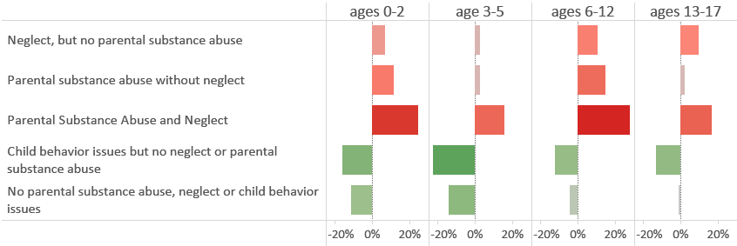
Parental substance abuse, neglect are most prominent reasons for increase
Change in children entering care between FY13-FY15, by reason and age
Red bars show the age and removal reason groups where there has been an increase in children entering care. Green bars show groups where there has been a reduction.

Slide 7
Most prominent increase in children entering is among school-age children
Babies continue to make up the highest percentage of entries
But school-age children seeing biggest increase
Notes:
The graph line shows where there have been increases or reductions in the number of children entering care over the past 2 years. Gray bars above the line show the increases. As you can see, the increase for the school age children is the largest overall, although very young children continue to increase as well. Teens continue to decline.
The red line shows the percentage of entries of each age as a percentage of all entries. Easy to see that babies continue to represent the largest percentage of entries overall.
Also, among the school age children, 1 in 4 or 5 are re-entries to care, meaning they first entered care even earlier.

Slide 8
What do trends look like prior to entry? Are children safe(R)?
Safety by the numbers

Slide 9
According to standard federal measures of safety, there has been consistent improvement
About 10% of all children who are victims of maltreatment experience another incident of maltreatment in 12 months
About 5.6% experience repeat maltreatment in 6 months
Notes:
Maltreatment recurrence in 6 months was the CFSR Round 2 measure of safety.
Maltreatment recurrence in 12 months is the CFSR Round 3 measure of safety.
Definition: of all children involved in a substantiated/confirmed incident of maltreatment, what percent experience another substantiated/confirmed incident of maltreatment within 6/12 months?

Slide 10
But an increasing number of children are involved in a screened-in report
Notes:
The data includes children who are involved in a screened in report of maltreatment, meaning the report will have an investigation or assessment.
** EPH and BN’s research that found that a prior allegation of maltreatment is the single strongest predictor of an intentional injury death – much stronger than poverty, maternal age, child health, or other risk factors. A report of maltreatment is more than just a marker of poverty, it is an important signal of child risk.
Background note:
NCANDS data starts with children who are screened in for an investigation or assessment. We don’t know much about children who are screened out. About 40% of referrals nationally are screened out but there is huge variation across states.

Slide 11
Rates of children screened in increased across age groups, and remain highest for babies
Notes:
Rate per 1,000
All age groups saw increase, highest for babies.

Slide 12
# of children in substantiated reports of maltreatment remained relatively stable, with slight increase in most recent year
* Rate per 1,000 children
Notes:
This is the number and rate of children involved in a substantiated/confirmed incident of maltreatment.

Slide 13
Relationship between children screened in and substantiated
Notes:
The percent of children involved in a substantiated report of maltreatment among all those screened in has been relatively steady.

Slide 14
Despite relatively stable trend overall, increasing rate of babies involved in substantiated report

Slide 15
What other considerations should we keep in mind?
Safety by the numbers

Slide 16
For young kids entering care, involvement with child welfare may be long-term
Notes:
This graph shows the percent of children in each age group who exit care within a certain period of time. This is all based on cohorts of children of each age group entering care.
The blue line represents babies. It is at the bottom. If you track that line over time, you see that a smaller percent of babies exit within each of the time periods. At the 2 year point, the percentages are more equal by age group.

Slide 17
Safety measured for children who do experience care is often by re-entry
Notes:
This is the standard CFSR Round 3 measure of re-entry.

Slide 18
Child maltreatment fatalities
*rate per 100,000 children
Notes:
Issues with measurement, undercount

Slide 19
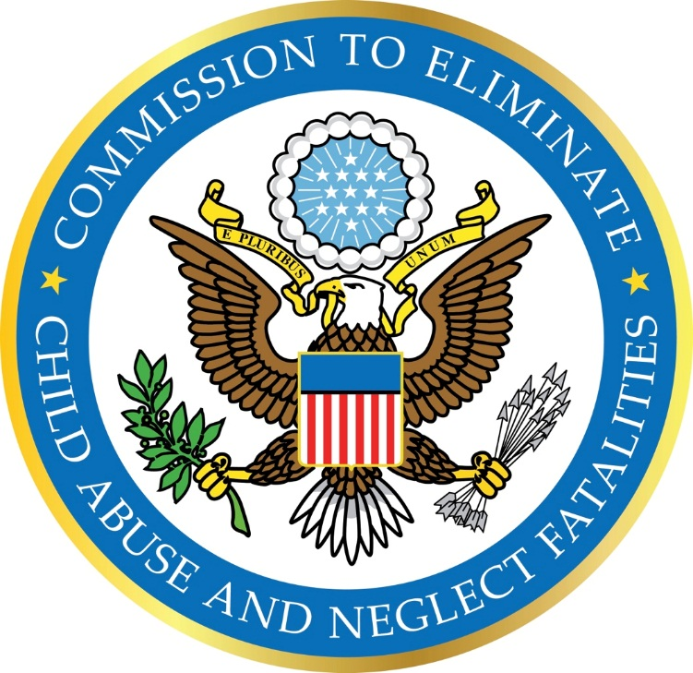
Commission to Eliminate Child Abuse and Neglect Fatalities (CECANF)
Established by the Protect Our Kids Act of 2012
(P.L. 112-275) to develop a national strategy and recommendations for reducing fatalities resulting from child abuse and neglect.
Notes:
Why was it created? GAO report
What is its goal? To develop a national strategy and recommendations for reducing fatalities resulting from child abuse and neglect (federal, state, etc.)

Slide 20
CECANF charged with studying:
The use of child protective services and child welfare services funded under Title IV and subtitle A of Title XX of the Social Security Act to reduce fatalities from child abuse and neglect.
The effectiveness of the services funded under Title IV and subtitle A of Title XX.
Best practices in preventing child and youth fatalities.
The effectiveness of federal, state, and local policies and systems within such services aimed at collecting accurate, uniform data on child fatalities in a coordinated fashion.
Notes:
What is the Commission’s charge?
Commission’s charge and how the Commission is looking beyond CW programs and practices, including:
The use and effectiveness of current federally funded child protective and child welfare services
Best practices for, and barriers to, preventing child abuse and neglect fatalities
Issues such as how confidentiality and data sharing laws, policies, and practices facilitate or inhibit system improvement

Slide 21
CECANF charged with studying:
Barriers to preventing fatalities
Trends in demographic and other risk factors that are predictive of or correlated with child maltreatment
Methods of prioritizing child abuse and neglect prevention for families with the highest need
Methods of improving data collection and utilization
Notes:
The Commission is also charged with studying:
The most and least effective federal, state, and tribal policies and practices impacting the prevention of child abuse and neglect fatalities
What barriers need to be removed to protect children at risk
Trends in demographic and other risk factors that correlate with child abuse and neglect fatalities
How to prioritize prevention services for families with the greatest need
How to improve collection of data on child abuse and neglect fatalities

Slide 22

Commission members
Dr. David Sanders, Chairman, Executive Vice President, Casey Family Programs
Amy Ayoub, Advocate and Presentation Skills Coach
Marilyn Bruguier Zimmerman, Director, National Native Children’s Trauma Center
Theresa Covington, Director, National Center for the Review and Prevention of Child Deaths
Bud Cramer, Former Member of Congress (D-AL) and founder of the National Children’s Advocacy Center
Susan N. Dreyfus, President and CEO of the Alliance for Strong Families and Communities
Notes:
6 Presidential appointees
6 Congressional appointees

Slide 23
Commission members
Dr. Wade Horn, Director, Deloitte Consulting; former Assistant Secretary, Administration for Children and Families
The Hon. Patricia M. Martin, Presiding Judge, Child Protection Division of the Circuit Court of Cook County, IL
Michael R. Petit, Founder and Advisor, Every Child Matters Education Fund
Jennifer Rodriguez, Executive Director, Youth Law Center
Dr. David Rubin, Professor, Perelman School of Medicine at the University of Pennsylvania, and Pediatrician, Co-director, PolicyLab at The Children’s Hospital of Philadelphia
Dr. Cassie Statuto Bevan, Lecturer, Graduate School of Social Policy and Practice, University of Pennsylvania
Notes:
The Commissioners include a former ACF secretary, judge, law, advocates, a former Congressman, a doctor, a state human services/Medicaid director, and others with a broad and diverse range of experience and connection to the issues.

Slide 24
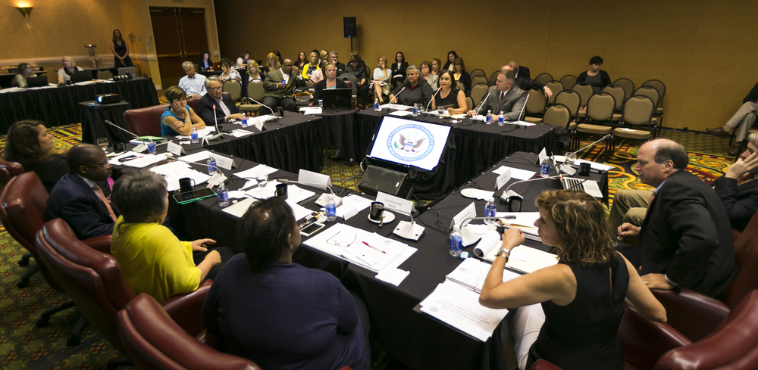
Gathering information through public meetings and events
State public meetings in:
  San Antonio, TX
  Tampa, FL
  Plymouth, MI
  Denver, CO
  Burlington, VT
  Portland, OR
  Memphis, TN
  Salt Lake City, UT
  Madison, WI
  New York, NY
Tribal meeting in Scottsdale, AZ
Research roundtable in Philadelphia, PA
Ongoing commissioner deliberations through early December 2015
Notes:
How is the Commission going about its work?
Commission held 10 public meetings around the country and a tribal-focused meeting to learn what’s working, where state and local areas are having challenges, and to learn from the experts
The Commissioners held a research roundtable in Philadelphia
Final deliberations will occur into early December 2015
All meetings are open to the public; information and teleconference number are available on the Events section of the website

Slide 25
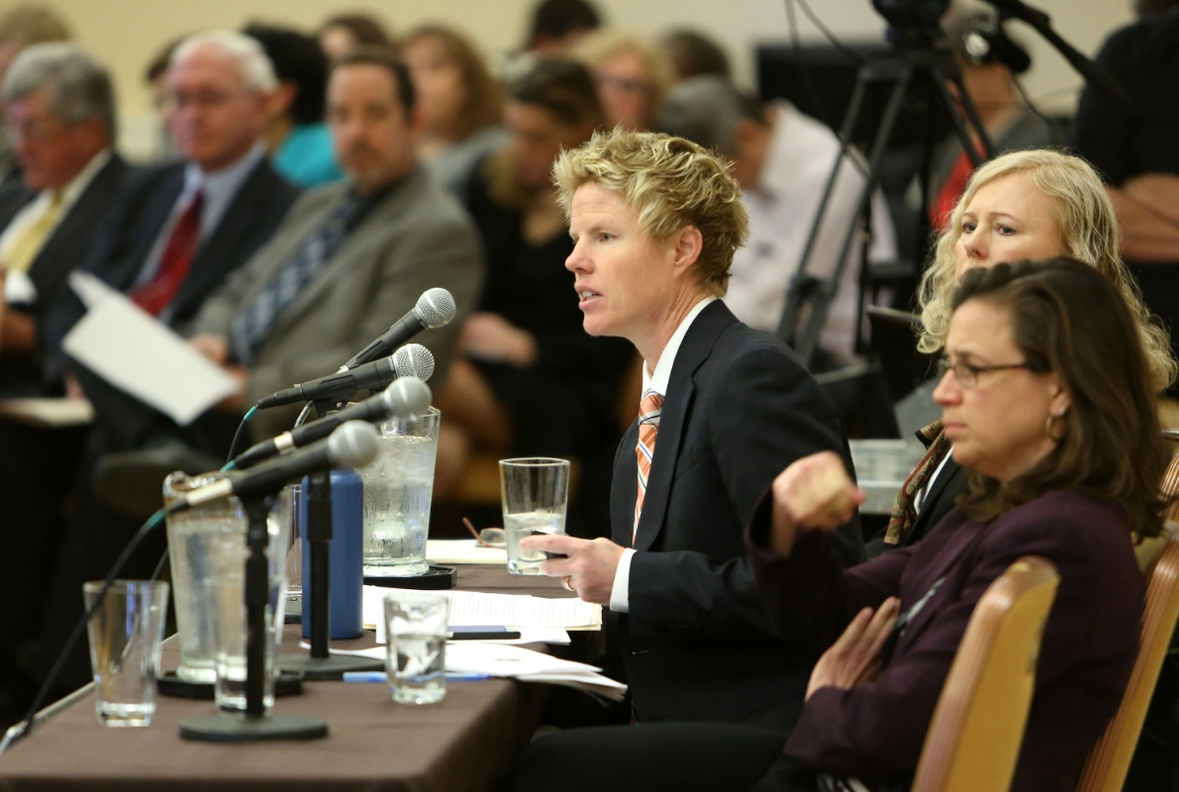
Gathering information through public meetings and events
Federal stakeholder meetings with:
  The White House
  Congress
  ACF
  CDC
  HHS’s Assistant Secretary for Planning
  and Evaluation
  Health Resources and Services Administration
  Dept. of Defense
  Substance Abuse and Mental Health
  Services Administration
  Dept. of Justice
  Centers for Medicare and Medicaid Services
Other stakeholder meetings with numerous local, state, and national organizations
Notes:
The Commission is working with federal partners legislatively and administratively to keep them apprised and learn what federal efforts are already underway.
The Commission is also working with local state and national organizations to get feedback and input on solutions.
Public can submit testimony in writing via the website.
The Commissioners are organized into 7 subcommittees – CPS, PH, Disproportionality, Military, NA/AI, Policy, and Measurement.

Slide 26
How many children died from abuse or neglect in 2013?
NCANDS reported an estimated 1580 children* died due to abuse and neglect (4 children every day). This is a rate of 2.15 deaths per 100,000 children in the national population.
In 2011, the Government Accounting Office reported more children likely died from maltreatment than reflected in NCANDS.
Published research suggests the numbers may be 3 times higher than the NCANDS estimate.
*Source: Child Maltreatment 2014
Notes:
What is the scope of the problem the Commission is studying that necessitates a national strategy?
What the data we have shows.
Underestimate: What the data doesn’t show.
Why is a number so important? If we don’t have an accurate way to count the number of children who die, we cannot measure the success or lack of success of interventions designed to decrease fatalities.
For your 1st slide, there were an estimated 1580 CM fatalities in 2014; given that there were 73.6 million US children ages 0-17 that year http://www.childstats.gov/americaschildren/tables/pop1.asp the estimated rate was 2.15 abuse/neglect deaths per 100,000 in 2014. Those are pretty rough calculations, but probably as good as what’s in the original slide. The GAO 2011 point about NCANDS child fatality numbers being an undercount would apply just the same in 2014. I think the suggestion that actual numbers are 3x the NCANDS number may overstate it—a lot of experts would say something closer to 2x instead, but either way it’s speculation since we just don’t know the actual number.
.

Slide 27
Child maltreatment fatalities happen to very young children
Nearly three-quarters (73.9 percent) of the children who died due to abuse and neglect were younger than 3 years old.
Nearly half (46.5 percent) were under age 1.
Source: Child Maltreatment 2013
Notes:
For your 2nd slide, CM 2014 says that 72.3% of child maltreatment fatalities were attributable to neglect alone or in combination with other forms of maltreatment. If you add in medical neglect (8.9%) the total would be over 80%. 41.3% of fatalities for 2014 were attributed to physical abuse alone or in combination with other forms of maltreatment
Our youngest children are at the most risk:
Nearly three-quarters (73.9%) of the children who died due to child abuse and neglect were younger than 3 years old.
Nearly half (46.5%) were under age 1 year.
Infants under 1 -- for every 10 cases of nonfatal hospitalization due to abuse, there was 1 fatal hospitalization.
Deaths among American Indian/Alaska Native and African-American children are overrepresented in child maltreatment fatalities as compared to their proportion in the nation’s child population.
If we know these are the children most at risk, how can we intervene to save them?

Slide 28
Front end: percentage of screened-out reports
Data source: Child Maltreatment 2013. Data are not available for Hawaii, New York, North Carolina, Pennsylvania, or Puerto Rico.
Notes:
Numbers of screened-out reports are high in most states, and the percentages vary widely.

Slide 29
Child neglect is involved in a high number of fatalities
More than 70 percent (71.4 percent) of child fatalities were attributed to neglect only or a combination of neglect and another maltreatment type.
Nearly half (46.8 percent) of child fatalities were attributed to physical abuse only or to physical abuse in combination with another maltreatment type.
Source: Child Maltreatment 2013
Notes:
Largest percentage is neglect (supervision related – hardest to determine, rollover death, SIDS or maltreatment)
Physical abuse is more prevalent than overall CAN (shaken baby, abusive head trauma).

Slide 30
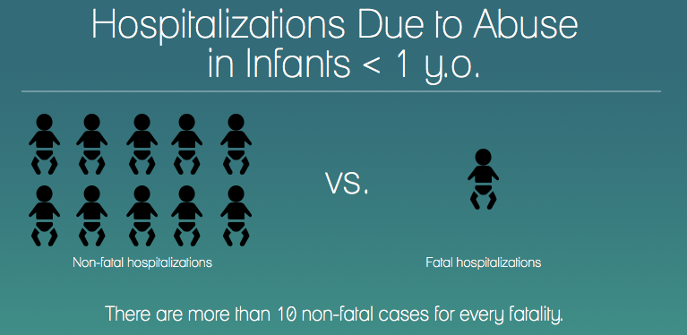
How common are near-fatalities?
Source: Leventhal, J.M., Martin, K.D., & Gaither, J.R. (2012). Using U.S. data to estimate the incidence of serious physical abuse in children. Pediatrics, 129(3), 458-464.
Notes:
For every 10 cases of nonfatal hospitalization due to abuse, there was one fatal hospitalization in infants under one year of age.
Even more children experienced a near fatality.
Near fatalities and fatalities share similar child, perpetrator, and risk factor profiles.
CAPTA: “An act that, as certified by a physician, places the child in serious or critical condition.”
National estimates are not available, and there is wide variation of definitions among states.
However, we have data for nonfatal hospitalization and serious injury in children.

Slide 31
Highlights of lessons learned
1. Infants and toddlers are at high risk of an abuse or neglect fatality compared to other age groups. They require special attention.
Notes:
Children from birth to age 5 with a prior maltreatment allegation are >2.5 times more likely as unreported children to be fatally injured.¹
The risk of maltreatment is highest in the first few years of life – 2.1% of children have confirmed maltreatment by age 1, and 5.8% do by age 5.²
More than two-thirds (70.7%) of the children who died due to child abuse and neglect were younger than 3 years. Nearly half (44.2%) were under age 1.³
Sources: 1: Emily Putnam-Hornstein (2011). Report of Maltreatment as a Risk Factor for Injury Death – A Prospective Birth Cohort Study.
2. Christopher Wildeman, et al (2014). The Prevalence of Confirmed Maltreatment Among U.S. Children, 2004 – 2011.
3. Children’s Bureau, Child Maltreatment 2014.

Slide 32
Highlights of lessons learned
2. A call to child protection hotline, regardless of the disposition is the best predictor of a later child abuse or neglect fatality. This points to the importance of the initial decision to “screen out” certain calls. Screening out leaves children unseen who may be at a high risk for later fatality.

Slide 33
Highlights of lessons learned
3. Involvement of health care and public health agencies and professionals is vital to safety for children. Well-coordinated interagency efforts are essential.

Slide 34
Highlights of lessons learned
4. The importance of child protection workers’ access to real-time information about families cannot be over estimated.

Slide 35
Highlights of lessons learned
5. It is critical to have an accurate national count of child protection fatalities. Better data allow us to begin to understand what works and what doesn’t.

Slide 36
Highlights of lessons learned
6. The Nurse–Family Partnership program has been demonstrated to save lives.

Slide 37
Recommendations
Immediate changes
Longer-term strategy

Slide 38
Immediate changes
States should undertake a retrospective review of child abuse and neglect fatalities from the previous five years.
Every state should review their policies on screening reports of abuse and neglect to ensure that children most at risk for fatality — those under age 3 — receive the appropriate response.
The administration should lead an initiative to support the sharing of real-time information among key partners such as CPS and law enforcement.

Slide 39
Immediate changes
Existing child death review teams should also review
life-threatening injuries caused by maltreatment.
All other programs — such as Medicaid and home visiting programs — should be held accountable for ensuring their services are focused on reducing abuse and neglect fatalities.
There is a need for a minimum standard designating which professionals should be mandatory reporters of abuse or neglect.

Slide 40
Longer-term strategy
Elevate the U.S. Department of Health and Human Services (HHS) Children’s Bureau to report directly to the Secretary of HHS.
Every state should be required to develop and implement a comprehensive state plan to prevent child abuse and neglect fatalities.
Congress should hold hearings on safety, provide resources, and encourage innovation.
Congress should support flexible funding.

Slide 41
Addressing the needs of special populations
Analyze data from past fatalities to identify the children who are at greatest risk right now.
Improve and support data collection about child abuse and neglect fatalities of American Indian/Alaska Native children.
Conduct pilot studies of place-based intact family courts in communities with disproportionate numbers of African American child maltreatment fatalities.

Slide 42
A public health approach to child safety
Leadership and accountability: Strong leaders at every level — federal, state, local, and tribal — are needed.
Decisions grounded in better data and research: We must collect, share and use real-time, accurate data to ground child protection decisions.
Multidisciplinary support for families: Everyone has a role. Cross-system prevention and earlier intervention are critical to building and sustaining healthier families and communities.

Slide 43
We can change this
4.3 children die from child abuse and neglect per day

Slide 44
Questions and discussion
Casey Family Programs
casey.org
Commission to Eliminate Child Abuse and Neglect Fatalities eliminatechildabusefatalities.sites.usa.gov

